Slide 1


Narrative Intervention
childrenandfamilyhealthdevon.nhs.uk

Slide 2
Why is narrative important?
Narrative helps us ‘talk to each other, organise our thoughts about the world and establish memories’ – ASHA (2006)
We use narrative when we:
Tell friends/family what happened at school/on the weekend
Teach a lesson/topic
Tell a doctor what’s wrong
Tell a teacher what happened on the playground
Have a conversation
Discuss a film/TV show/book.
Make plans/predictions
Tell/listen to a joke
Build relationships and relate to other people
Gossip!
‘…we dream in narrative, daydream in narrative, remember, anticipate, hope, despair, believe, doubt, plan, revise, criticize, construct, gossip, learn, hate and love by narrative.’- Hardy (1978)

Slide 3
Why is narrative important?
Research has shown that:
The ability to retell a simple story is one of the best predictors of a child’s overall language skills in preschool (Bishop and Edmundson, 1987).
Narrative skills contribute to a child’s social and academic success (ASHA, 2006; Spencer and Slocum, 2010)
Children who develop their narrative skills have an improved ability in participating in and benefiting from mainstream classroom activities (Shanks and Davies, 2007)
Children make progress in other aspects of language, such as grammar and vocabulary development, while working on narrative (Petersen et al, 2010; Petersen et al, 2008; Davies et al, 2004)
Narrative skills are interlinked with executive functioning skills in early development and children in preschool to Year 1 may benefit from small group interventions to support both skills (Scionti et al, 2023)

Slide 4
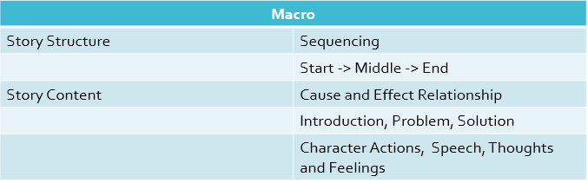
Elements of a story
The parts of a story can be separated into two main categories:

Slide 5
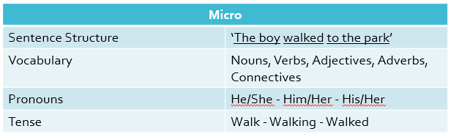
Elements of a story
The parts of a story can be separated into two main categories:

Slide 6
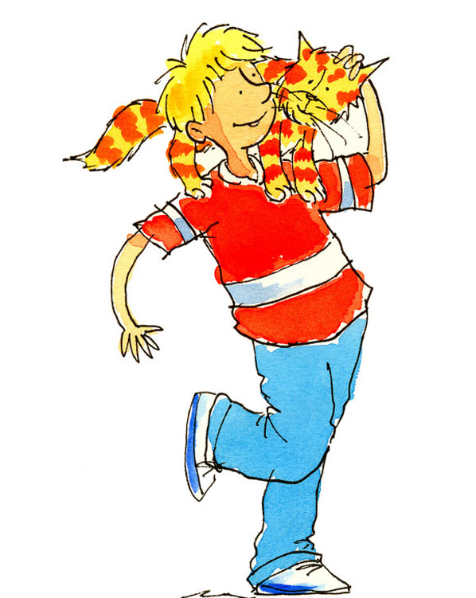
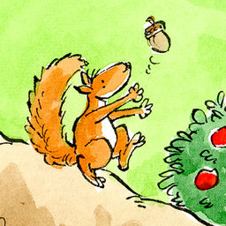
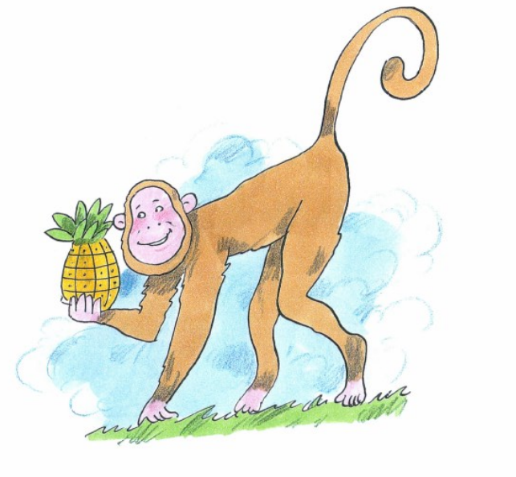
Assessing narrative skills
Ages 5-9
Ages 3 - 5
Ages 5 - 11

Slide 7
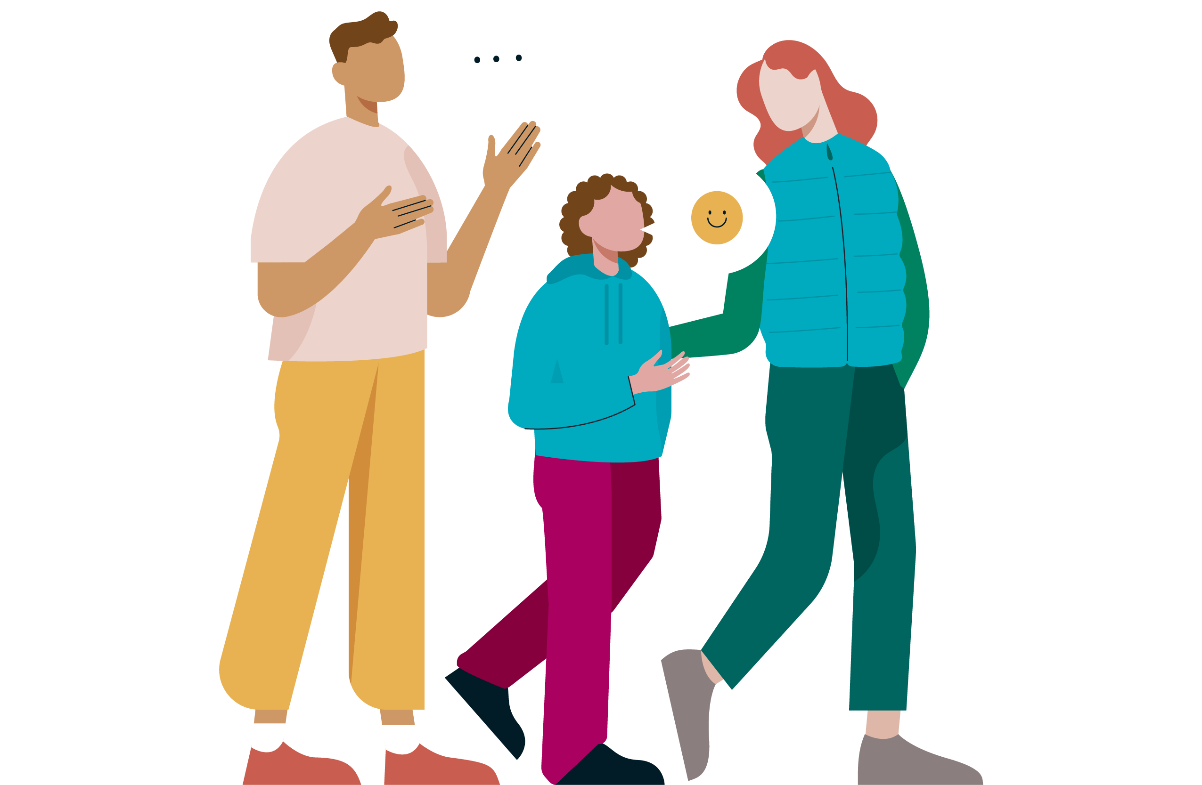
When is narrative therapy appropriate?
The child must:
Be able to form a sentence,
Have an understanding of language at Blanks Level 2 or higher,
Have a difficulty with more than one macro or micro element.

Slide 8
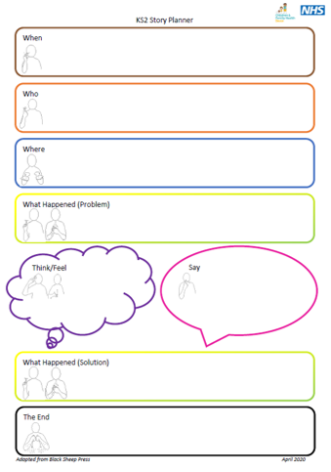
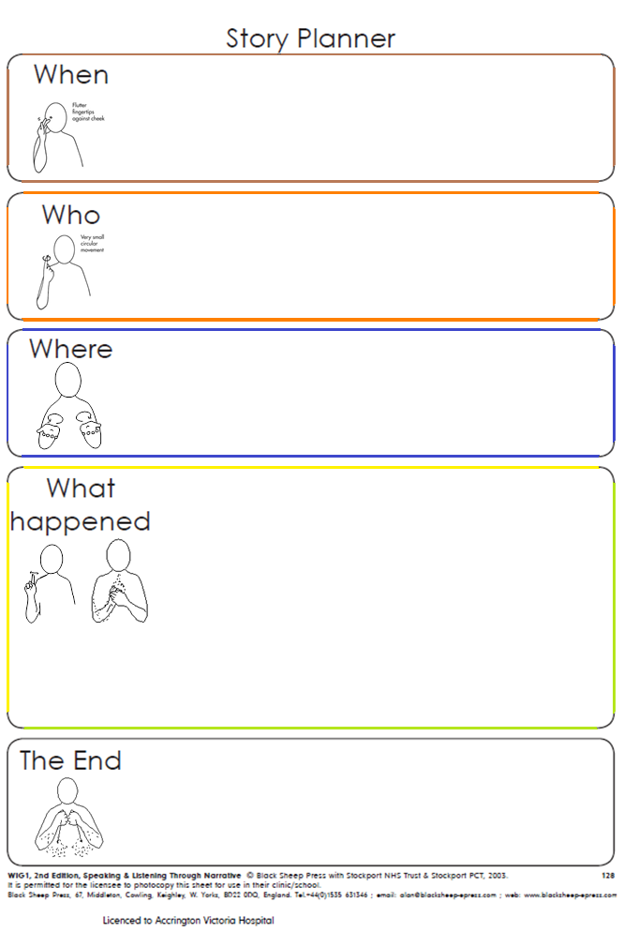
Therapy Framework

Slide 9
Narrative Approach to Therapy
1 Introduction | Familiarise child with questions on story planner, order and meaning
2 Story | Create silly story Recall story (prepared or made up by adult) Sequence pictures to make a story Create own story (real or made up)
3 Micro | Activity to target regular and irregular tense, pronouns, verbs, word-finding, etc
4 Story Review | Support child to amend story to incorporate grammar/vocabulary being targeted Child retells story again
5 Homework | Further resources are given for the child to practice their macro and micro skills outside of session Advice and strategies given to adult as needed
Each session consists of:

Slide 10
Workshop
Have a go at putting together a story using the Story Planner.
Create a silly story using the Colourful Sentences pictures.
One person read the Language For Thinking story and the rest of the table retell it by filling in the planner (key words/drawings/sentences).
One person tell a story about your weekend and the rest of the table retell it by filling in the planner (key words/drawings/sentences).
Sequence the pictures into the correct order and then create the story using the planner (key words/drawings/sentences).

Slide 11
Generalisation
Continue to practice with the child outside of therapy sessions.
Reduce dependency on visuals as appropriate – turn planner/pictures over when child is retelling story after filling it in.
Use planner outline to create/recall story without filling it in.
Prompt child to remember the planner when talking about their day in general conversation/in class.
Use planner to write a story.
Ask child to recall the story in their reading book.

Slide 12

What happens next?
Child might be offered a block of direct therapy and/or a narrative programme will be provided to work on individually or in small groups.
Child’s current episode of care is ended while practice and generalisation continues.
If the child has not been known to the service for longer than 12 months, a new referral will be needed.

Slide 13
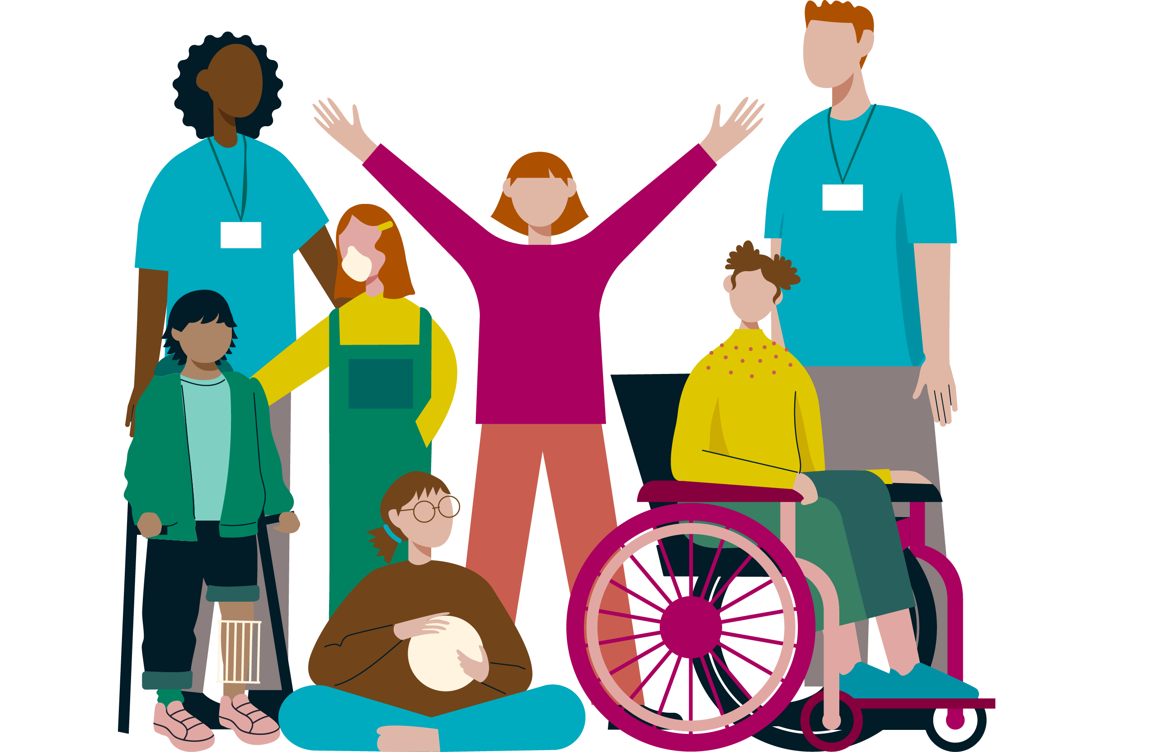
Thank you!
Any questions?

