Slide 1


Honouring Autistic Communication Styles and supporting Self-Advocacy
In Autistic Children and Young People
childrenandfamilyhealthdevon.nhs.uk

Slide 2
Aims of Presentation
To introduce autistic styles of communication
Explore strategies we can use to honour, respect and support autistic styles of communication
How you can support Children and Young People to explore their own autistic communication profiles
How you can support our CYP to advocate their needs and preferences to others within the school environment.
childrenandfamilyhealthdevon.nhs.uk

Slide 3
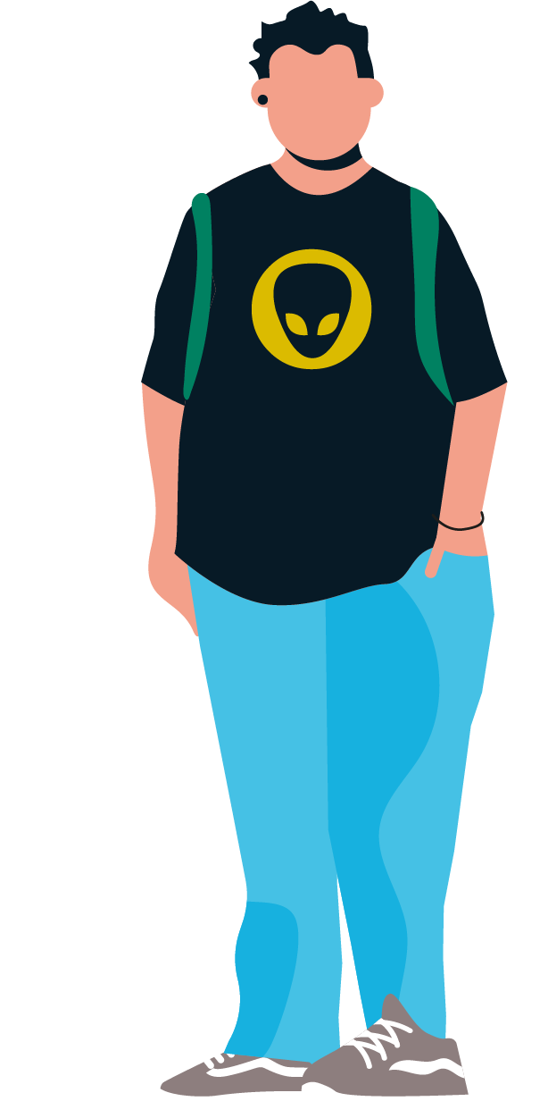

What does it mean?
Neurodiversity
Refers to the natural diversity in human brains, such as, Autism, ADHD, Language Disorder, Dyslexia, Tics and Tourette's.
Autistic Communication Styles
All autistic CYP are different and will have different communication profiles. However, there are patterns associated with autism in relation to:
Understanding of Language
Use of language
Non-verbal communication
Social Communication and Reciprocity
Neurodiversity Affirmative Perspective (NAP)
This is the importance of autism being considered a difference that should be supported, rather than a disorder, or something to be fixed.
Focus on understanding and supporting the CYP's unique strengths and needs. NAP fosters inclusive, adaptable environments where all can thrive.
Embracing neurodiversity affirmative practice: A path to inclusive support for autistic people
Self-Advocacy
Self-Advocacy is the ability to communicate our needs, preferences and what is important to us.
As supporting adults, (parents, teachers, clinicians), it is our role to create the right conditions for CYP to feel that their safety, comfort and preferences are acknowledged and respected.

Slide 4
How we are using neuro affirmative language to reflect autistic communication styles
Rationale: it's important to avoid judgemental language.
Useful information about language/goals - Report Writing & Language | AutisticSLT
“CYP has poorly modulated eye contact”
“CYP finds eye contact uncomfortable, particularly when communicating with people less familiar to them.”
“Doesn’t show empathy.”
“It can be tricky for X to know how others are feeling, or why they behave in a certain way. X needs adults to support you with this.”
“…defiant…” or “doesn’t follow adult instruction”
“Direct demands can make X feel anxious, X learns best when they are given different choices around tasks.”
NAIT | Evidence Informed Neuro-affirming Practice

Slide 5
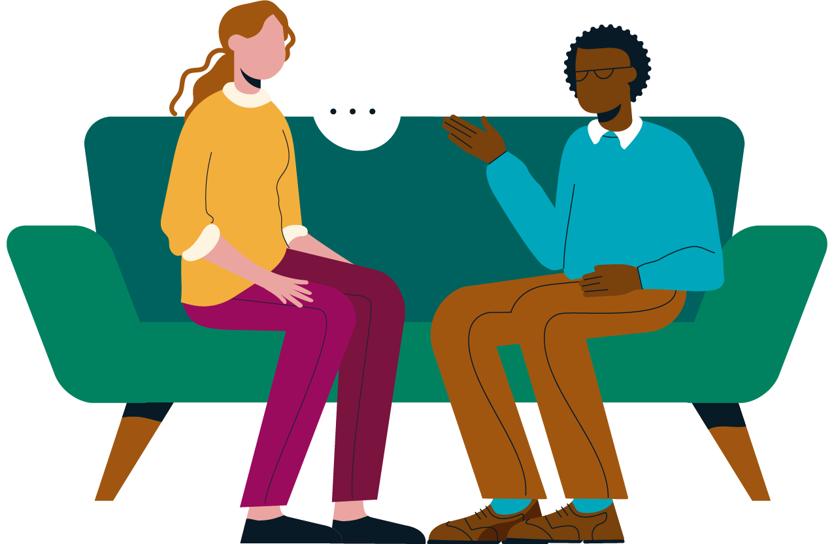
The ‘Double Empathy Problem’
Theory by Dr Damian Milton explains a two-way problem. Both Autistic and non-autistic people find the other as lacking in communication skills, including empathy.
The different experiences, communication styles and preferences leads to difficulties reading each other.
Neither is ‘correct’ nor ‘superior’ – just different.
Effort must be made on both sides to bridge the gap
YP Report Example:
“You shared that you often make ‘mistakes’ in your friendships that aren’t clear to you. It is important to understand that this is a result of you, and them, misunderstanding each others’ communication styles.”
Notes:
The ‘double empathy problem’ is a theory from the autistic autism researcher Dr Damian Milton. It tries to explain why non-autistic people can experience autistic people as lacking in communication skills, including empathy. The theory states that there is a two-way problem, and that autistic people often experience non-autistic people as lacking in these skills too.
The theory suggests that this is because the two groups of people have different experiences and their different communication styles and preferences can lead to difficulties in relating to each other. Neither is ‘correct’, nor ‘superior’ to the other, they are simply different, and effort must be made on both sides to bridge the gap.
Evidence from lived experience (from autistic people) and some research suggests the double empathy problem theory may explain the challenges of and differences in communication between autistic and non-autistic people.

Slide 6

Differences in Understanding of Language
!?
May need additional time to process verbal language and to formulate their response.
Are more likely to have a literal understanding of language used by others.
Might find topics like English difficult, as interpreting abstract meaning and identifying characters’ perspectives can be challenging.
Hints and indirect instructions might be harder to pick up on.
YP Report Examples:
“It is easier when people are direct and say what they mean, instead of using hints, jokes, sarcasm and subtleties, which are harder to understand.”

Slide 7
Strategies to Support Understanding of Language
Be aware of the CYP’s specific communication profile of strengths, needs and differences (e.g. Language Disorder, Selective Mustism, EAL)
Allow additional time to process and regulate when communicating.
Give clear instructions, broken down into simple steps.
Use total communication methods to support CYP, such as objects, visuals, photos, text (adapted to their needs) to support with processing information and instructions.
Autistic children and communication in school | Autism Space | Leicestershire Partnership NHS Trust – more examples and recs on here
Regularly checking in for misunderstandings.

Slide 8
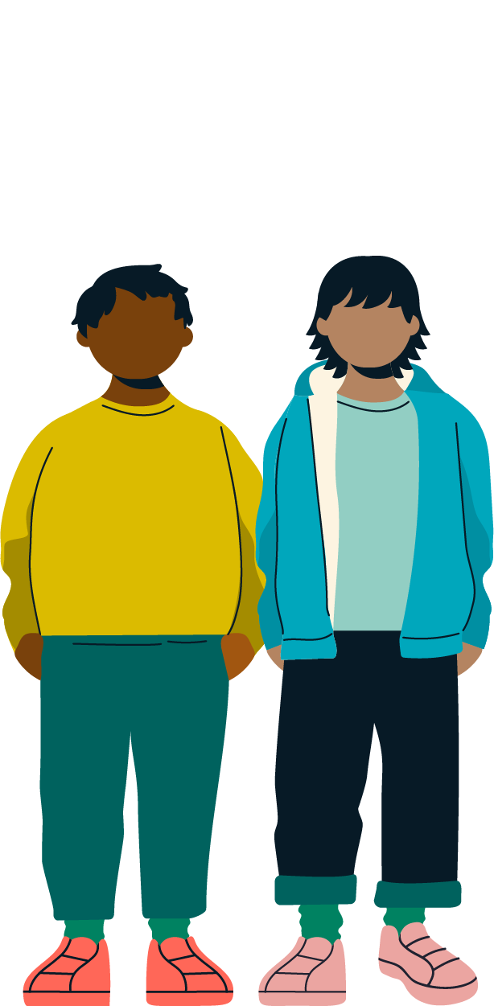
Differences in Use of Language
Autistic CYP might show differences in tone of voice, volume or speed of speech. They may use an accent or have a formal quality to their voice.
Autistic CYP use ‘stock’ or ‘learnt’ words and phrases repetitively. This might be because they enjoy the sound of these words, or, they may carry meaning. For example, they may use the same word or phrase/es when they are experiencing a particular emotion.
Autistic CYP may use less social ‘small talk’ and their language may come across as more direct.
Autistic CYP may develop language skills in different way to neurotypical children e.g. gestalt language processing – this means they might find it easier to learn words and phrases in whole chunks or sentences, rather than breaking words down into individual sounds.
They might find it difficult to share their experiences verbally and may prefer written or alternative communication methods.
YP Report Examples:
“You have a passion for X and Y, and can talk at length about these topics when you’re given the opportunity to.”
“It is important to you that others know what you mean when you are sharing information or your views, so you may give more details than people expect at times.”
“At times, it is hard for you to stay calm when you are feeling difficult or unwanted emotions. In these moments, it is also hard for you to tell others how you are feeling”

Slide 9

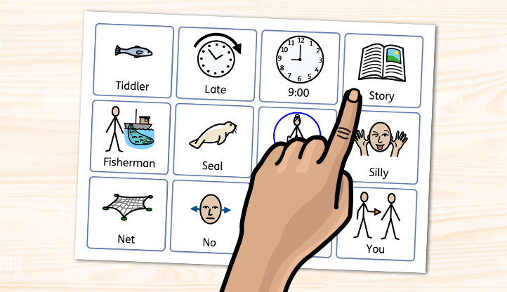
Strategies to support Use of Language
Allow extra time for CYP to formulate their response.
Offer different means of communication, especially at times when CYP is experiencing overwhelm.
Appreciate that autistic CYP may find talking in front of groups/whole class more difficult than 1:1/small group setting.
For CYP who experience demand-based anxieties, or a strong sense of autonomy, keep all interactions with CYP as low demand as possible and pressure to communicate should be avoided as being ‘put on the spot’.

Slide 10
Non-verbal Communication
Differences in Non-verbal Communication
Eye contact: For some autistic CYP, eye contact may be difficult or uncomfortable. Other autistic CYP may make a conscious effort to engage in eye contact, and this can appear as ‘fixed’ or slightly more ‘intense’ than expected.
May use less gestures and facial expressions
Some autistic individuals rely more on written, typed, or visual communication.
Strategies to support Non-verbal Communication
Respect CYP’s preferences around their non-verbal communication and do not insist on use of eye contact.
Model use of gesture, body language and facial expressions.
Explore different methods that the CYP feels comfortable sharing how they are feeling, if this is something they don’t tend to show verbally or physically, for example, using visuals like emotion cards.
YP Report Examples:
“When you are talking or listening to others, you find it easier or more comfortable to look away rather than making direct eye contact.
“You are observed to communicate with others mostly by using your words, and less so by using your facial expressions and gestures.’

Slide 11
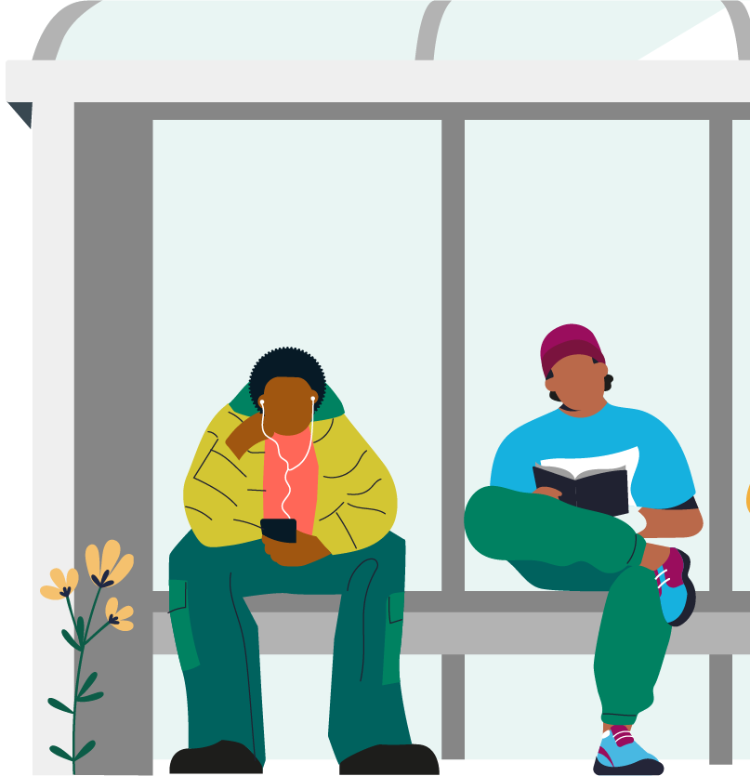
Differences in Social Communication and Reciprocity
Autistic CYP may value their own space/prefer to play, or work on their own, or find this easier than in a group
Autistic CYP are likely to be less motivated by social char, or ‘small talk’, but prefer to talk in depth about topics that interest them, therefore may seek a different style of connection.
Use of contact, facial expressions, or turn-taking may vary between autistic and neurotypical CYP. For example, autistic CYP may show differences in judging pauses and turn-taking, or may find it hard to be interrupted during a conversation
Autistic CYP may experience differences in recognising thoughts and feelings of their peers, and their thoughts and feelings may be misunderstood by their neurotypical peers.
CYP may experience anxiety in social interactions, especially around new or less familiar people.
YP Report Example:
“You also shared that you can find it hard to make new friends and you might find that your friendship group changes often.”

Slide 12
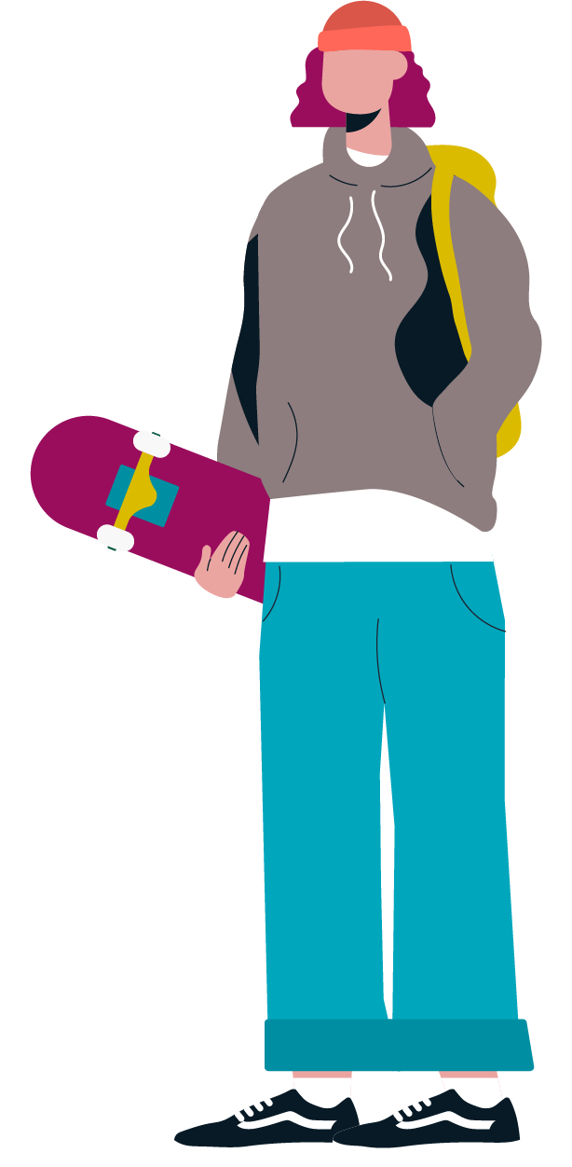
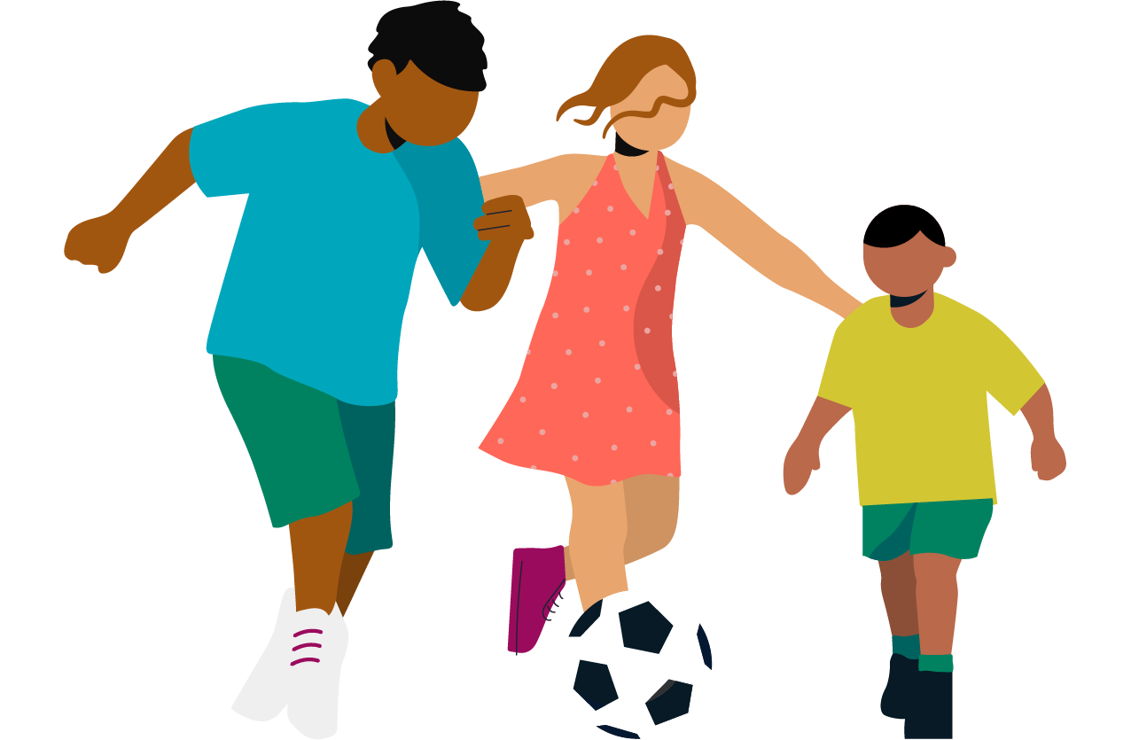
Strategies to Support Social Communication and Reciprocity
Use the CYP’s interests to build a connection and create space/opportunities for them to spend time with others with common interests.
Explore ways in which CYP feels comfortable to explore perspective taking and to reflect on any communication breakdowns (e.g.by using films, video clips, TV programs, sharing books or short stories or paragraphs, photos, pictures and real-life scenario), ensuring that all perspectives are acknowledged and respected.
Support CYP in identifying their individual boundaries and how they can self-advocate these. For example, model the language needed for them to communicate when they need something, like some time on their own.
Be aware that many groups aimed at teaching ‘Social Skills’ are not neurodiversity affirming, and encourage masking.

Slide 13
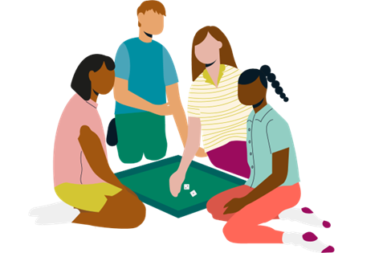

Using the CYP’s interests to build a connection and create space/opportunities for them to spend time with others with common interests is a great way to honour autistic communication:
Validate and show interest
Respect their passion; connect with them through their interest - play alongside them or with them if that is ok with them; make encouraging comments such as, ‘you have such great ideas’; ‘you know so many interesting facts about that’; ‘I love talking to you about this’.
Interests are valuable – make sure each child knows that their interests are part of their identity – they give joy, contentment and comfort.
Use interests as Learning tools
Brilliance can often be found within interests – they light up a person's brain with huge passion as they absolutely love them so it makes sense to try to incorporate them into classroom learning.
When children are doing something related to their special interest they can show great ability to focus on it, they may notice details that others may not as they look at in through their autistic lens.
Encourage social interaction through shared interests
Help children to find others with similar interests or activities related to their interest if they’d like that – friendships may grow with like-minded people.
Develop lunchtime clubs around interests or even online clubs. It is great to just be part of a club for fun but they can also include a focus on teaching others about their interest/sharing their knowledge/showing something they have made etc.
Balance engagement with flexibility
Incorporate their interest in their day but encourage other activities where possible, perhaps something related but slightly different could become another interest.

Slide 14



Being Aware of Masking
What is Masking?
“Autistic masking involves the autistic person covering up how they are actually feeling. They may hide how they are feeling about the world around them, their preferences, and their reactions to sensory issues, communication or social experiences (also referred to as ‘autistic traits’).” (NAIT, 2022)
LINK: Masking and camouflaging: a 1 minute guide about autism -Children and Family Health Devon
What can it look like?
Using eye contact when it feels uncomfortable or distracting.
and/or
Spending lots of time thinking about how much eye contact you’re using.
Using different tones of voice or facial expressions that don’t come naturally to you.
Asking more questions than you would be comfortable with, or about things you’re not interested in.
Planning for things you might say in social situations, or having ‘go to’ phrases that you use to make this easier.
Hiding, or minimising sensory responses. E.g. allowing a friend to hug you when you find this uncomfortable.
Hiding or reducing stimming behaviours, e.g. clicking a pen instead of flapping your hands.
Laughing or joining in with jokes even though you don’t understand them.
YP Report Example:
“At times, you might feel that you have to ‘mask’ your communication preferences, or ‘prepare’ to communicate a certain way in social situations (e.g. talk and use eye contact and gesture that doesn’t come naturally to you or talk about things that don’t interest you) in order to fit in with a group or to maintain friendships and relationships. This is likely to be tiring for you and you may need to ensure you have time by yourself afterwards.”
Notes:
Microsoft Word - NAIT Guide to Autistic Masking for Parents and Carers 2022.docx
Masking | AutisticSLT - 2021-25 AutisticSLT.

Slide 15
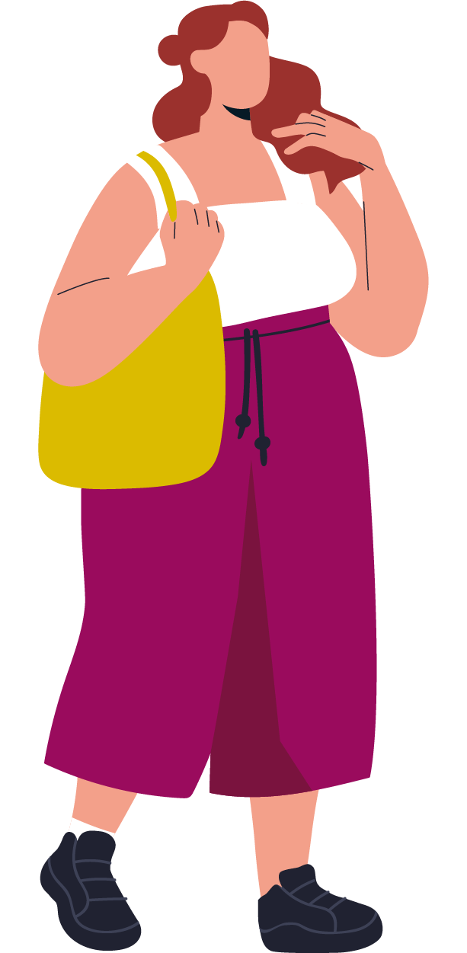

Being Aware of Masking
The impact
Increased stress and anxiety, which can lead to meltdowns in the short term, and autistic burnout over longer periods
A sense of feeling like a ‘fake’ or a loss of own identity
Low self esteem
Needs/differences not being recognised, leading to late or mis-diagnosis (NAS, 2025)
Increased rates of self-harm and suicide
Ways to Support CYP who mask
Being aware of the energy that masking can take for a CYP and offering space and time to recover after social interactions.
Support CYP to explore their communication preferences and accommodate these.
Creating neurodiversity inclusive environments – reducing the amount CYP may feel that they need to mask their needs differences.
Nearly 75% of autistic people (male and female) surveyed, report masking all or some of the time to avoid being seen as visibly autistic (NAIT, 2022)

Slide 16

Self-Advocacy
The ability to communicate our needs and what is important to us
Requesting an item or activity
Making a choice
Asserting themselves
Requesting help
Communicating a need
Describing their boundaries
Expressing an opinion
Problem-solving
Creating the right conditions for self-advocacy is the responsibility of the child’s adults. If an adult respond’s negatively to a child self-advocating this is likely to prevent them from speaking up in the future. It is a priority that our children know that their opinions, safety and comfort are valid and important.
There can be lots of barriers for children getting what they need. Many neurodivergent children do not want to stand out in class or draw attention to themselves. It can help if class-wide self-advocacy systems are in place.
See Home | NeuroWild

Slide 17


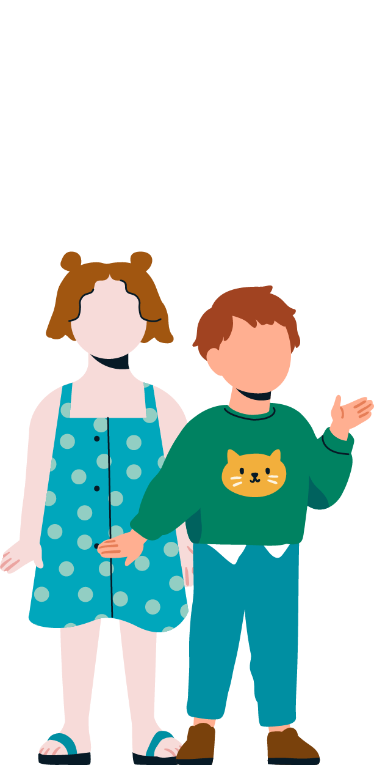



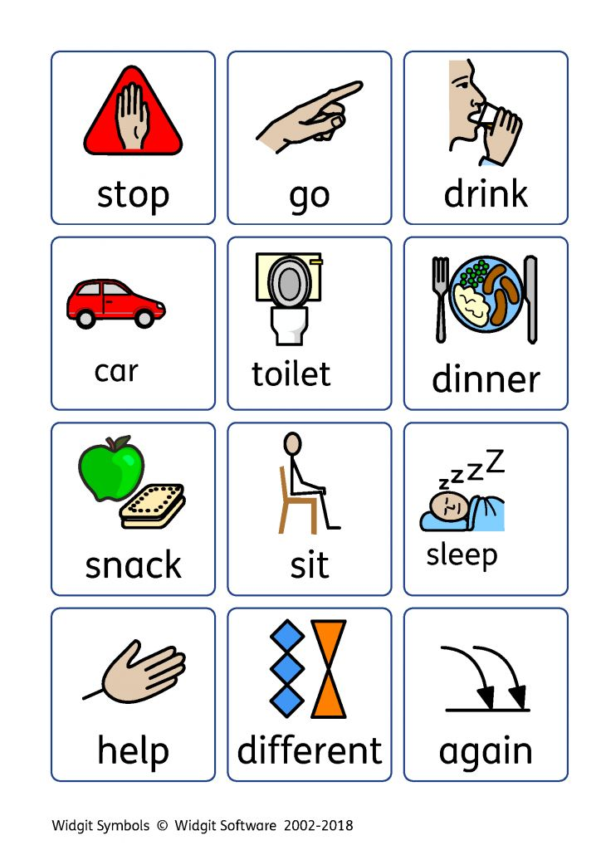
What Supporting Self-Advocacy Might Look Like
First recognising their strengths can give them confidence to communicate what they need.
Create lots of means, reasons, opportunities for self-advocacy through the day e.g. offer choices, model how to express needs.
Don't insist on "use your words" or "say that more politely" - they may not have the language, vocabulary, cognitive or sensory capacity in that moment. They might be dysregulated or shut down.
Write affirmations on little cards for them to carry around e.g. "it's OK to ask for what I need" Write affirming messages and reminders on post-its and put them on the child's desk e.g. "I can take my time and don't have to rush" Disclosure badges as a visual aide to communicate needs to people - "I'm autistic", "I need time to process your words" etc.
Understand that the behaviour might present as 'challenging' but the CYP might just be trying to communicate a need and self-advocate.
Detect and respond to any attempts they make to communicate their needs, verbally or nonverbally. Self-advocacy doesn’t always look polite!
Respect when the child refuses something or says no. Acknowledge the child's attempts of self-advocacy - ‘that is great, you said what you need’ OR, for an older child: ‘I liked how you advocated for yourself there!’.
Provide visual aids that they can use to say what they need such as break / help cards. If the young person struggles to self-advocate verbally, start off by helping them do this via other methods e.g. writing their needs down, gesturing, pointing, nodding or shaking their head to closed questions. Ask the child "do you need anything from me?”

Slide 18
For neurodivergent children to experience success when self-advocating they need the following components:
What Supporting Self-Advocacy Might Look Like
The right conditions (adults’ responsibility) Self-advocacy is a powerful skill and an essential one to learn. As adults, it is important for us to model it, for example, ‘I need you to stop touching my face, I don’t like it’; invite it, for example, ‘Hey, your boy looks stressed. I wonder what might help right now?’; validate it, for example, ‘I heard you telling that child to stop and leave you alone. That was a really good thing to say’; accommodate it, ‘thanks for telling me this place feels scary. Do you want to leave or try and work out a way to feel safer here’; support it, for example, ‘Grandpa, Max said no cuddles today thanks. Maybe she’ll wave instead.’
Positive self-regard – an understanding and acceptance of how their brain works and to be proud of it– Explore with CYP, their personal qualities, talents, strengths. Develop a communication passport or general profile of who they are including their strengths, differences and strategies to support them.
Skills (regulation- adjusting your energy levels to suit your task/environment, executive functioning- cognitive skills for analysing, planning and making decisions, language – can be verbal or non-verbal, interoceptive awareness – tuning in and listening to their body)
If a child is missing any of these components, they will need additional support in these areas.
Self-advocacy is a skill that needs to be practised. The Neurowild website - Home | NeuroWild has some very helpful resources to support teaching self-advocacy including lots of visuals such as ‘steps for supporting self-advocacy in ND Kids’ and self-advocacy cards that could be cut out and laminated and put on someone’s desk or on a ring if it would help for them to be portable.
Notes:
Source: Neurowild

Slide 19
What Supporting Self-Advocacy Might Look Like
By supporting CYP to explore their own autistic communication profiles
This may begin with a conversation with the CYP to talk about what they enjoy, what they are good at and what things may be more difficult for them. Visual support can be very helpful to support this conversation. Talking mats can be very helpful - we have an example of a talking mat in the next slide. Use whatever is the CYP preferred way of communicating. Be mindful of choosing the right time and location to support them. Gather additional information from the family/carers and teaching staff.
Discuss with the CYP things that help them (suggest different strategies to try).
Information gathered can then be transferred into a communication profile and supportive strategies can be added. This information should be regularly reviewed and updated to ensure that it is relevant and helpful to the CYP and those supporting them at home and school.

Slide 20





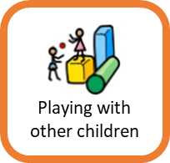
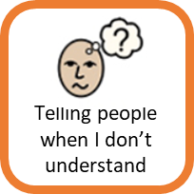
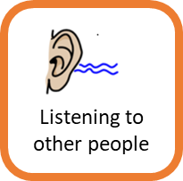
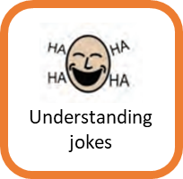
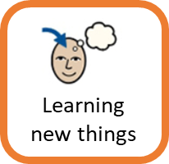
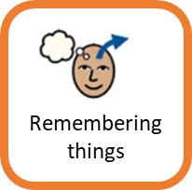
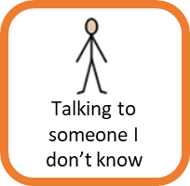
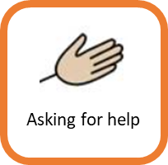
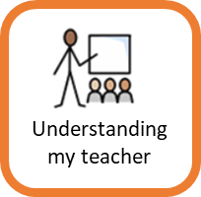
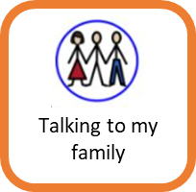
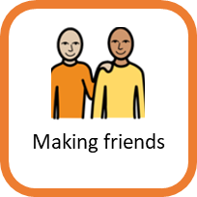
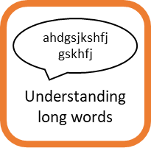
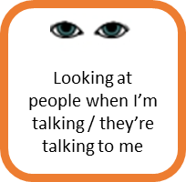
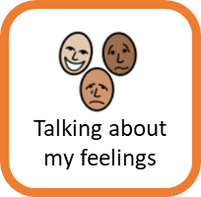
Capturing CYP’s Views
Tricky
Okay
Easy
How I feel about my Communication

Slide 21
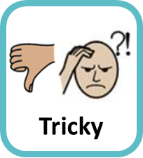

Capturing CYP’s Views
One page profile/What autism looks like for me
My Learning Preferences:
I like to know what is happening and I don't like change.
I find it hard to follow instructions.
You can help me by:
Visual timetable
Letting me sit at the same desk each lesson
Reduce direct demands
My Communication Preferences:
I don't like using eye contact.
I prefer to speak with 1 person.
You can help me by:
Not insisting I look at you.
Letting me work in a pair rather than a group.
My sensory preferences:
I don't like loud noises.
I like fast movement, like running around and jumping.
You can help me by:
Letting me wear my ear defenders.
Letting me have regular sensory breaks to run or jump.
My Interests:
I like to tell others facts about things that are interesting to me
You can help me by:
Allowing me time each day to share a fact about XX with a friend or teacher.
Other e.g. Mental health and well-being,
When I’m feeling anxious, you might see me with my head down. I might fidget more.

Slide 22
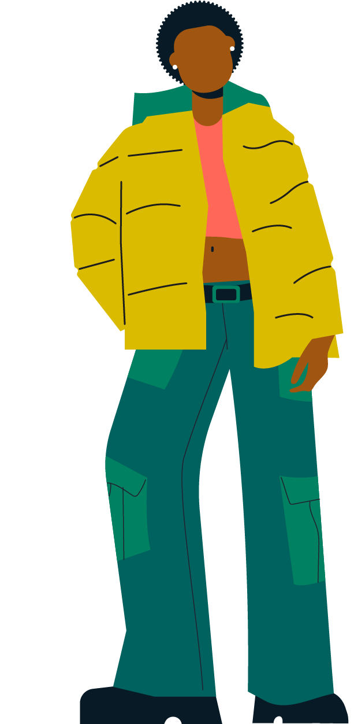
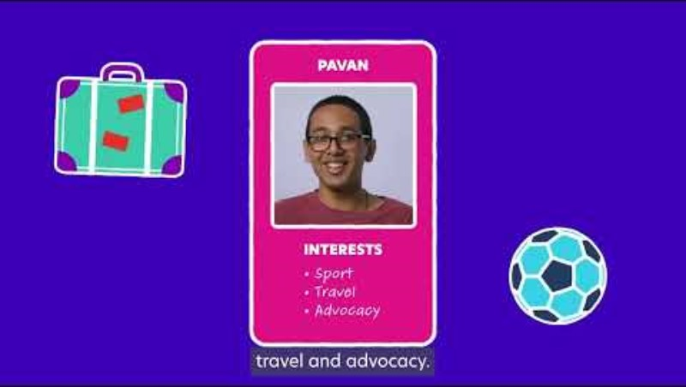
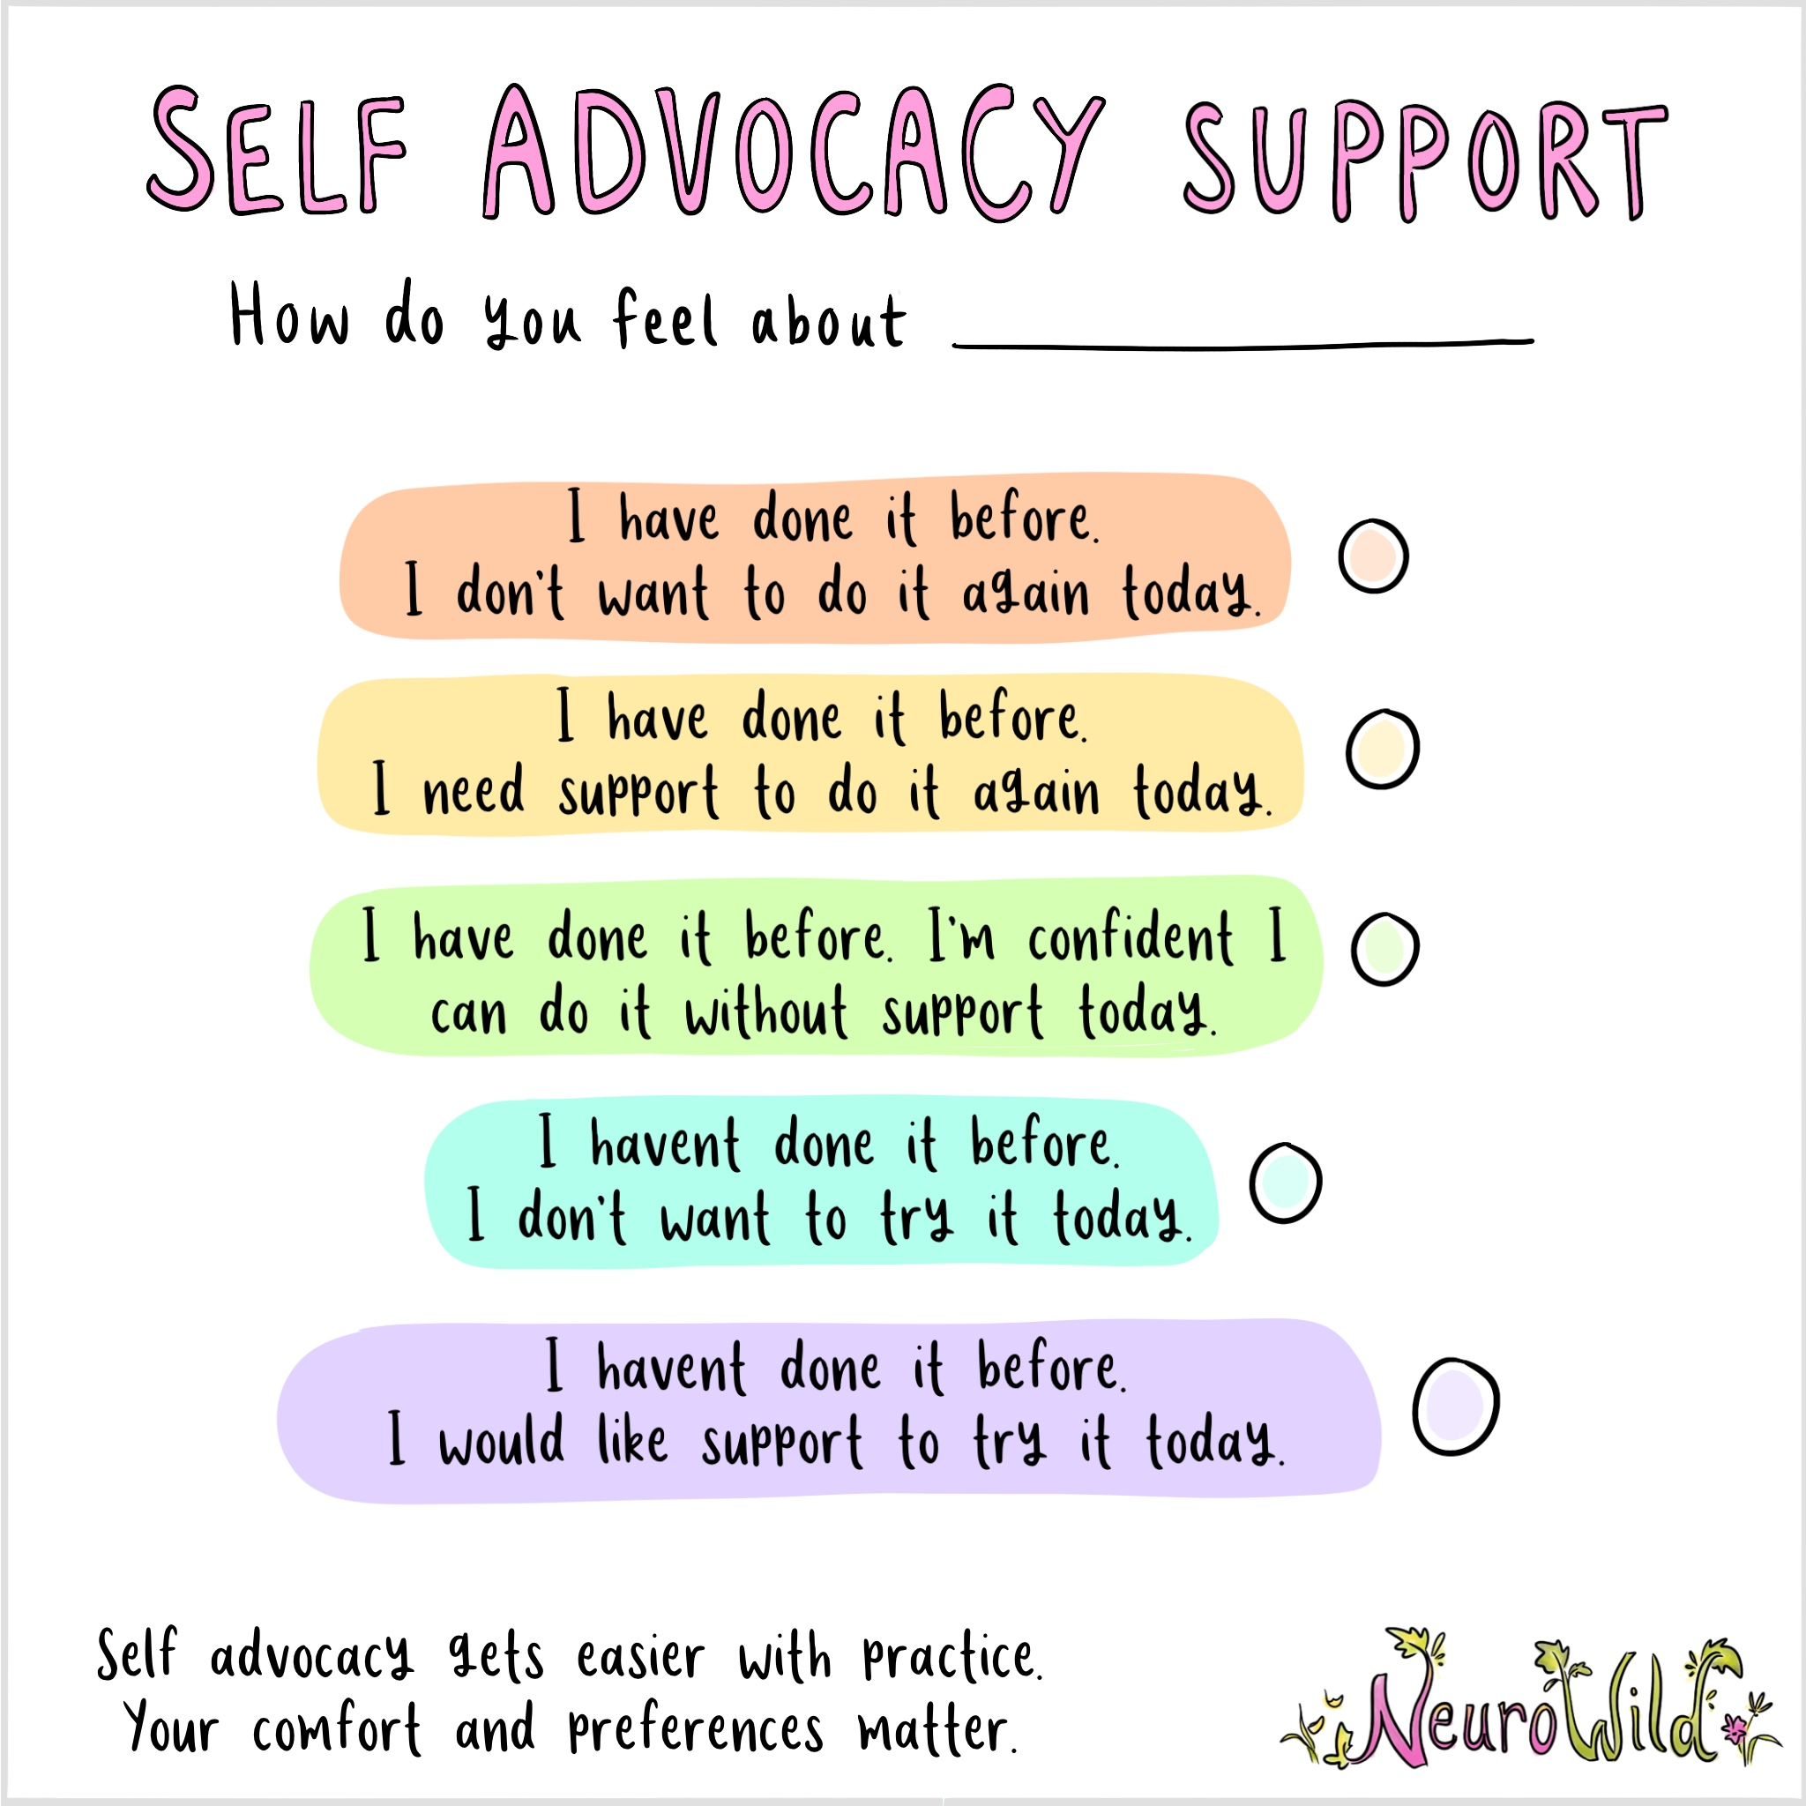
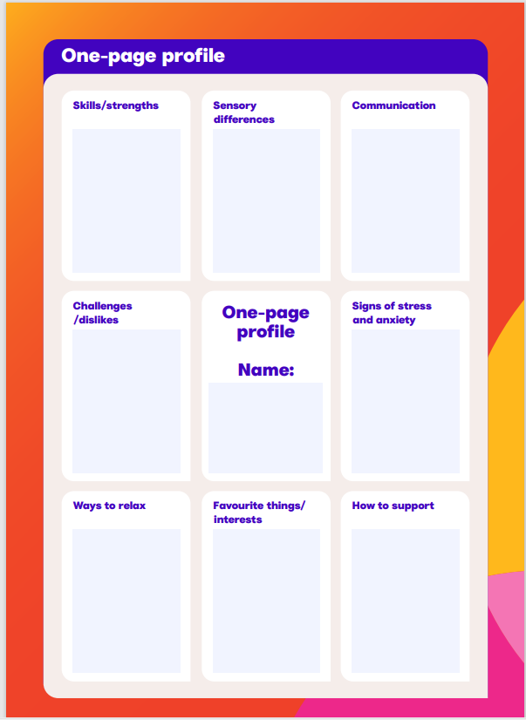
Capturing CYP’s Views
Build a toolbox of strategies/activities to use to in your setting to support you in exploring the views of the CYP you support, including:
The National Autistic Society ‘Know yourself series’: Resources for autistic teenagers
Tools to support identification of emotion/energy and regulation:
  My Energy Meter www.AutismLevelUp.com
  The Alert program www.alertprogram.com
  Use of an energy accounting tool or spoon theory to recognise and manage energy day to day.
Self Advocacy Support by Emily Hammond -NeuroWild | TPT – this is free to download and is very helpful to use to show our children so they know they have options to respect their needs and to help them to communicate them to others. It can be a helpful way to start conversations about self-advocacy.
This visual is a helpful as it can relate to a specific task/activity in school and can help the CYP and teacher understand how a CYP is feeling about something and what they might need to help them.
NAS one-page profile

Slide 23
It is important to always hold in mind that communication doesn’t happen in isolation and there are many other factors to consider, including:
Sensory considerations – Making Sense of Sensory Behaviour - Falkirk Council
Well-being - How to support positive mental wellbeing | Ambitious about Autism
Mental health https://www.autism.org.uk/advice-and-guidance/professional-practice/anxiety-classroom
Background/history/Trauma Autism & Trauma | AutisticSLT
The environment – Autism friendly/ inclusive https://www.autism.org.uk/advice-and-guidance/topics/autism-friendly-guide/accessible-environments
The Autism Education Trust website may be helpful as a framework to support CYP in education. Please see https://www.autismeducationtrust.org.uk
Importance of Collaboration – with CYP, families, other professionals
Autistic children may have additional communication difficulties such as: Situational Mutism Dysfluency (stammering) Expressive or receptive language difficulties Apraxia / dyspraxia of speech Speech / phonological difficulties Voice disorders.

Slide 24
Conclusion
Recognizing, exploring and respecting someone’s individual autistic style of communication is crucial.
We can use strategies to honour, respect and support the CYP's particular communication profile and create environments that accommodate these preferences and promote inclusive social connections.
When we recognise a CYP’s strengths, this helps to support a positive autistic identity. This can give the CYP confidence to communicate what they need. As supporting adults, (parents, teachers, clinicians), it is our role to create the right conditions for CYP to feel that their safety, comfort and preferences are acknowledged and respected. Self-advocacy is a powerful skill to learn.
Teaching ALL children and young people (not just neurodivergent children) about different communication styles helps them identify and accept styles that are different to their own and advocate their preferred style of communicating.
A robust neurodiversity acceptance educational programme for school is vital. For example, the free LEANS (Learning About Neurodiversity at Schools) resource pack by Alcorn, A.M., Fletcher-Watson, S., McGeown, S., Murray, F., Aitken, D., Peacock, L.J.J., & Mandy, W. (2022). Learning About Neurodiversity at School: A resource pack for primary school teachers and pupils. University of Edinburgh. https://salvesen-research.ed.ac.uk/leans This may include teaching all children and young people to understand how and why neurotypical peers and adults act the way they do in various settings and situations.
Bespoke SLT support is available for staff, children and parents as needed– please contact your link Speech and Language Therapist for further information.
If there are particular concerns about a CYP that need further consideration/assessment please complete the referral form on the CFHD website. Requesting help from CFHD - Children and Family Health Devon

Slide 25

References
NAIT | Evidence Informed Neuro-affirming Practice
Neurodivergent-Affirming SLT | AutisticSLT
Home | NeuroWild
Welcome to the | Autistic Girls Network
Embracing neurodiversity affirmative practice: A path to inclusive support for autistic people
27

