Slide 1


Supporting Perspective Taking and Verbal Reasoning
In Autistic Young People
childrenandfamilyhealthdevon.nhs.uk

Slide 2

Overview
What is perspective taking and why does it matter?
Neurotypical development of perspective taking
Common challenges with perspective taking
Strategies & Activities
Ideas for goals / targets
Resources
References
4

Slide 3
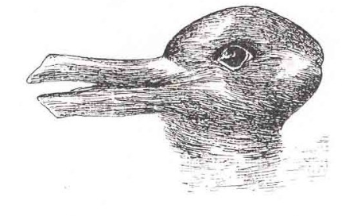

What do you see?
childrenandfamilyhealthdevon.nhs.uk
Notes:
What do you see? Is it a duck or a rabbit –Both perspectives are correct.

Slide 4
What is Perspective Taking and why does it matter?
6

Slide 5
What does it mean?
Perspective Taking
Perceiving another person's thoughts and feelings in a particular situation. Understanding a situation from another person's point of view.
Verbal Reasoning
The ability to understand, analyse, and draw logical conclusions from a piece of information.
childrenandfamilyhealthdevon.nhs.uk
Notes:
Perspective taking:
Perceiving another person's thoughts and feelings in a particular situation. Understanding a situation from another person's point of view.
Perspective taking allows us to feel what it would be like to be in the other person’s shoes during a situation. It requires you to put yourself in the other person’s position and imagine what you would feel, think, or do if you were in that situation. Perspectives are formed from past experiences.
Verbal reasoning:
is the ability to understand, analyse, and draw logical conclusions from a piece of information. It involves comprehending the words themselves and how the words and sentences relate together to form a concept. In a nutshell, it allows someone to figure out what someone really means, not just what they have said.

Slide 6
Why Perspective Taking Matters
Perspective-taking supports social relationships
Builds empathy and reduces misunderstandings
Helps with problem-solving and conflict resolution
Encourages flexible thinking
childrenandfamilyhealthdevon.nhs.uk
Notes:
Perspective-taking supports social relationships
Builds empathy and reduces misunderstandings
Helps with problem-solving and conflict resolution
Encourages flexible thinking
When children have difficulty with perspective taking, they may have difficulty making or maintaining friendships, working as a team or in groups.
When you are able to imagine a situation from someone else’s perspective, you can gain a better understanding of someone else’s motives or change your own behaviour so you don’t offend someone.
Some of the higher functioning social skills that require perspective taking include helping, empathy, cooperation, maintaining interpersonal relationships.
Verbal reasoning skills are essential for tasks such as critical thinking, problem-solving, effective communication, and making informed decisions about the world around us.

Slide 7
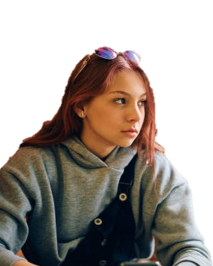

Amy’s lack of eye contact is because she doesn’t care about the situation.
Eye contact is uncomfortable .
If I force myself to make eye contact, all my energy goes on that, rather than the conversation.
childrenandfamilyhealthdevon.nhs.uk
Notes:
Examples of differing perspectives.
Perspective is based on past experience and in this instance, The teacher may have never been informed that some people feel eye contact is uncomfortable or painful and her only understanding is that people look away when they are not interested or don’t care.
Past experiences may have involved a mismatch in communication, misunderstandings, social trauma, broken trust and therefore led to a need for self-protection. Example ‘This is how I see it and what works for me to keep me safe’. Different views can be uncomfortable and difficult to imagine something that is not happening now.

Slide 8
Neurotypical Development of Perspective Taking
10

Slide 9

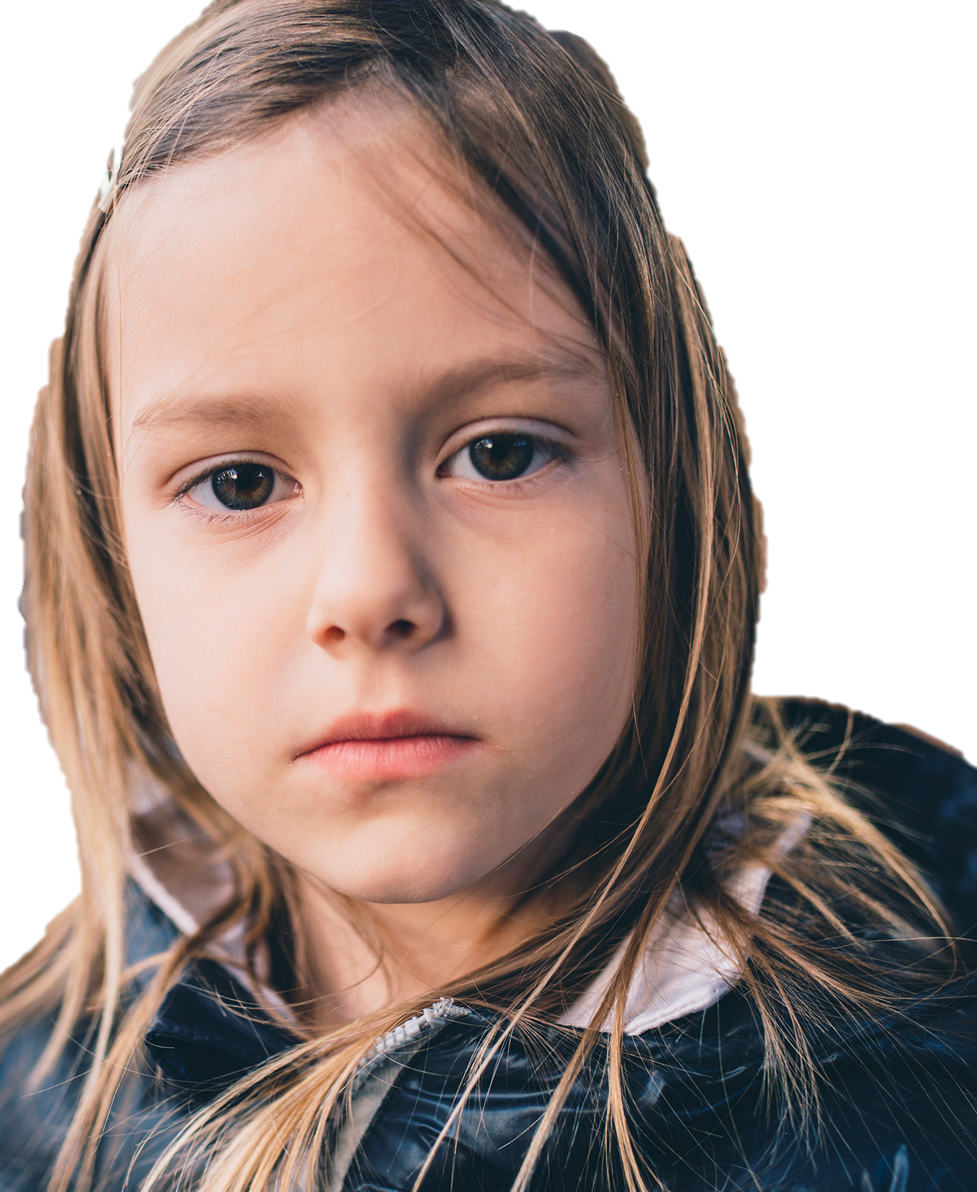
Neurotypical Development
Baby:
Do not have the ability to take the perspective of someone else.
Starting to understand that everyone is experiencing different things.
Shows concern.
2-3 years:
5-7 years:
Starting to guess what people are thinking or feeling based on their behaviours and understand their motivation for certain behaviours.
childrenandfamilyhealthdevon.nhs.uk
Notes:
As a baby, they Do not have the ability to take the perspective of someone else. E.g. baby cries because another baby is crying – doesn’t understand the discomfort is not it’s own. They have not developed Theory of Mind.
2-3 years of age, children start to gain an understanding that each person is experiencing different things. Start to see a child show concern for others who are upset. They may try to do something to help that person. children still often confuse their own perspective with others. A preschooler may think that since she likes ice cream, everyone likes ice cream. This may lead to actions like giving someone who is crying a favourite toy because the child knows that would cheer him up if he had it himself.
As children grow older, they will start developing the ability to guess what people are thinking or feeling based on their behaviours and understand their motivation for certain behaviors by 5-7 years of age. should be able to guess that the child pushed over the chair because he was angry. He probably wouldn’t be able to tell you though that the other child was frustrated because the task that the teacher asked him to do was too difficult.

Slide 10

8-11 years:
Others may have different perspectives. Others may misinterpret situations depending on their own perspective. People do not always express their true intentions and feelings.
12-14 years:
More complex understandings of others’ thoughts, feelings and emotions formed. Learn to navigate situations where they have conflicting inner motives or when a friend has motives that go against their own.
15-18 years:
Understand a person’s culture and environment impacts their perspectives.
childrenandfamilyhealthdevon.nhs.uk
https://www.speechandlanguagekids.com/how-to-teach-perspective-talking-to-children/
https://www.healisautism.com/post/perspective-taking-children-autism
Notes:
8-11 years: the child will understand if you explain to him that when he walked up to his friend and hit him on the back, he meant it as a greeting but his friend interpreted it as anger. begin to understand that a person may be hiding his/her true feelings. For example, they would begin to understand that if a child said “I’m okay” but still had tears in her eyes, she may not really be ok but she just wants others to think she is.
12-14 - these include the understanding that there could be multiple motives behind behaviors. They then also learn to maneuver through social situations in which they have conflicting inner motives or when close peers have motives that go against their own. . For example, the child may understand that a teenager may be tempted to smoke because it will make him look cooler (peer pressure) but that he may be reluctant to do so because it is unhealthy and gross.
15 – 18 young adults - begin to understand that a person’s culture and environment impact their personality, behavior, and perspectives. They begin to see how we are all a product of our environment and that past events and present circumstances all affect how we see the world. For example, young adults may begin to see that a person who has always been discriminated against is more likely to assume he’s being discriminated against than someone who has never known discrimination.
These young adults are also beginning to understand that people may not always be fully aware of why they act the way they do. They may be acting a certain way because they were brought up that way or they are repressing some feelings that they don’t want to deal with.

Slide 11
What are the Common Challenges with Perspective Taking?
13

Slide 12
Common Challenges in Autistic individuals
Possible difficulties recognising thoughts and feelings of others
Difficulty reading non-verbal cues of others
Literal interpretation of language
Trouble following indirect or implied meaning
Anxiety in social interactions
‘Monotropic thinking’ theory
www.autism.org.uk/advice-and-guidance/professional-practice/what-is-monotropism
childrenandfamilyhealthdevon.nhs.uk
Notes:
Difficulty reading non-verbal cues of others – it might be difficult to read people’s facial expressions, tone of voice or body language
There may be a literal interpretation of language and trouble following indirect or implied meaning
The person may have high anxiety in social interactions – they might feel overwhelmed which makes it hard to ‘notice’ non-verbals and process what the other person is communicating.
Monotropism is becoming more recognised as a theory. Monotropism suggests autistic individuals have a difference in attention and information processing, This produces both strengths and challenges.
It suggests autistic individuals with monotropic thinking, tend to focus on a small number of interests at a time, rather than spreading focus across a range of things.
On the plus side, this intense focus can lead to a real depth of interest, expertise and immersive sensory experiences,
However it may also make it harder to switch tasks, process multiple inputs at once or cope with interruptions.
Applying this to perspective taking – Monotropic thinkers may struggle more with the rapid shifts in attention that social interaction often demands - making it hard to juggle understanding facial expressions, tone of voice, non-literal language. Without these additional clues, it can be challenging to then understand the thoughts and feelings of the other person.
.

Slide 13

The ‘Double Empathy Problem’
Theory by Dr Damian Milton explains a two-way problem. Both Autistic and non-autistic people find the other as lacking in communication skills, including empathy.
The different experiences, communication styles and preferences leads to difficulties reading each other.
Neither is ‘correct’ nor ‘superior’ – just different.
Effort must be made on both sides to bridge the gap
childrenandfamilyhealthdevon.nhs.uk
https://www.autism.org.uk/advice-and-guidance/professional-practice/double-empathy
Notes:
The ‘double empathy problem’ tries to explain why non-autistic people can experience autistic people as lacking in communication skills, including empathy, by addressing ity as a two-way problem. autistic people often experience non-autistic people as lacking in these skills too.
The theory suggests that this is because the two groups of people have different experiences and their different communication styles and preferences can lead to difficulties in relating to each other. Neither is ‘correct’, nor ‘superior’ to the other, they are simply different, and effort must be made on both sides to bridge the gap.
Evidence from lived experience (from autistic people) and some research suggests the double empathy problem theory may explain the challenges of and differences in communication between autistic and non-autistic people.

Slide 14
What are the Common Challenges in understanding an Autistic person’s perspective?
Limited knowledge, experience or understanding of an Autistic thinking and communication style.
Mismatch in facial expression and how they are really feeling.
Alexithymia - trouble identifying, understanding and describing emotions.
Masking – An autistic person may be ‘masking’ or ‘camouflaging’ how they are feeling in order to ‘fit in’.
childrenandfamilyhealthdevon.nhs.uk
Notes:
For example, an autistic person might not use as much facial expressions to convey how they are feeling, or their facial expressions may not match their inner experience – this can cause confusion.

Slide 15
Strategies & Activities
to support Verbal Reasoning Skills & Perspective Taking
17

Slide 16
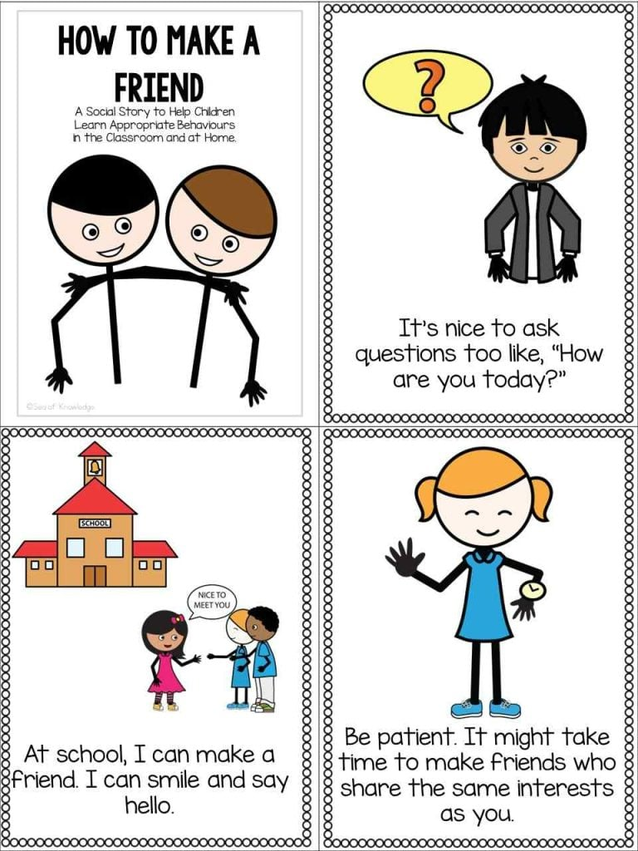
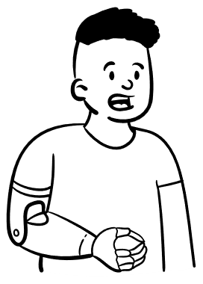



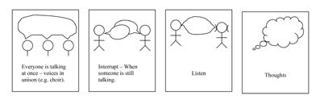
Everyday Activities to Support Perspective-Taking
Role-play
Social Stories
TV and Books
Comic Strip Conversations
childrenandfamilyhealthdevon.nhs.uk
Notes:
Use social stories to illustrate different viewpoints NB not to enforce neurotypical behaviour (eye contact, social norms) - for all parties involved
Role-play scenarios to practice empathy
Watch TV and read books together and discuss ‘what are they feeling/thinking?’
Use comic strip conversations – can be stick people to look at different scenarios.

Slide 17
Strategies
Break down abstract language into concrete examples
Use visuals to support understanding
Teach idioms and figurative language explicitly
Practice in a safe setting
Teach emotional vocabulary explicitly
Encourage questions like: 'What might they be thinking?'
childrenandfamilyhealthdevon.nhs.uk
Notes:
Break down abstract language into concrete examples
Use visuals to support understanding – this could be comic strip conversations, books etc
Teach idioms and figurative language explicitly – for example phrases like ‘put yourself in someone else’s shoes’ might need to be explained
Practice in a safe setting – use sympathetic peers and avoid causing embarrassment.
Teach emotional vocabulary explicitly
Encourage questions like: 'What might they be thinking?'

Slide 18
Top Tips
Encourage 2-way perspective taking – helping neurotypical students to understand autistic peer too
Provide clear, structured communication
Allow extra processing time
Encourage peer support and buddy systems
Remember, it is very hard to change your own perspective when challenged due to the danger of losing face.
Celebrate effort, not just ‘correctness’
childrenandfamilyhealthdevon.nhs.uk
Notes:
Always encourage 2-way perspective taking – helping neurotypical students to understand autistic peer too
Provide clear, structured communication
Allow extra processing time where needed
Encourage peer support and buddy systems
Remember, it is very hard to change your own perspective when challenged due to the danger of losing face.
Celebrate effort, not just ‘correctness’
Try to model your own thoughts and feelings without conflict or challenge or expectation for the other person to change their view in the moment – leave it with them.

Slide 19
Blank Levels
Framework developed by Marion Blank with 4 levels.
Helps us to understand how children develop comprehension and reasoning through language.
Level 1 – Matching Perception (Simple Recall & Naming)
Increasing cognitive and language skills
Level 2 – Selective Analysis of Perception
Level 3 – Reordering Perception (Basic Reasoning)
Level 4 – Reasoning about Perception (Abstract Thinking)
childrenandfamilyhealthdevon.nhs.uk
Notes:
Level 1 - Focus: Looking at what’s directly in front of the child.
Questions: “What’s this?” / “Find the dog.” / “Point to the red ball.”
Skills: Naming, labeling, noticing details.
Level 2 Focus: Describing and noticing features.
Questions: “What is the boy doing?” / “Find one that is round.”
Skills: Understanding functions, attributes, and simple actions.
Level 3 Focus: Making predictions, connections, and sequencing.
Questions: “What will happen if…?” / “How are a spoon and a fork the same?”
Skills: Categorization, comparing, problem solving.
Level 4 - Focus: Going beyond what’s visible, dealing with why and how.
Questions: “Why do we wear coats when it’s cold?” / “How do you know he is sad?”
Skills: Cause-and-effect reasoning, perspective-taking, abstract explanations

Slide 20


The Scales of Justice – Tony Attwood
Activity designed to help YP make better attributions of responsibility in conflict situations.
Uses visual reasoning to help the YP understand the degree of importance – the ‘weight’ – given to particular acts
The ‘weight’ of evidence is used to determine the degree of responsibility and consequences.
childrenandfamilyhealthdevon.nhs.uk
Notes:
Following an incident, the student is asked to talk about what happened. During the discussion, when the child / adult involved in the incident has taken an action that breaks a ‘code of conduct’ or acts inappropriately, a block is placed on their side of the scale or a shape is drawn in their circle on the paper.
Breaks in a ‘code of conduct’ could include:
• Being physical with another student
• Using inappropriate language with other students / staff
• Breaking a resource
• Taking something that does not belong to them
The facilitator and student can ‘rate’ how serious the action was and more than one block can be assigned. This supports the students understanding of the severity of their actions. This process is repeated for each stage of the discussion. The number of blocks for each individual are counted at the end of the discussion.
This activity supports the student by:
• Enabling them to see the part they have played in the situation, particularly when they struggle to see their role in the situation.
• That they have a choice and to learn to take responsibility for their choices.
• Using visuals in this activity will support and develop their understanding and the thought processes of other people.
• To understand that actions have consequences.
If adults are part of the situation, they may be assigned blocks also. For example:
• If an adult did not intervene / ignored a situation.
• If an adult was not present to support them when they should be.
• If an adult did not explain a situation.
Once the activity is completed a discussion can be held regarding the consequences of the students actions and the development of appropriate strategies that could be used in similar situations.

Slide 21
Goals/Targets for Perspective Taking
23

Slide 22
Goals for Perspective taking
When presented with films, video clips, TV programmes, sharing books or short stories or paragraphs, photos, pictures, they will successfully…
describe the possible motivations and perceptions of others.
describe their perception of events and situations.
explain why a behaviour made someone else feel a negative emotion.
Imagine what might make the person feel better or worse.
State whether they would have made the same decision in that situation /how they would have responded instead.
Imagine how the other person might be feeling
Infer why a particular person may say, feel or do things in a particular situation
State which outcome would be most positively received for the situation
State what they could do instead to communicate their message (while maintaining self-advocacy).
childrenandfamilyhealthdevon.nhs.uk
Reference: https://neurodiversity-training.therapistndc.org/

Slide 23
Key Takeaways
Perspective-taking and verbal reasoning can be taught
Explicit teaching helps bridge gaps
Practice and patience are essential
Every young person’s needs are unique
Perspective taking should be 2 way – include everyone’s perspective
childrenandfamilyhealthdevon.nhs.uk

Slide 24
Resources
to Support Perspective Taking and Verbal Reasoning
26

Slide 25
Resources
Language for Behaviour and Emotions (LFBE, Anna Branagan,Melanie Cross, Stephen Parsons) Language for Behaviour and Emotions – Thinking Talking
Active listening/ repairing conversation:
Merrimaps https://www.elklan.co.uk/
Lego Therapy
Comic Strip Conversations & Social stories https://www.autism.org.uk/advice-and-guidance/topics/communication/communication-tools/social-stories-and-comic-strip-coversations Carol Gray - https://carolgraysocialstories.com/social-stories/what-is-it/
Blank Levels
Pragmatics, inference, verbal reasoning, figurative language, sarcasm:
Black Sheep Press resources https://www.blacksheeppress.co.uk/product-category/speech-and-language-therapy/pragmaticssocial-communication/
Mental State Verbs - The-Thinking-Side-of-Social-The-Role-of-Mental-State-Verbs-in-Social-Success-Vagin.pdf
childrenandfamilyhealthdevon.nhs.uk

Slide 26
References
Asperger’s Syndrome: A Guide for Parents and Professionals by Tony Attwood (1997)
www.healisautism.com/post/perspective-taking-children-autism
www.speechandlanguagekids.com/how-to-teach-perspective-talking-to-children/
www.autism.org.uk/advice-and-guidance/professional-practice/double-empathy
therapistndc.org/why-teach-perspective-taking-neurodiversity-acceptance/
www.altogetherautism.org.nz/a-shift-in-perspective-empathy-and-autism/
www.autism.org.uk/advice-and-guidance/professional-practice/what-is-monotropism
28

