Slide 1


Universal support for Secondary schools
childrenandfamilyhealthdevon.nhs.uk

Slide 2
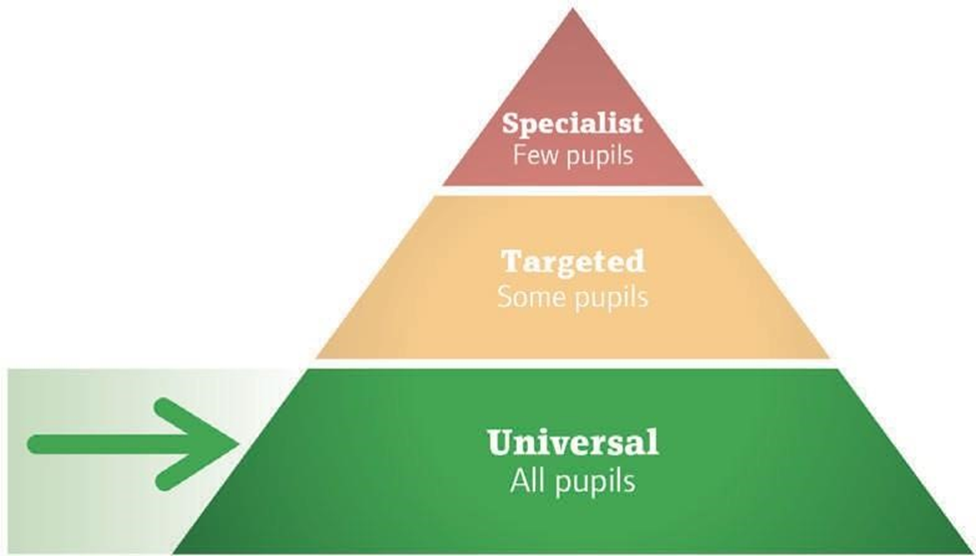
Universal support
A communication friendly environment considers both the classroom and the school setting as a whole. It should provide opportunities for everyone to understand and take part, in order to support their academic, social, and emotional development.
The following key features of a communication-friendly environment will be discussed:
Physical Environment
High Quality Classroom Talk
Vocabulary Teaching
Adult Use of Language
These strategies support the development of all pupil’s SLC skills but are also particularly beneficial for pupils with SLCN.

Slide 3
Physical Environment
If you would like to know more about Communication Friendly Spaces™, visit: www.elizabethjarman.com
Space, layout, and seating arrangements
How do I implement it in the classroom?
Examples:
The classroom should be arranged so that all pupils can see the teacher, board, displays etc.
Pay particular attention to seating arrangements for pupils who need the greatest access. For example, pupils with poor attentions skills should sit at the front of class or away from distractions. Pupils with a hearing loss should be able to see the teacher’s face, particularly if they use lip pattern to support understanding.
Give consideration to how pupils are seated to support group work and discussions.
Make sure that the environment is not too ‘busy’ in terms of colour and displays to avoid sensory chaos.
Light and Noise Levels
How do I implement in the classroom?
Be aware of background light e.g, from windows
Keep background noise and distractions to a minimum and manage this on a consistent basis
Be mindful of noise form equipment and consider soft furnishings to absorb the sounds

Slide 4

High quality classroom talk
High quality classroom talk facilitates spoken language skills (sometimes referred to as ‘oracy’ skills).
Research indicates that these skills are just as important as reading and writing skills and require explicit teaching and practice. If you would like to know more, then visit the following websites:
www.esu.org/oracyhttps://languageresearch.cambridge.org/images/CambridgePapersInELT_
www.literacytrust.org.uk Oracy_2018_ONLINE.pdf
www.liberty.k12.ga.us/pdf/TandL/Effective_Questioning_Talk.pdf

Slide 5

Talk for learning
What is it? Creating opportunities to use discussion and talk to support learning. It can take place in either whole class discussions or small groups.
The two main types of talk are:
Dialogic Talk - enables pupils to explore and build upon their own ideas and others’. A supportive environment for talking is created. For example, talking opportunities are equal (e.g., ‘no hands up’ policy) and pupils listen to each other. The aim is to achieve a common understanding.
Exploratory Talk - enables pupils to listen critically but constructively to each other’s ideas. Reasons are given to justify answers if any views are challenged. The aim is to reach an agreement.
Why use it?
Talking allows pupils to formulate their thoughts, communicate their ideas and reflect upon their learning. It also helps teachers to understand and clarify pupils thinking.
How it helps pupils with SLCN: “...talking helps me understand”

Slide 6

How do I implement it in the classroom?
Questions - Use open ended questions. Ask probing questions such as ‘how?’ and ‘why?’ to facilitate detailed answers beyond re-call.
Extend pupils thinking - Encourage differences in opinions and different viewpoints. Tentatively offer suggestions where necessary and signpost a change of topic, e.g., “have you thought about….?” or “have you considered….?”.
Give pupils opportunities to talk.
Validate efforts from classroom discussions.
Set expectations and rules for classroom talk.
Allow sufficient time for feedback following group work. Consider how pupils are seated in the classroom depending on the format of discussion.

Slide 7

Working with parents
Parents can be encouraged to give their child time to talk to them. They can start by asking open questions like “tell me something you liked about today?” and give everyone in the family a turn to talk, e.g., at mealtimes.
For more information, please visit: www.speechandlanguage.org.uk/talking-point/for-professionals/primary-and-secondary-schoolteachers

Slide 8

‘Thinking time’ rule
What is it?
Allowing pupils more time to answer a question. The teacher may wait up to 10 seconds between setting the question and requiring an answer. It also links to the ‘no hands up’ rule and ‘talking partners’.
Why use it?
Research shows that increasing wait time increases the length of responses and participation from less able students. It also decreased the number of “I don’t know” or no responses.
How it helps pupils with SLCN:
“people talking when I’m thinking – that’s not good” CYP with SLCN need more time to process spoken language and articulate a response.

Slide 9
Working with parents
How do I implement it in the classroom?
Introduce thinking time – let pupils know about the concept.
Alert pupils that you will be asking a question.
Give more thinking time when asking complex questions, e.g., ‘why?’ questions or questions that require prediction/problem solving (verbal reasoning) such as “what will happen if…?”.
Use thinking time in the following ways:
Independent time – allow pupils time to process the question and think through their answer independently.
Paired discussion time - allow pupils to think about the question with a partner.
Writing time – allow pupils to put their thoughts on paper first.
Adjust the length of waiting time depending on the pupils in your class.
Working with parents:
Encourage parents to pause after speaking, to give their child an opportunity to respond.

Slide 10

Vocabulary teaching
What is it?
A framework for teaching vocabulary effectively in school, for example, ‘Word Aware’ developed by Parsons and Branagan (2010).
Why use it?
Vocabulary is fundamental to learning; it is linked to reading comprehension and academic attainment. In addition to indirect approaches (e.g., a rich reading experience), pupils also need direct approaches (e.g., selecting and teaching specific words) in order to learn vocabulary effectively.
How it helps pupils with SLCN: CYP with SLCN often have difficulty storing and retrieving vocabulary. This means they may have vague meanings of the word or make minor mispronunciations. They will need more exposure to new words and for vocabulary to be specifically taught.

Slide 11
Vocabulary teaching
How do I implement it in the classroom?
Teaching vocabulary:
Identify core vocabulary. These will be words that are essential to understanding the topic and will be encountered again but are not too easy and not too hard. You may wish to sort and select words based on the system of: anchor words, goldilocks words and step on words. Be aware of cross-curricular vocabulary used in exam questions such as ‘compare’, ‘discuss’ or ‘summarise’.
Discuss definitions of new vocabulary and use a word map/wizard to teach phonological (sound), semantic (meaning) and syntactic (grammar) features. Do not forget to include diagrams or pictures.
Reinforce words in class:
Write vocabulary on the board and refer to it explicitly during the lesson. o Link vocabulary to activities in class. Vocabulary is best taught in context and with real experiences.
Arrange frequent encounters in multiple contexts (at least six exposures per new word).
Review vocabulary at the end of the lesson, day, week, or term. Consider having a central vocabulary wall in class or pupils creating their own glossary for each topic.

Slide 12
Vocabulary teaching
Working with parents:
Share vocabulary lists with parents on a regular basis so that words can be practiced and reinforced at home.
For parents with younger children, encouraged them to support their child to learn new words and concepts using everyday tasks.
For parents with older children, encourage them to use and explain high level words.
Leaflets for parents (with primary or secondary aged children) can be found here: www.speechandlanguage.org.uk/talking-point/parents/resource-library-for-families
For more information: www.thinkingtalking.co.uk/word-aware www.literacytrust.org.uk
Elklan Language Builders (yellow book – page 50-69, red book – page 54-70)

Slide 13
Adult use of Language
Top Tips
Use a slower pace when talking
Pause to give pupuls extra time to process a question or instruction
Encourage pupils to ask for help when they don’t understand
Simply language when needed e.g rephrasing , chunking instructions or explaining key words
Try to link new vocabulary to information that the pupil is laready familisr with
Be aware that sarcasm, irony, idioms interference and implied meaning may not be understood
Keep instructions short and to the point and in the order that you want them to happen
Be aware of the complexity of questions ( Blanks levels)

Slide 14
Targeted support for Secondary schools
childrenandfamilyhealthdevon.nhs.uk

Slide 15
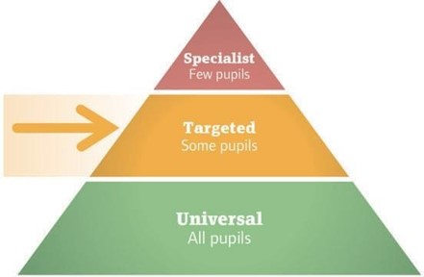
Adult use of Language
In addition to universal support pupils may need targeted interventions (either individual or group) outside of the classroom, to practice their SLC skills. Included in this section you will find
Aims for targeted intervention.
List of programmes which are highly structured and includes session plans, resources, and training.
List of resources which can be used if planning your own small groups or individual intervention
Advice for running interventions

Slide 16
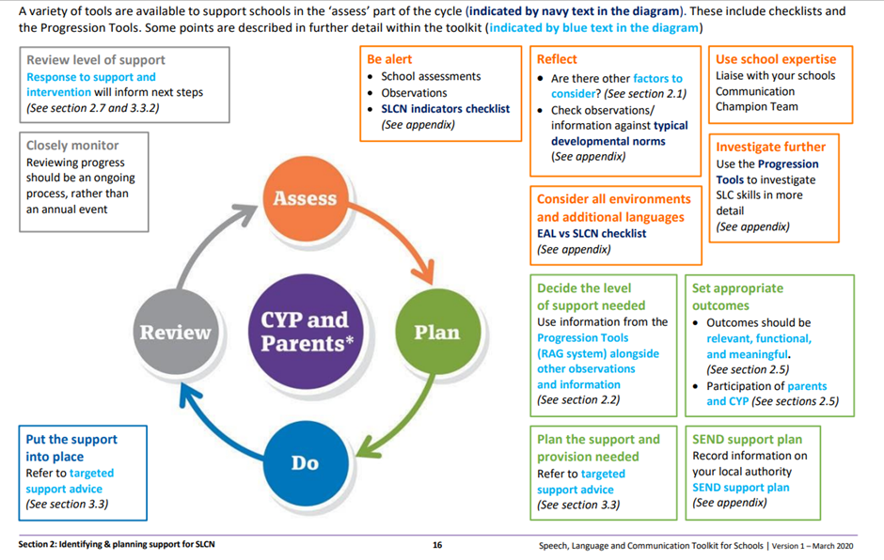
Adult use of Language
By using the checklist and/or Progression Tools, you would have identified which areas of SLC the pupil has difficulty with:
Understanding spoken language
Understanding and using vocabulary
Sentences
Storytelling and narrative
Speech
Social Interaction

Slide 17
Understanding Spoken Language
A pupil must be able to understand what is being said to them before they can express it.
Understanding language can encompass other skills such as attention and listening, understanding vocabulary, verbal reasoning, problem solving and working memory. Please refer to other sections of the toolkit for more specific recommendations.
Indication of difficulties
May give irrelevant answers or not respond to questions.
May have difficulty understanding implied meaning.
May only remember part of an instruction.
May need you to repeat the instruction several times.
May watch other children so that they can work out what to do.

Slide 18
Impact
May have poor reading comprehension.
May show disruptive behaviour, become quiet/withdrawn, or look lost, as they are unable to understand what is being asked of them.
May appear like they have not paid attention.
May not recognise when they have not understood and do not ask for clarification.
May avoid, opt out, or abandon tasks.

Slide 19
Strategies to embed within the classroom
Instructions, questions, and explanations should be supported visually referred to explicitly
Use colour coding symbols and signs to support understanding of questions, e.g., ‘why?’, ‘when?’ and ‘how?’
Use a visual timetable to show the structure of the day
Use visual task plans for pupils to easily refer back to.
Use natural gesture or point to pictures while speaking to highlight key words/messages.
Demonstrate wherever possible.
Write key points and vocabulary on the board.

Slide 20
Adult use of language
Focus attention
Make sure you have gained the pupil’s attention (e.g., by using their name) before giving an instruction or introducing an activity.
Questions
Be aware of the complexity of questions. For example, ‘how?’, ‘when?’, and ‘why?’ questions (Blank levels 3 and 4) require inferencing skills, which may be particularly challenging to answer.
Give the pupil enough time to respond to questions.
Consider Simplifying your Language
Use simpler vocabulary (e.g., “mix together” rather than “combine’).
Use positive statements (e.g., “walk” rather than “don’t run”).
Avoid using ‘if’ (e.g., “Tom, you have school dinners, rather than “If you have school dinners).
Emphasise the important words within a sentence and repeat key information.
Explain non-literal or ambiguous language (e.g., “pull your socks up”)
Be explicit with instructions, rather than using inferred language (e.g., “please can you close the window?” rather than “it’s a bit cold in here now”)

Slide 21
Adult use of language
Recording key points
Provide opportunities for the pupil to either draw or write down key points.
Instructions
Say things in the order you want the pupil to do them (e.g., “Pack away your books, then go to lunch” rather than “Before you go to lunch, pack away your books).
Break information into smaller chunks.
Repeat information as required.
Slower rate of speech
Slow down your own rate of your speech and pause more often, to allow more time for the pupil to process information.
Check understanding
Check understanding by asking the pupil simple questions or asking them to repeat key points.
Encourage the pupil to say when they have not understood, e.g., “what does it mean?” or “can you repeat the question please?”.

Slide 22
Targeted interventions (individual or small group)
Principles/ aims of programmes
For pupils to learn how to identify why they have not understood. For example, because it was said too quickly, they did not understand the words used or because the instruction was too long.
For pupils to learn phrases which they can use to repair conversation breakdown, e.g., “can you say it again please?”, “can you write it on the board please?”, “can you say it slower please?”
For pupils to learn and practice memory strategies such as, counting on fingers, rehearsal, visualisation, and note-taking.
For pupils to know which strategies are most effective for them so that they can use them independently. Please note that some of the memory strategies will only be suitable for children of 8 years and older and they will only be able to spontaneously use them from this age.

Slide 23
Published Programmes
Active Listening for Active Learning
www.integratedtreatmentservices.co.uk/ our-approaches/speech-therapy- approaches/active-listening-active- learning
Resources
https://childrenandfamilyhealthdevon.nhs.uk/
Auditory memory
Black Sheep Press Memory resources www.blacksheeppress.co.uk/product-category/memoryskills-3
Elklan Language Builders (yellow book page 32-37)
Comprehension monitoring
Elklan Language Builders (yellow book page 99-102, red book page 90-93)
Blank Levels
www.childspeechbedfordshire.nhs.uk/wp-content/uploads/2023/04/Introduction-to-Blanklevels.docx
.

Slide 24
Understanding and using vocabulary
A specific area of vocabulary is word-finding difficulties (storing and retrieving words). This means a pupil may find it difficult to recall a word which they know but cannot retrieve.
www.youtube.com/watch?v=_y7TJ7Th8cY
Indication of difficulty
May have a limited range of vocabulary or difficulty learning new vocabulary.
May struggle to ‘find’ words they know.
May use the wrong words or made-up words.
May over-use general words, e.g., “thingy”, “that”.
May use a lot of fillers or hesitations, e.g., “um”, “er”.
Impact
May become withdrawn or frustrated as pupils are often aware of their difficulties.

Slide 25
Strategies to embed within the classroom
Adult use of language
Emphasise key words/concepts when speaking “The mouse is under the box”
Reinforce new vocabulary in different situations and contexts – with plenty of repetition.
Try and link new vocabulary to information the pupil is already familiar with.
Give phonological or semantic cues to support word-retrieval. For example, the beginning sound of the word , the first syllable of the words, an associated word or can the pupil describe it or talk about what the word means?

Slide 26
Visual support strategies
Use pictures/symbols/objects to support understanding.
Use tools such as word maps.
Use a multi-sensory approach when teaching, rather than relying on spoken language alone.
For the pupil to create personal word glossaries, with diagrams and pictures.

Slide 27

Targeted interventions (individual or small group)
Principles/aims of published programmes and resources:
For pupils to develop a range of words including nouns, verbs, prepositions (e.g., ‘in/on/under’) and adjectives/adverbs (e.g., ‘heavy’, ‘little’).
For pupils to be able to identify and use synonyms.
For pupils to be able to sort words into categories and identify similarities/differences.
For pupils to be able to describe a word based on its attributes/functions or provide a definition.
For pupils to be able to use word finding strategies when unable to retrieve a word.

Slide 28
Published Programmes
Where as this is a pack designed for Secondary aged children it is important to access resources that support their level of need not their chronological age
Vocabulary
Reception – ‘Nuffield Early Language Intervention’ www.teachneli.org
(also works on narrative skills, attention and listening and phonological awareness).
Primary – ‘Talkboost’ www.speechandlanguage.org.uk/talk-boost (also works on listening, sentences, storytelling, and conversations).
Secondary – ‘Vocabulary Enrichment Programme’
www.routledge.com/Vocabulary-Enrichment-Programme-Enhancing-the-Learningof-Vocabulary-in/Joffe/p/book/9780863887987
Resources
https://childrenandfamilyhealthdevon.nhs.uk/
Vocabulary and concepts
Rhodes to Language (pupils in KS2 – KS4) www.elklan.co.uk/Shop/Rhodes_to_Language
Elklan Language Builders (yellow book page 79, 82)
Categorisation and word retrieval strategies
Semantic Links www.elklan.co.uk/Shop/Semantic_Links

Slide 29
Sentences
Includes problem solving and verbal reasoning difficulties, e.g., explanation, justification, and prediction.
Indication of difficulty
May have difficulty with using well-formed and longer sentences.
May make errors or miss out pronouns and tense markers etc.
May mix up the word order making spoken language difficult to understand.
May have difficulty with hypothesising and predicting.
May rely a lot on pointing or gestures to get their message across.
Impact
May have difficulty with literacy (the same problems they have with spoken sentences will be evident in their written attempts).
May have difficulty developing vocabulary through reading (for example they may not be able to work out the meaning of an unknown word from the context of the sentence).

Slide 30

Sentences
Adult use of language
Model the correct response (rather than correcting mistakes)
Repeat back what the pupil says using the correct vocabulary and grammar – so that they hear good examples. Sometimes referred to as re-casting.
Expand the sentence by adding a few words - to show how they can make their sentence longer. Sometimes referred to as expansion.
Emphasise key words – to draw the pupil’s attention to.
Visual support strategies
Use colour coding approaches, e.g.,
Use colour to highlight missing words in written work, e.g., blue line for location words.

Slide 31
Targeted interventions (individual or small group)
Principles/aims of published programmes and resources:
For pupils to develop grammatical structures. For example: pronouns (e.g., ‘he/she/him’) o plural endings (e.g., regular ‘-s’ and irregular ‘sheep’) o auxiliaries (e.g., ‘is/are’)
past tense (e.g., regular ‘-ed’ and irregular, e.g., ‘broke’) o future tense (e.g., ‘will/is going’) o comparatives (e.g., ‘better’) o conjunctions (e.g., ‘and/but/because’) o connectives (e.g., ‘firstly/therefore’)
For pupils to develop verbal reasoning skills. For example, prediction, evaluation, justification, and explanation.

Slide 32
Published programmes
Verbal reasoning
Language for Thinking: A Structured Approach for Young Children www.thinkingtalking.co.uk/language-forthinking
Resources www.childspeechbedfordshire.nhs.uk/information-and-advice/resources
Questions (Blank levels)
Elklan Language Builders (yellow book page 39-47, red book page 44-51)
Grammatical structures
Elklan Language Builders (red book page 76-80)
Colour coding*
*It is recommended that you seek advice and support from a Speech and Language Therapist when using Colourful Semantics and/or Shape Coding, particularly if the pupil presents with severe or complex SLCN.
An introduction to these approaches can be found in Elklan Language Builders (yellow book page 76-77).
Colourful Semantics pack: www.elklan.co.uk/Shop/Colourful_Semantics • Shape Coding: www.shapecoding.com

Slide 33
Storytelling and narrative
A specific area of narrative is sequencing. Sequencing is the ability to organise and order events.
Indicators of difficulty
May find common sequences hard to remember, e.g., days of the week.
May have difficulty talking about events, retelling stories, or making up their own stories.
Narratives may be shorter, may not be organised/coherent (e.g., difficulty setting the scene, events not linked together), may include irrelevancies.
Impact
May be difficult for someone to understand and follow what they are saying.
May have difficulty with peer relationships (e.g., not being able to talk about things that have happened or explain things clearly).
May have difficulty with literacy skills

Slide 34
Strategies to embed within the classroom
Adult use of language
If the pupil makes a mistake in their sentence, help them to repair it by modelling back the sentence. You may need to:
Adjust the order
Add missing vocabulary
Add grammatical structures
Visual support strategies
Use first, next and last templates to help structure events.
Use story planners/narrative frameworks to help structure stories, e.g., ‘beginning’, ‘middle’ and ‘end’.
Use visual timetables and reference explicitly to events, e.g., “First it’s maths, next it’s lunch”.
Use colour coding approaches to show that question words relate to story components, e.g., who = characters, what doing = what happened (events), where= location (places), when = time, what like = description of characters/ settings.
Use timelines to make concepts of past events explicit.

Slide 35
Targeted interventions (individual or small group)
Principles/aims of published programmes and resources:
For pupils to understand concrete units of time (e.g., times of day, days of the week, seasons) and abstract concepts of time (e.g., earlier, soon, later).
For pupils to order and describe a sequence of events.
For pupils to be able to use sequential concepts (e.g., ‘now and next’, ‘before and after’, ‘first’, ‘then’, ‘last’).
For pupils to have an increased awareness of the components of a story (e.g., beginning, middle and end) and understanding of question words (e.g., who, when and where, what happened?).
For pupils to be able to re-tell stories (before they can generate their own narrative).

Slide 36
Published programmes
Storytelling and Narrative
Black Sheep Press
Reception – ‘Reception Narrative Pack’ www.blacksheeppress.co.uk/product/reception-narrative-narrative-skills-for-age3-5-years
Key Stage 1 - ‘Speaking and Listening Through Narrative’ www.blacksheeppress.co.uk/product/speaking-and-listening-throughnarrative-ages-5-7
Key Stage 2 – ‘From Oral to Written Narrative’ www.blacksheeppress.co.uk/product/from-oral-to-written-narrative-ages-7-11
Secondary www.blacksheeppress.co.uk/product/secondary-talk-narrative-ks3-4-2
Speechmark
Secondary – ‘Narrative Intervention Programme’ (developed by Victoria Joffe) www.routledge.com/Narrative-InterventionProgramme/Joffe/p/book/9780863887970

Slide 37
Published programmes
Resources
www.childspeechbedfordshire.nhs.uk/information-andadvice/resources
Storytelling and Narrative (narrative grids)
Elklan Language Builders (yellow book 88-94, red book 87-88)
Sequencing
Sequencing cards - We recommend you photograph sequences to make it personal and motivating for CYP. However, if you wish to purchase resources, Speechmark Colour Cards produce a range of 2, 3, 4, 6-8 step sequences.
www.routledge.com/search?kw=sequence+colorcards
Elklan Language Builders (yellow book page 85-86, red book page 86)

Slide 38
Speech (speech sounds, stammering and voice)
Underlining processes are involved with the development of speech skills. There is a subconscious element, known as the ‘speech processing system’ and a conscious element known as ‘phonological awareness’. Phonological awareness is the ability to reflect on the word structures including rhyme, syllables, and phonemes.
Indication of difficulty
Speech:
May have difficulty producing specific sounds/substitute sounds/miss off parts of words.
Stammering:
May repeat sounds or part of words, e.g., “b-b-b-but”.
May prolong sounds, e.g., “mmmum”.
May block, e.g., no sound comes out.
May have tension in their face or make extra movements, e.g., blinking.
Voice:
May have an unusual voice quality, e.g., hoarse, husky, breathy, rough, or weak.
May lose their voice or it cuts out whilst speaking.

Slide 39
Strategies to embed within the classroom
May have poor phonological awareness.
Adult language and communication
Speech sounds
Focus on what the pupil is saying not how they are saying it.
Repeat back clearly what the pupil has tried to say – so that they hear good models.
Avoid direct correction and don’t make the pupil repeat after you.
If you are finding it difficult to understand, ask if they can show you. Don’t pretend to understand.
Stammer
Focus on what the pupil is saying not how they are saying it.
Don’t interrupt or finish their sentence for them.
Slow down your own rate of speech
Encourage turn-taking to avoid pupil feeling rushed or interrupted.
Give plenty of time for the pupil to answer the question, to avoid the pupil feeling under pressure.
Don’t give direct advice about how to manage their stammer. For example, it’s often not helpful to tell them to “hurry up”, “slow down” or “take a deep breath”.

Slide 40
Strategies to embed within the classroom
Voice
Encourage turn-taking to avoid pupils shouting over each other.
Ensure voice rest periods by having a balance between activities that require voice and activities which don’t.
May have speech processing difficulties such as sequencing multi-syllabic words.
Impact
Speech
May be unintelligible to unfamiliar listeners.
May have difficulty with phonics, e.g., unable to tell the difference between sounds.
May be at higher risk of reading, spelling, and writing difficulties (if have weak phonological awareness).
May have difficulty learning new vocabulary (if have persistent speech processing problems).
May avoid speaking in certain situations or avoid certain words.
Stammering
May avoid certain situations (e.g., social events or responding to questions in class).
May avoid certain sounds or words.
May adopt strategies to hide their stammering, e.g., change what they were going to say mid-sentence.
May feel fear frustrated or embarrassed

Slide 41
Targeted interventions (individual or small group)
Principles/aims of published programmes and resources:
Referral to NHS speech and language therapy service may be required for speech, stammering and voice. For example, they may provide a specialist assessment and an individual programme which will show which sounds to target first.
However, because phonological awareness skills are fundamental to literacy development, it is worth considering if the pupil has difficulty in this area and provide necessary targeted support.

Slide 42
Targeted interventions (individual or small group)
Published programmes
Speech (phonological awareness)
Speechmark
Reception - ‘School Start’ (also has section on language)
www.routledge.com/School-Start-Targeted-Intervention-for-Language-and-Sound-Awareness-in/BedoyereLowry/p/book/9781909301580
Year 1 – ‘School Start’ (also has section on language) www.routledge.com/School-Start-Year-1-Targeted-Intervention-for-Language-and-SoundAwareness/Bedoyere-Lowry/p/book/9781138573956
Resources
https://childrenandfamilyhealthdevon.nhs.uk/
Speech (phonological awareness)
Elklan Language Builders (yellow book page 108, red book page 119-122)

Slide 43
Social Interaction
Many CYP experience difficulties with social interaction including pupils with ASD and language disorders.
pragmatic skills – refers to how a CYP uses communication in a social situation, e.g., non-verbal communication, turn-taking, initiating, and maintaining conversation.
social thinking (a term developed by Michelle Garcia Winner) refers to the process of how we understand our own and other people’s thoughts/feelings/intentions.
***It is important to recognise that any approaches that you take are neuro diversity affirming, this means recognising that people communicate, process information, and express themselves in diverse ways. Some young people may wish to learn what we may consider to be ‘neuro typical’ ways of social interaction whilst others will not. Any recommendations within this section of the tool kit are aimed at young people who wish to explore neuro typical communication styles.

Slide 44

Indication of difficulty
May find it difficult to understand and discuss their own/ other people’s feelings.
May find it difficult to see things from another person’s point of view.
May find it difficult to start, join in and maintain conversations. For example, they may interrupt, give too much information, may switch topic without signal or persevere on a favoured topic.
May find it difficult to understand and use non-verbal communication, e.g., body language, eye-contact, personal space, and tone of voice.
May not understand non-literal language, e.g., jokes, idioms, and metaphors.

Slide 45

Strategies to embed within the classroom
May show behaviour communicating unmet needs
May have difficulty with peer relationships.
May find it difficult to join in and play with other peers. Unstructured activities such as ‘break time’ may be particularly challenging.
May have difficulty participating in group work.
May have difficulty adapting to new or unfamiliar social situations.

Slide 46
Adult language and communication
Support the pupil to maintain topics of conversation. For example, if the pupil changes subject, remind them of the topic and encourage them to talk about the other topic afterwards.
Support the pupil in giving a clear amount of information. For example, let the pupil know if they have not given you enough information.
Model commonly used social phrases, such as when greeting someone.
Talk about your own feelings and model clear, respectful responses.
Use real life situations as an opportunity to discuss solutions to a problem,
e.g., “We haven’t got enough chairs. What should we do?”
It may be necessary to label the feeling for the pupil in the situation.
Visual support strategies
Reinforce shared social skills in the class by using symbols.
Help students to ‘check-in’ and say how they are feeling using visual support.

Slide 47
Targeted interventions (individual or small group)
Principles/aims of published programmes and resources:
For pupils to develop awareness of using different ways of communicating when talking to different people.
For pupils to develop skills important for interaction and group work, e.g., turn-taking, following instructions, problem solving and collaboration.
For pupils to develop an understanding and use of non-verbal communication skills (e.g., body language, proximity).
For ppils to develop emotional literacy (e.g., vocabulary related to emotions).
For pupils to develop emotional regulation strategies (e.g., strategies to regulate or move between different emotion states).

Slide 48
Targeted interventions (individual or small group)
Pragmatics***
‘Talkabout’ series (developed by Alex Kelly) www.routledge.com/Talkabout/book-series/SMT
‘Socially Speaking: a pragmatic social skills programme for primary schools’ (developed by Alison Schroeder) www.ldalearning.com/product/social,-emotional-and-mental-health/socialskills/games/socially-speaking/admt00416
Emotional literacy and regulation
‘The zones of regulation’ (developed by Leah Kuypers) www.zonesofregulation.com
The incredible 5 point scale https://www.5pointscale.com/
Social skills
‘Lego based therapy: how to build social competence through LEGO-based clubs for children with autism and related conditions’ (LeGoff, 2014) https://uk.jkp.com/products/legobased-therapy
Resources
https://childrenandfamilyhealthdevon.nhs.uk/
Pragmatics
Reception – KS1 ‘Talking about friends: situational understanding’
(Black Sheep Press) www.blacksheeppress.co.uk/product/talking-about-friendssituational-understanding-2
Elklan Language Builders (yellow book page 105-106, red book page 96-100).
Language for Behaviour and Emotions Developed by Anna Branagan, Melanie Cross and Stephen Parsons

Slide 49

Non Literal Language
Elklan Language Builders (red book page 101-103).
Non-literal language ‘Mystifying Metaphors’ www.elklan.co.uk/Shop/Mystifying_Metaphors
‘120 idioms at your fingertips’ www.elklan.co.uk/Shop/120_Idioms_At_Your_Fingertips

Slide 50
Advice for running interventions
Why should schools run interventions?
Research shows that when TAs run one-to-one or small group interventions, it can have a positive impact on pupils’ attainment (when TAs receive high quality support and training). Professional development resource: https://educationendowmentfoundation.org.uk/education-evidence/guidance-reports/teaching-assistants
Choosing group members (if applicable)
Groups typically consist of a maximum of six children.
Consider how well the pupils will work together. It can be helpful to include some children who will act as good role models (e.g., for language or behaviour).
Selecting an adult to run the intervention
One adult to consistently lead the intervention/group. Other support staff may also be needed.
The adult leading the intervention should be appropriately trained (e.g., Level 3) and supported. Specific training for published programmes is advised. They should know the pupils fairly well and understand SLCN.
It is preferable if the adult also spends time with the pupil in class to promote the generalisation of skills

Slide 51
Advice for running interventions
Length and frequency
The length of each session will depend on the attention abilities of the pupil(s). However, as a guide, most interventions for school aged children run between 20-45 minutes.
Typically, interventions occur 2-3 times a week, but this will depend on the programme and other practicalities.
Most interventions will run for a minimum of 20 sessions (e.g., equivalent to a school term

Slide 52
Advice for running interventions
Planning
Interventions should be planned into the timetable to ensure consistent running of interventions, availability of staff and rooms/spaces. Spaces should be clear of distractions.
Sufficient time should be allocated to staff leading interventions in order to prepare resources before the session, record progress after the session and to feedback and liaise with others such as class teachers.
The content of interventions should be consistent with or extend learning from the classroom. For example, selecting vocabulary to pre-teach.
During the session
Re-cap rules/expectations at the start of each session.
Use a visual timetable to show which activities will be covered in the session. Include the aim of the activity as well as the game.
Remember – interventions are for practicing and working towards the aim. So, give the pupil the support they need in order to learn and don’t over test them.
Use different activities to practise each skill. Activities should be engaging and incorporate the goal. For example, if working on the concept ‘in’ - drop water balloons in a tray.
Use visual support and language which supports their SLC skills, e.g., chunk information, repeat new vocabulary etc.

Slide 53

Advice for running interventions
Monitoring of progress
Use a screen before and after the period of intervention to measure response and progress. Most published programmes will have their own.
Each programme will have aims for the period that the intervention runs. The leading adult will likely select 2-3 aims to work on per session.
Use a record form to record progress after each session. Reflect on whether the pupils have achieved the aim and if they need to move onto a different aim the following

Slide 54
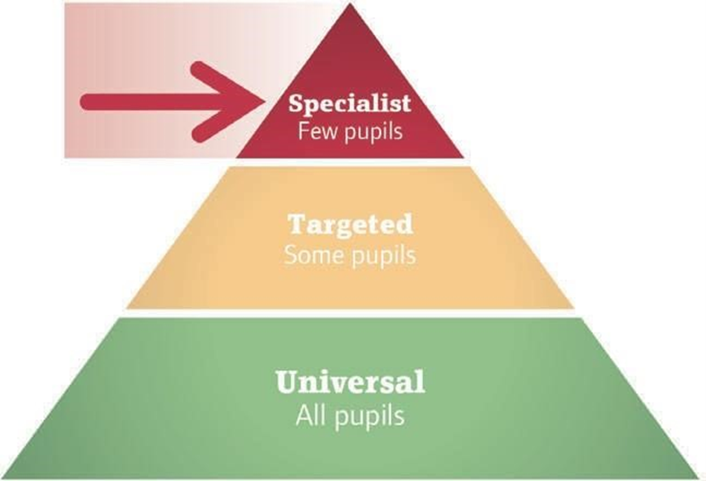
Specialist support - Pupils with long-term and persistent SLCN)
This section of the toolkit will support schools to better understand when it is appropriate to seek support from to specialist services, e.g., CFHD Speech and language Therapy in Devon, for assessment, advice, or intervention.
In this section of the toolkit, we also discuss what information to gather to make effective referrals.

Slide 55
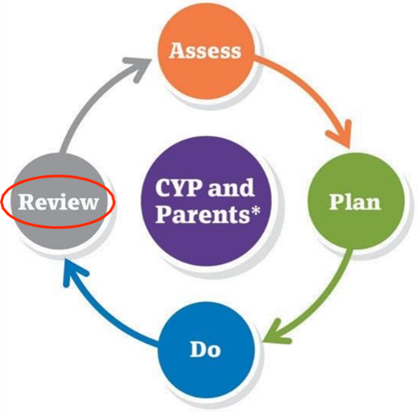
Specialist support - Pupils with long-term and persistent SLCN)
When to refer to specialist services
Referral to NHS speech and language therapy service after identification of SLCN. For example, the CYP may score within the red zone on the Progression Tools, indicating that specialist services may be required.
Referral to NHS speech and language therapy service following targeted interventions and monitoring of progress. This would be an outcome of the review phase in the ‘Assess-Plan-Do-Review’ cycle. For example, if the CYP has made less progress than expected with targeted intervention, they may need specialist support in order to make progress. (See targeted support )
In both cases, it is recommended that you follow local procedures by looking at referral guidelines.

Slide 56

Specialist support - Pupils with long-term and persistent SLCN)
Please visit the CFHD website
https://childrenandfamilyhealthdevon.nhs.uk/requesting-help-from-cfhd/

Slide 57
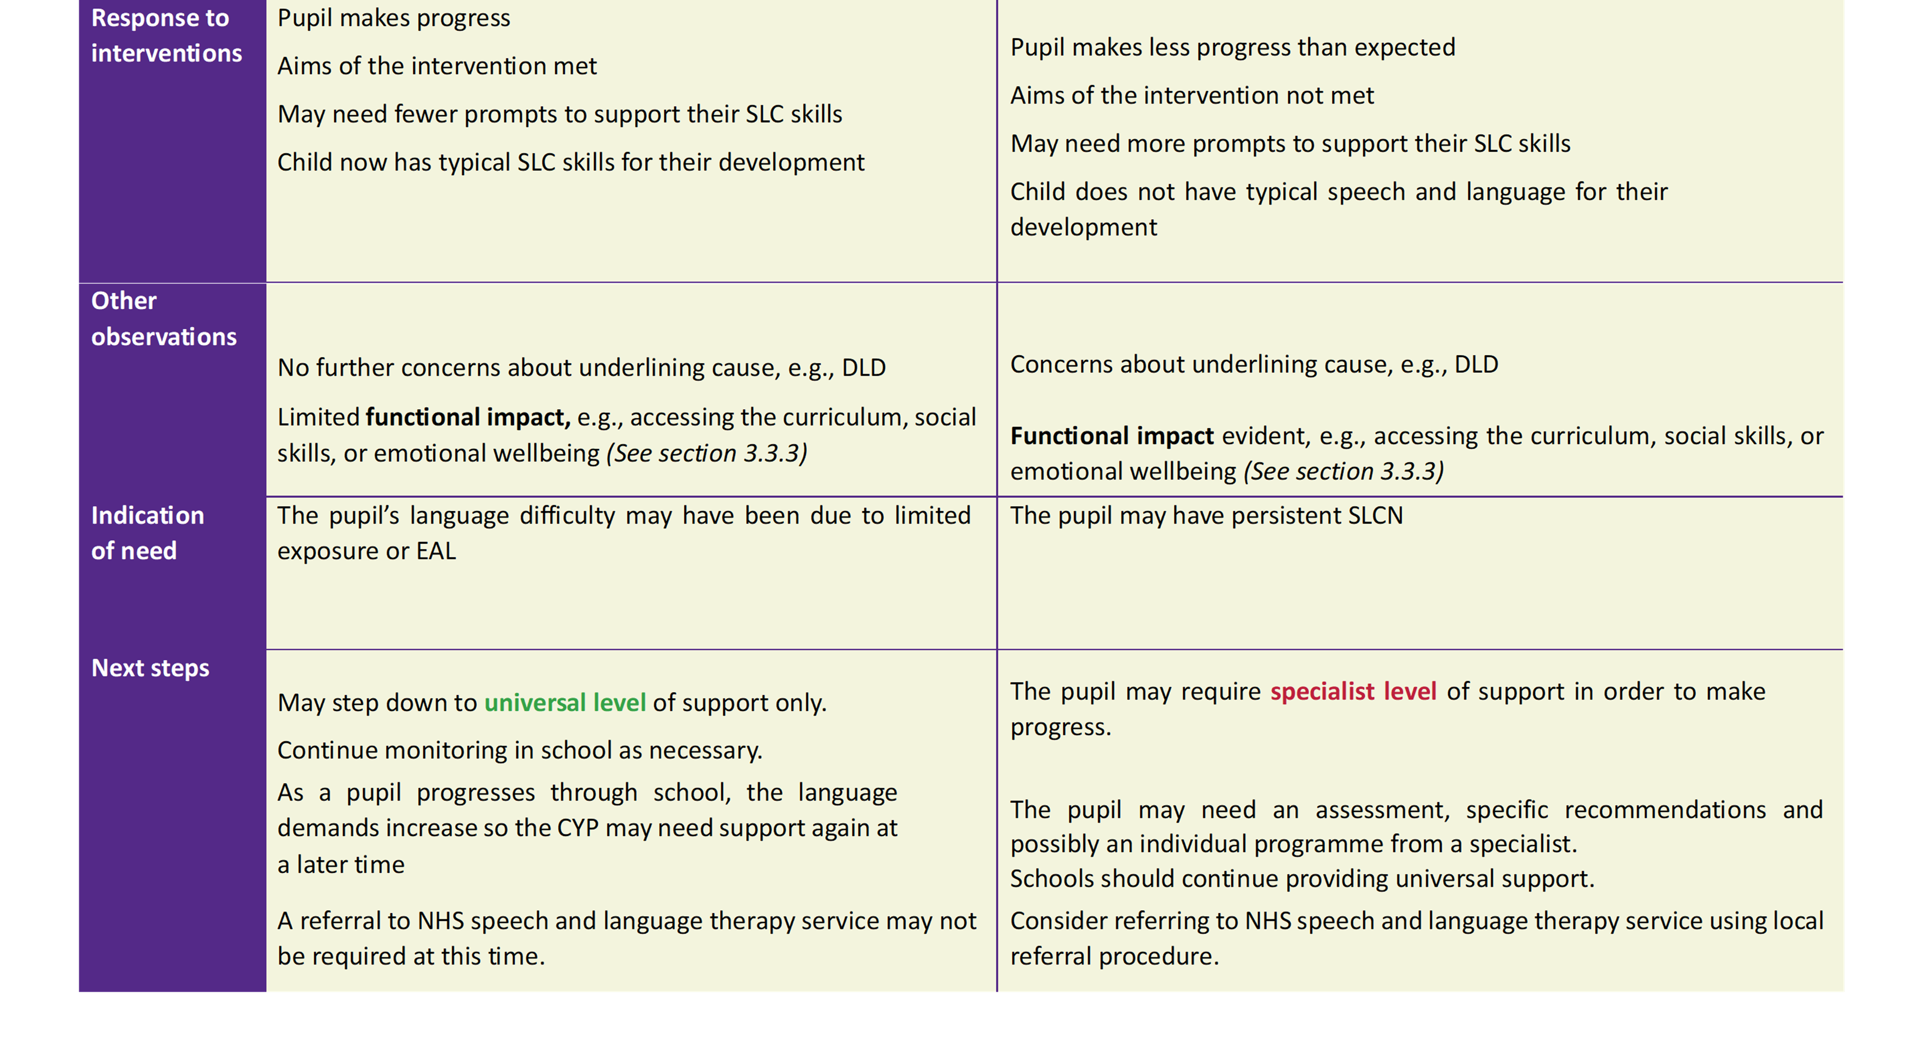
Decision making chart following targeted support

Slide 58
What do we mean by functional impact?
Functional impact relates to how well a child can participate in everyday activities. Whilst there are currently no formal assessment measures of functional impact for SLCN, the following aspects are taken into account:
Accessing the curriculum, e.g., • Literacy.
Attention and listening.
Participation in language-based tasks.
Learning new information.
Social skills, e.g.,
Solitary play or difficulty in group situations.
Difficulty with peer relationships.
Emotional wellbeing, e.g., • Internalising difficulties.
Externalising difficulties

Slide 59
Collating information for onward referrals
When outcomes continue to not be achieved despite support being provided, or when a more significant difficulty is identified, this toolkit provides the opportunity to collate evidence to support onward referrals if required.
NHS speech and language therapy
Assessment and advice from a SLTist may be needed when the pupil has SLCN and needs one of the following:
An individual/ specialist communication system (this is known as AAC). For example, PECS or voice output communication aid.
A differential diagnosis, e.g., DLD.
Specialist support in order to make progress.

Slide 60
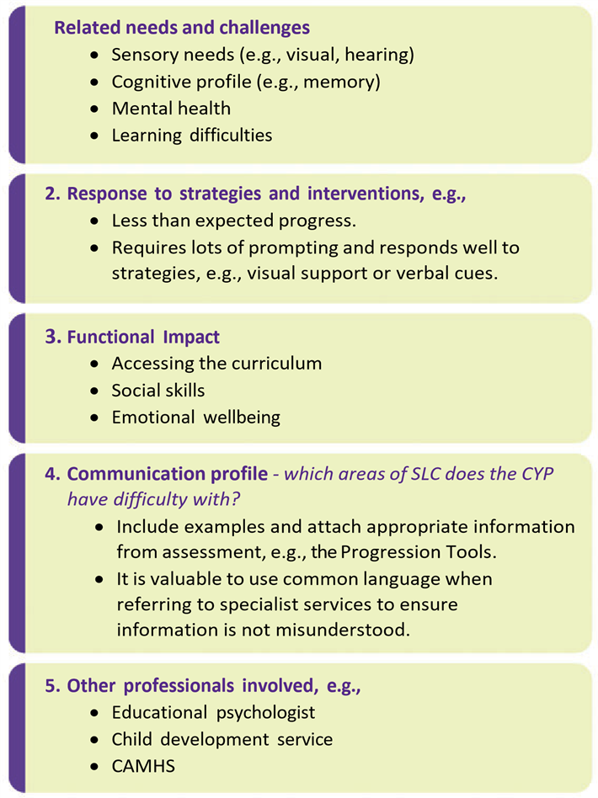
Collating information for onward referrals
When referring to NHS speech and language services, the information provided by referrers is invaluable. Include information on:

Slide 61
Thank you
childrenandfamilyhealthdevon.nhs.uk

