Slide 1



BLANK’S SCHOOL AGE LANGUAGE PROGRAMMES
TRAINING
FOR SCHOOLS
Notes:
In this training video, we will be talking about how to support children in developing their understanding of language skills using the blanks levels and blanks level programmes that we provide to schools.
Along with this presentation, you should also have a copy of example questions for Levels 1-4. You will need this handy for the upcoming activities.

Slide 2
Why is it important to know about the complexity of the questions we ask in the classroom?
Asked in the right way, questions are a good way of:
Assessing how much the child has understood
Encouraging the child to explore their thoughts and expand their responses
Structuring a child’s responses
Answering a question verbally supports formulating a written response
However, not all children may understand what they are being asked. This may lead to misunderstandings and frustration in the classroom and at home.
Notes:
Before we look into Blanks Levels in more detail, we should first consider why it is important to know about the complexity of questions we ask in the classroom.
As someone who works in a school, you will know that questions are used to assess a child’s knowledge and how much they’ve understood. Questions can encourage a child to explore their thoughts and expand on and even scaffold a child’s responses. Giving a verbal answer to a question can also help a child in forming a written answer as well.

Slide 3
  What are Blanks Levels?
  This is a language model based on the work of Blank, Rose and Berlin (1978). It was developed from studies that looked at the interactions between children and teachers. They found a range of various question types that could be organised into four levels according to complexity.
  They identified that children's understanding of question words follows a developmental pattern.
  As a child’s understanding develops they are able to move from concrete questions about the “here and now” to more abstract questions such as, “how?” and “why..?”
  This model can be used to think about the verbal reasoning skills of all children but especially those with delays in their understanding of language.
Notes:
The success a child experiences in being able to correctly answer a question leads to increased confidence and further supports the development of abstract verbal reasoning at their ability level.
The Blanks Levels can also be used when considering approaches to behaviour. This will be discussed in more detail later.

Slide 4
How do we assess Blanks Levels?
Test of Abstract Language Comprehension (TALC). The scores are plotted to give the Blank Level the child understands best at.
The child is then given a programme at the level they are secure at with questions to help support them to move on to the next level. A score of 80% is required to pass each level.
Once children can answer Blank Level 4 questions consistently their language levels are not functionally impacting their ability to access the curriculum.
Notes:
To assess a child’s understanding of Blanks Levels, we tend to use the Test of Abstract Language Comprehension, or TALC for short. In this assessment, we show the child a series of pictures, ask them questions and record their responses. The child’s answers are then scored and evaluated to see what level of language the child is consistently understanding. Because these responses are given verbally, we also get information about their use of language skills, such as their ability to structure a sentence and use of vocab.
Typically, a child will demonstrate a consistent understanding of all Blanks Levels by 6 years of age.
If children at this age continue to find accessing the curriculum difficult, then this may not be because of their overall understanding of language but rather the complexity of what they are expected to understand may not be in line with their overall learning levels.

Slide 5
Why are we using these programmes?
They allow children to remain in class where they are able to see what their peers are doing and be part of the class. These children find generalising information difficult so if they see and hear information and can directly relate it to what they are doing they should be more successful.
Ideas and language that are developed within everyday situations are easier for a child to generalise than non-functional tasks outside of everyday life. For example, learning how to make a cup of tea is much better than ordering pictures that show the same task. Hence the programmes provide functional tasks to complete in the classroom alongside peers and related to the curriculum.
However, you can carry out these programmes in small group or even individually when sharing a book, by using the Blank Level that the child can understand.
Notes:
So why do we give out programmes instead of working directly with the child on their language targets?
The programmes have been designed to be used as a working document by teachers and TAs in class. When you are teaching a subject, the aim of the programmes is to provide you with the types of questions that a child can already answer, so that they have the best chance of understanding what is being taught, and then also provide you with examples of questions from the next level up, so that you may scaffold the child’s understanding of more complex questions.
These programmes therefore allow children to remain in class where they are able to see what their peers are doing and participate in the classroom activities.
Language is not learnt in a vacuum, so it is important that children have multiple opportunities throughout the day to see language in use. Children with language difficulties can also find it difficult to generalise information. For example, if we were to teach a child to use ‘he/she’ pronouns through a table-top activity outside of the classroom, they may be able to do this consistently within the task but they may struggle to then use them correctly when having a conversation with their friends. It would be much more effective to support the child in using pronouns when they came up in conversation or during a lesson to make it easier for them to generalise this skill into a real-life natural context. So if a child can see and hear information that they can directly relate to what they are doing, they are likely to be more successful in building and reinforcing the links between their language and learning.

Slide 6
ACTIVITY
Look at the four questions.
Can you rank these in complexity from 1-4?
(1 being the easiest, 4 being the most complex)
Notes:
Now we are going to have a go at deciding how complex a question is. For this activity, we will use the topic of the life cycle of a butterfly to demonstrate how a topic can be differentiated for different levels of understanding.
On the next slide you will be shown 4 questions. Please rank these questions in order from easiest to hardest.

Slide 7
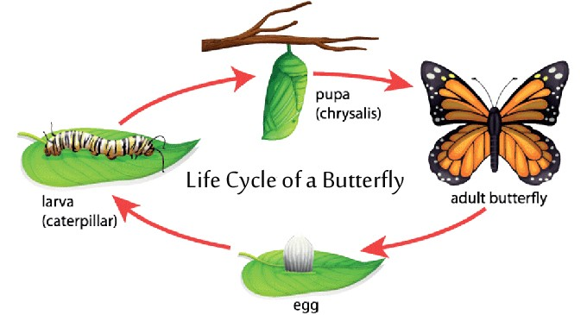
Why does the caterpillar need to shed its skin?
Tell me the name of another insect…
Where’s the butterfly?
What happens after the caterpillar comes out of the egg?
Notes:
When you have finished ranking these questions, you can move onto the next slide to see the answers.

Slide 8
4. Why does the caterpillar need to shed its skin?
2. Tell me the name of another insect…
1. Where’s the butterfly?
3. What happens after the caterpillar comes out of the egg?
Notes:
Post it notes – teachers to write questions on notes and stick in order.
1. Where’s the butterfly?
2. Tell me the name of another insect…
3. What happens after the caterpillar comes out of the egg?
4. Why does the caterpillar need to shed its skin?

Slide 9
Level One
(naming)
The language used at this level allows the child to directly match what they hear to what they see.
The child is able to respond to simple commands involving matching and is beginning to be able to name something they have seen or done in the immediate past.
Understanding of these questions typically develops at around 3 years of age.
Notes:
For this next part, we will be looking at the Blanks Levels individually and creating our own questions for a given picture. It will be helpful to have our copy of the Blanks Levels questions handy for this part.
This might be asking them to find a simple item, such as ‘where’s your nose?’, find something on an action, such as “Who is painting?”, or name an object, such as saying “What is this?” when pointing to a ball.
Often with level 1 questions, the child can respond by showing rather than speaking.

Slide 10
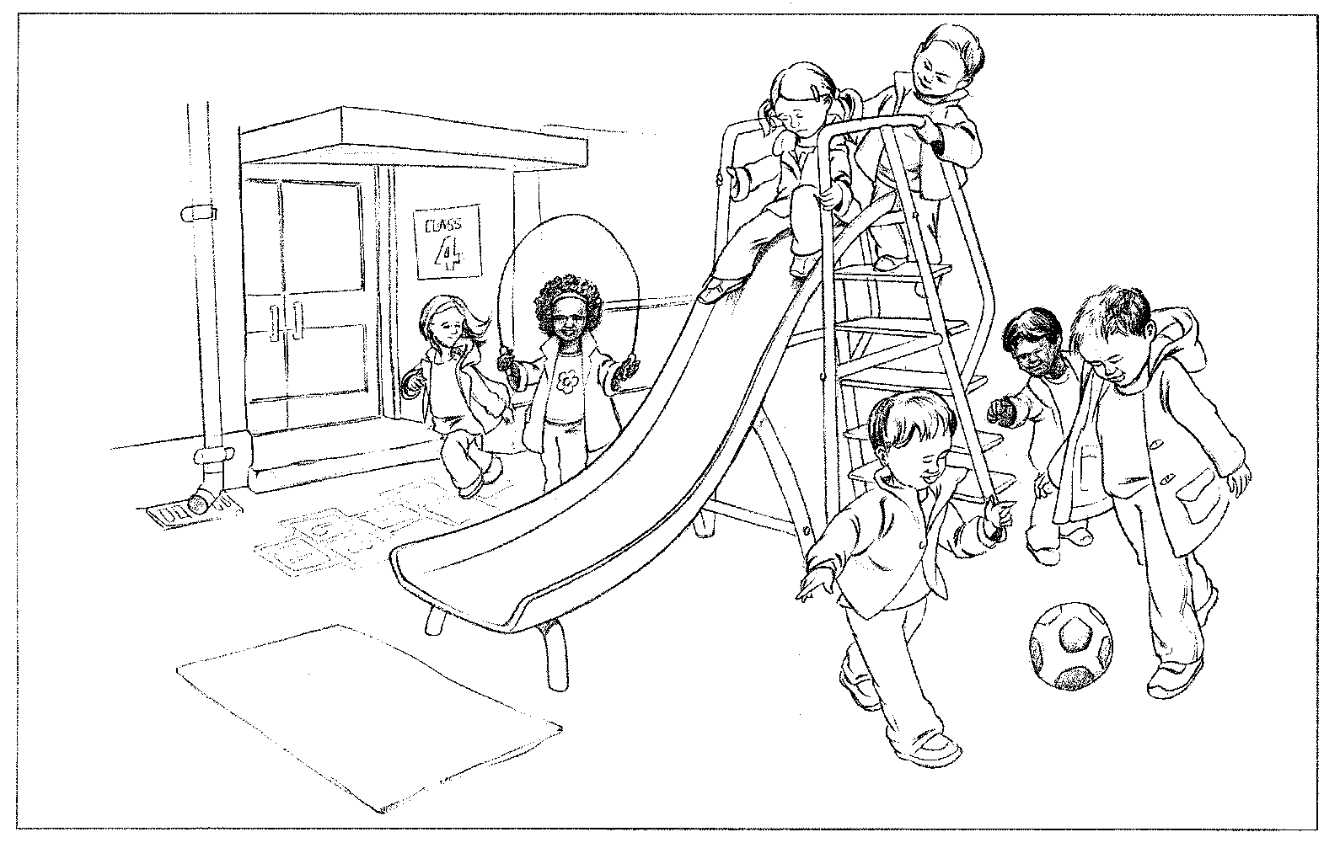
Who is skipping?
Where is the ball?
What is this?
Show me the slide
Point to the doors
Notes:
An example at level 1: where is the slide
Can you think of some other questions at this level? (look at the blanks handout to help)

Slide 11
Level Two
(describing)
At this level the child still needs to match what is in their immediate environment but they are moving away from the whole object and focussing more on selective attributes.
At this level a child is being introduced to both concrete and abstract concepts which will enable them to describe what they see and determine how things are similar and different. It is this descriptive language that helps a child understand simple stories or describe pictures.
Understanding of these questions typically develops at around 4 years of age. A child entering Reception will be working within this level.

Slide 12
What are the children doing?
Finish this sentence: “You go down the ________”
Look at the girl and boy. Where are the girl’s shoes?
What is happening in the picture?
Notes:
An example at level 2: what are the children doing?
Can you think of some other questions at this level?

Slide 13
Level Three
(retelling)
The child can re-tell an event or narrative, is beginning to empathise with characters, say what someone is thinking or feeling and make simple predictions. So they have a developing understanding of time and can discuss what they think words mean making semantic links between categories.
Understanding of these questions typically develops between 4.5 years of age. Children in Reception should be establishing these question types.
Notes:
ASD – for children with ASD this level is difficult for them > making generalisations about their own experiences is really difficult them and they need support to learn how to try and do this

Slide 14
What is the same about these two children?
What could he say?
How does the girl feel?
What does playtime mean?
What might happen next?
What else can children climb on?
Notes:
An example at level 3: how is the girl feeling?
Can you think of some other questions at this level?

Slide 15
Level Four
Justifying
At this level a child has to think about the relationships between objects, people, and events and give reasons as to why they are making a particular prediction.
Questions at this level include abstract and complex verbal problems
Understanding these questions typically develops between 4-6 years of age. By the end of year 1 children should be able to use this level of language.

Slide 16

How do you know the boys are happy?
Why should the boy be careful on the slide?
The girl is unhappy. What could you do? What could the girl do?
What is making the girl unhappy?
Notes:
An example at level 4: why should the boy be careful on the slide?
Can you think of some other questions at this level?

Slide 17
Supporting children in the classroom
Use the activities recommended in the speech and language therapy programmes
Other ideas:
Explicitly teach wh- questions. Start with “what” and “where”
When the child can answer “what” and “where” consistently, move on to “who” and “which”
“when” is an abstract concept and is therefore notoriously difficult
to teach, especially for children with language difficulties. Making it
meaningful to the child will help e.g. visual timetables including days of the week, today/tomorrow/yesterday and times of the day, linking months of the year to birthdays, Christmas, etc.
Notes:
What, where, who, which: Levels 1 and 2 depending on how they are used
When: level 3
Why: Level 4

Slide 18
Strategies to support understanding of questions
Point to the parts of the picture that you want the child to think about
Sentence completion e.g. “The children are wearing their coats because…”
Give forced alternatives e.g. “Are the children in the playground or the kitchen?”
Use the child’s own experience e.g. “How did you feel when…?” Then repeat the original question, “How does the girl feel?”
Use visual supports e.g. sequencing cards, pictures with speech bubbles
If the child does not understand repeat the question and
model the answer e.g. “Why did you join that with the stapler? You joined it with a stapler to make it stronger.”

Slide 19
What kind of questions do we ask children after a behavioural incident?
“What should you have done?”
“How do you think she feels?”
“Why did you do that?”
“What do you need to do now?”
“How would you like it if I did that to you?”
Children with low language levels will struggle to understand these questions
They don’t know how to answer these questions and can get into more trouble for not responding
Notes:
As promised, we are now going to think about how we can use the Blanks Levels for supporting behaviour.
When a behavioural incident has occurred, it often common to hear adults asking children the questions you can see on the screen. You may have noticed that many of the questions fall into our highest Blanks Level. They are therefore less likely to be understood by young children or children with language difficulties.
It is also worth noting that a child with processing difficulties or underlying needs may also find it difficult to understand these questions after a behaviour incident, even when they usually have an age-appropriate understanding of language. This is because children and adults can experience feelings of dysregulation when they have been involved in a behavioural incident. When you are dysregulated, your ability to process information decreases, making hit harder to understand complex questions.
When a child does not understand a question like this, they will often provide no response at all, or respond with more unwanted behaviour, which can result in them getting into further trouble.

Slide 20
Behaviour management
Level Two
Tell the child directly and clearly what happened and how their behaviour has affected others
Describe appropriate behaviours using short, simple sentences
Avoid asking questions about why they behaved as they did
Avoid negative statements, e.g. “don’t run” try “walk please” instead
Notes:
Here are some strategies that you can use to support a child with their behaviour at each Blanks Level.
For children who are 4 years of age or who consistently understand Blanks Level 2, you can…
it may be helpful to use comic strip conversations or role-play with puppets to give them a visual element that may be easier for them to process alongside the spoken language.
Remember that if the child is upset or angry, they may not understand as well as they would in calmer circumstances.
It’s important that they are not asked to justify their behaviour, instead, state the justification yourself, in other words, tell them why they should not have done something.
Use positively phrased instructions instead of negative…
This is because when we say phrases like ‘don’t run’, our emphasis tends to be on the word ‘run’. This will be the bit of information that a child will find easier to process and they are more likely to continue running than if they are given the information ‘walk’. It is particularly important to name the wanted behaviour for children with social communication difficulties since just because you tell the child to stop running, it doesn't mean that they knows what to do instead.
Encourage other members of staff in school to use similar strategies.

Slide 21
Level Three
Ask the child to describe what happened, what people said and how others felt
Using role play or comic strip conversations might help this
Avoid asking them to justify their behaviour
State the justification i.e. say why they should not have
done something
Notes:
it may be helpful to use comic strip conversations or role-play with puppets
School roof example - don’t climb on the school roof because you might fall and hurt yourself or someone else

Slide 22
Level Four
Ask level four questions but if the child does not understand repeat the question and model the answer
Remember:
If a child gets upset or angry, they may not understand as well as they could in calmer circumstances
Give extra processing time
If the language is too difficult, the child will not learn from the situation!
Notes:
When a child is upset it is particularly important to reflect carefully on the levels of language used and to check that the child has understood by asking him to explain the information in his own words, if he can, or by monitoring his behaviour

Slide 23

Thank you!
Further information can be found here: https://elklantraining.worldsecuresystems.com/5-11s/language-builders
Notes:
Thank you for listening to this training. We hope you’ve found it helpful and that you feel more confident in using the Blank’s Levels programmes with children in school. More information can be found by clicking the link on the screen, or please contact your link speech and language therapist if you have specific questions about a programme or child.

