Slide 1

Attention & Listening

Slide 2

Attention and Listening
Why is attention important?
Learning to focus their attention on to different things will support children with their learning.
Neurotypical children develop their attention skills before they learn to understand words and learn to talk,however neurodivergent children will have differences in how they develop attention and listening skills.
Attention and listening skills can support the development of language skills.
Leeds SLT Pack, 2022
Notes:
Children learn by watching and listening to what happens around them
If they don’t have good attention and listening skills, or if the environment they are in doesn’t give them the opportunities to make listening easy , it can be very hard for them to learn these skills
Children have to learn to focus their attention on to different things.
This usually starts with attending to people, then to objects, then being able to share their attention between people and objects.
Children can listen to and recognise their mother’s voice whilst they are in the womb
Listening while learning language involves being receptive to tone of voice, patterns in talking (familiar words/phrases), children begin to associate particular patterns of sounds and groups of sounds with specific objects = words = names for items, people and actions
Leads to the child understanding familiar words and phrases.
The more and diverse language a child hears, the more language they will understand, and the more language they will be able to use
Being given opportunities to listen to others around them will support them to develop listening and attention skills which in turn will help them understand words and the meaning of sentences
It is important that they can focus and listen to the whole of what has been said in order to follow instructions and understand what is happening in the environment around them
Children need to have good listening and attention skills so they can use what they understand in spoken language to communicate with others

Slide 3
Different Stages of Attention and Listening
Stage and age | What attention looks like
Stage 1 0-1 years | Very distractible
Stage 2 1-2 years | Attention is single channelled
Stage 3 2-3 years | Still single channelled
Stage 4 3-4 years | Single channelled but more easily controlled
Stage 5 4-5 years | Integrated attention for short time
Stage 6 5-6 years | Integrated attention is well controlled and sustained.
This is based on a neurotypically developing child. Every child will be different.
Based on Cooper, Moodley and Reynell,1978
Notes:
Stage 1 - Very distractible Can pay fleeting attention but any new event will distract. Language interferes with attention.
Stage 2 - Attention is single channelled. Will attend to own choice of activity, but will not tolerate intervention, particularly verbal. Language interferes with attention. Must ignore other stimuli in order to concentrate on chosen activity.
Stage 3 - Still single channelled. Will attend to adults’ choice of activity, but still difficult control. Child must stop play to attend to adults, must listen and then shift attention back to activity with adult help.
Stage 4 - Single channelled, but more easily controlled. Adult verbalisation of tasks helps. Can shift attention between task and adult.
Stage 5 – Integrated attention for short time. Attention span is still short. Child listens to instructions without interrupting activity to look at speaker. Child externalises language
Stage 6 – Integrated attention is well controlled and sustained. Child internalises language.

Slide 4
Neurodiversity affirming strategies to support attention and listening differences
Neurodiversity affirming strategies supports adults to recognise and respect neurological differences as natural variations in the brain. This approach then shifts the focus from ‘managing’ the child to supporting them to thrive as they are, which often means adapting the environment to support their needs. Different children will need supporting in a different way.
Behaviours that may be labelled as ‘disruptive’ are indicative of an unmet need e.g. need to investigate sensory/emotional or communication reasons. In the past a child may have been punished for fidgeting – now we know to support the child e.g. with frequent movement breaks or wobble cushion.
Neurotypical behaviours, don’t expect the child to comply, they may prefer reduced levels of eye contact and may prefer to be active when learning rather than sat still in a chair.
Environmental accommodation rather than expecting the child to filter out the distractions adapt the classroom e.g. quiet space/ ear defenders

Slide 5
Neurodiversity affirming strategies to support attention and listening differences cont……
Celebrate difference how does the child learn best? e.g. it may be a visual approach rather than verbal instructions
Self advocacy support the child to understand and communicate their own needs and model to the child e.g. “I feel fizzy” “I need to move”
Regulation should be prioritised , if a child needs to get up and move this should be prioritised over sustained attention.

Slide 6
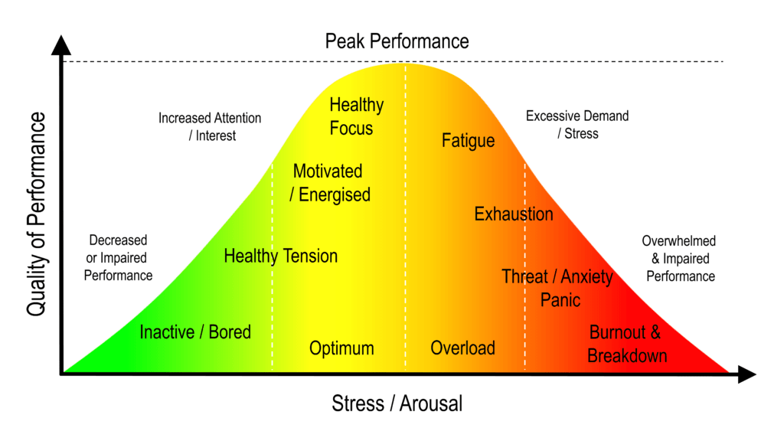
How to support regulation
Regulation is key for attention and listening.
  Children need to be in their optimal arousal zone to take in information and follow instructions. If a child is dysregulated, attention and listening is not the priority in that moment – regulation is.
When dysregulated, attention and listening drop.
  Hyperaroused children may appear impulsive, distracted, or reactive.
  Hypoaroused children may seem inattentive, drowsy, or zoned out.
Children fluctuate throughout the day.
  Stress, sensory input, hunger, tiredness, or excitement can shift a child out of the optimal zone.
Adults can help children return to the optimal zone.
  Through co-regulation strategies like movement, calming techniques, and emotional support.

Slide 7
Strategies to support attention
Reduce distractions by reducing background noise and turning off electronics.
Get down to the child’s level.
Say the child’s name first to get their attention.
Follow the child’s lead – focus on what interests them and join in their play. Children are more likely to engage in activities that interest them.
Reduce language and keep instructions short and simple.
Use visuals/objects to support the child’s understanding.
Use visual timetables in the classroom to support attention and listening as well as understanding of the daily routine.
Incorporate ‘Now and Next’ board to help the child know what they are doing next.
Use an animated tone of voice to engage children in the activities.
Use a countdown to signal the end of an activity e.g. 5,4,3,2,1...... 'finished' or use a sand timer (e.g. 5 min) may help the child to focus.
Notes:
Choose the strategies that you think will be useful for the child, you may need to try several strategies to see which ones are helpful, multiple strategies can be used at a time and should be used consistently throughout the day.

Slide 8




‘Ready, Steady, Go! Games
The child is encouraged to wait until you’ve said “go” before each turn. Increase the length of time (s)he has to wait for the word, “go”.
The child is encouraged to wait until you’ve said “go” .
Before each turn, increase the length of time they have to wait for the word, “go”.
Ideas to try:
Roll a ball/car between you and child.
Build a tower of bricks or stacking cups together and knock it over.
Child pinches the end of an inflated balloon and waits for “go” before they let go of the balloon.
Play with a click clack track/ garage. Child waits for “go” before sending the car down the chute/track.
Use shakers or drums. Child waits for you to say “go” before they can play the instrument.
Child waits for you to say “go” before they can run to pop the bubbles.

Slide 9

Take turns in simple games.
Increase the amount of time the child will sit to take turns.
Ideas to try
Take turns to……
add a brick to a tower.
put a piece in a jigsaw.
post pictures in a post-box.
roll a ball to each other.

Slide 10

Hide and Seek
Ideas to try
Hide things that make a noise (e.g. a wind-up toy, musical box). See if child can find the toy by listening to the sound.
Hide behind a chair and make a sound such as a giggle. See if child can find you.
Fill yoghurt pots with different things, e.g. rice, bells, shake them and listen to the different sounds. If you have two the same, play a game at finding the ones that have the same sound.

Slide 11

Action songs and rhymes
Ideas to try
Sing songs together such as “Wind the Bobbin Up” or “The Wheels on the Bus” and encourage child to join in and copy the actions.
Leave pauses in the song so that child has a chance to fill in the gaps.
Use a wooden spoon to bang different surfaces, for example, the bottom of a plastic mixing bowl, bottom of a pan, the floor, a metal table leg. Listen to the different sounds. Bang along to the rhythm of the song.

Slide 12

Play listening games
Ideas to try
Use sound lotto games. You can download applications on some mobile phones, look on the internet or you could buy/make one. Play the sounds and see if the child can point to the picture that matches the sound.
Make noises with rattles, keys, instruments and see if the child turns to the noise.
Go for a Listening Walk- talk about all the sounds you can hear, such as birds singing, cars brrruming, people chattering, phones ringing.
Use musical instruments. See if the child can copy the number of beats or shakes.
Play ‘Musical Bumps’- dance to the music then bump to the floor when the music stops.

Slide 13
More games
Ideas to try
Stories - look at books together and encourage the child to sit and listen and join in with their favourite parts of the story.
Play “Simon says….” Encourage the child to listen to the instruction before carrying out the action, for example, clap your hands, touch your nose, stamp your feet.
Play musical statues - the child listens for when the music stops and then stops dancing.

Slide 14
Links
Activity ideas - Microsoft Word - Attention and Listening Games.docx
Group activities - ECATbookletLeicestershireCC.pdf
Activities for older children - Activities to Build Attention and Listening Skills in Older Children - Alder Hey Children's Hospital Trust
Strategies - How to support with attention, activity, emotions and behaviour | Children Young People and Families Online Resource
Strategies - Paying attention - hints and tips - Children and Family Health Devon

Slide 15
References
Attention stages - Cooper, Moodley and Reynell,1978
SEND Code of Practice 2015 – Reasonable adjustments
Leeds Community Healthcare (activity ideas)
The National Autistic Society. (2025, September 24). Embracing neurodiversity affirmative practice. Embracing neurodiversity affirmative practice: A path to inclusive support for autistic people
TrueNorth Psychology. (n.d.). Neurodiversity affirming therapeutic practice. Retrieved October 8, 2025, from https://www.truenorthpsychology.com.au/neurodiversity-affirming-therapeutic-practice/.

