Slide 1


Children's Grief Awareness Week
Children and Family Health Devon
18 November 2025
childrenandfamilyhealthdevon.nhs.uk

Slide 2

About CFHD
Children and Family Health Devon (CFHD) is part of the NHS and provides integrated care and treatment across physical and mental health for children, young people and their families in Devon.
Our mission
Our vision is to be a successful, vibrant, partnership that benefits the communities we serve. We are working together to improve outcomes for children and young people in Devon.
Who we are
We are an alliance of local NHS organisations led by Torbay and South Devon NHS Foundation Trust in partnership with Devon Partnership Trust.
We are a multidisciplinary group of professionals such as psychologists, psychiatrists, occupational therapists, speech and language therapists, physiotherapists, nurses, administrative support and many other professions.

Slide 3
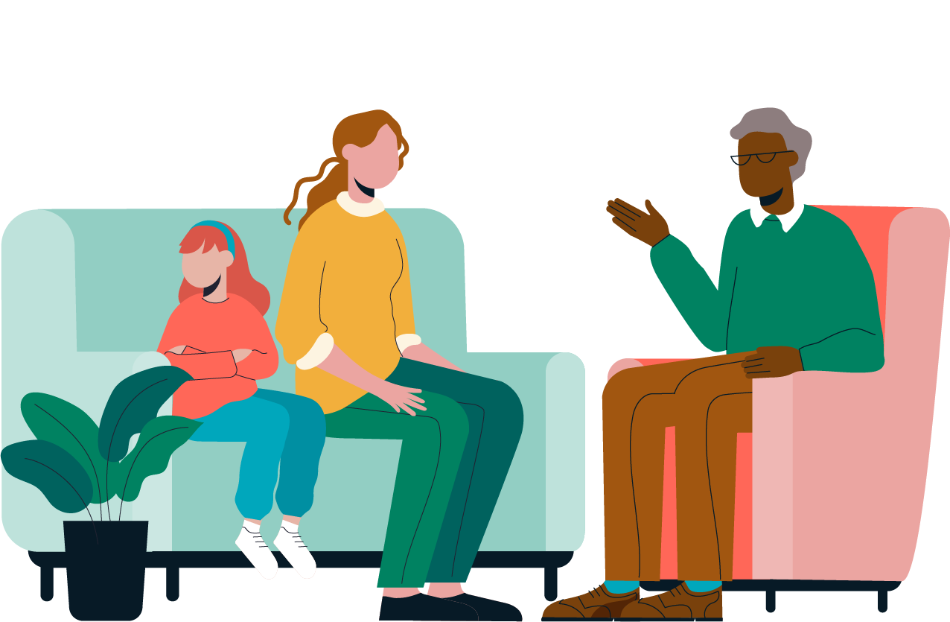
What is grief?
Grief is the emotional response to loss, encompassing a range of feelings which may include sadness, anger, confusion, and longing.
Grief is not just one feeling, but many layers — shaped by time, experience, and connection.
Every child experiences grief in their own way — and for children and young people with learning disabilities, that experience can often be misunderstood or overlooked.
Grief is an integral part of your being. In the words of Lois Tonkin, we can learn to grow around our grief, much like a tree that adapts to its surroundings. This process involves embracing grief as a part of ourselves, allowing it to influence our growth and shape our identity over time.

Slide 4
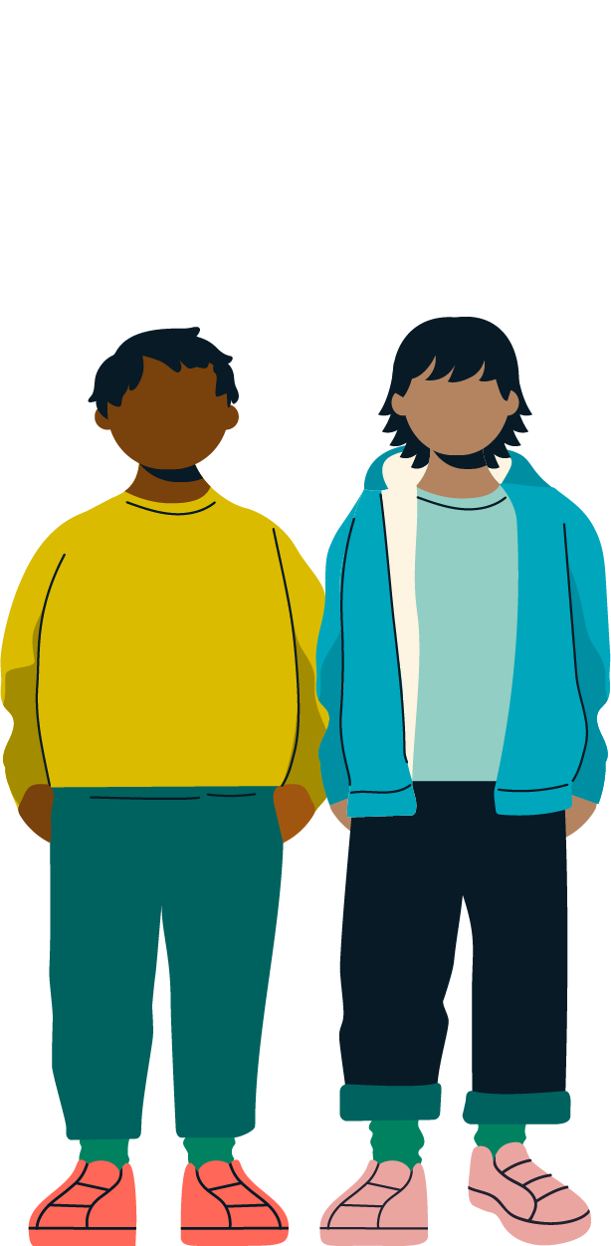
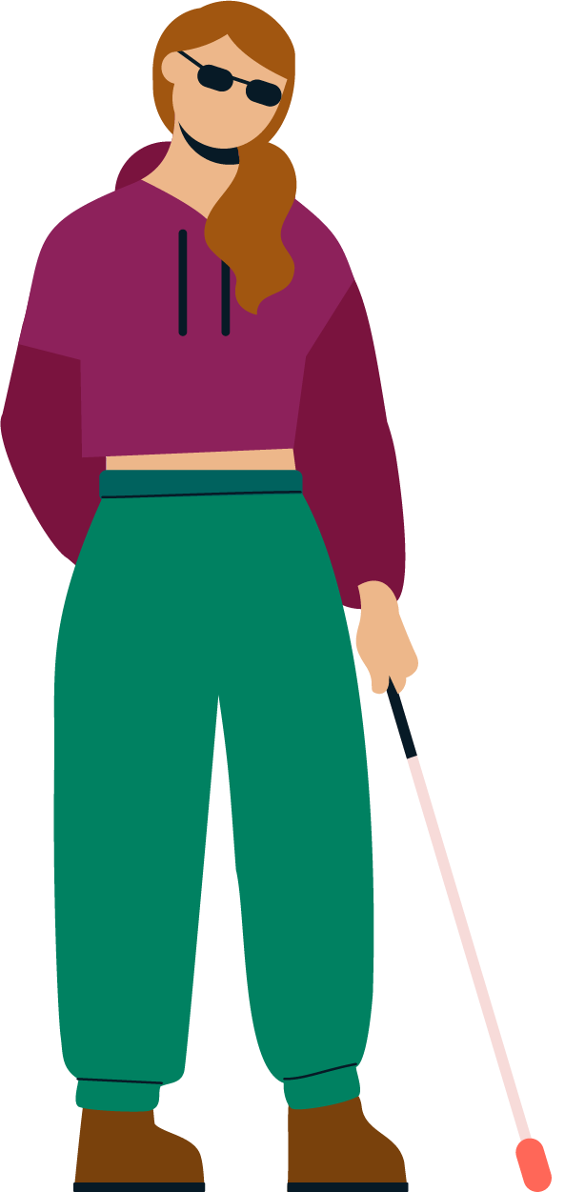
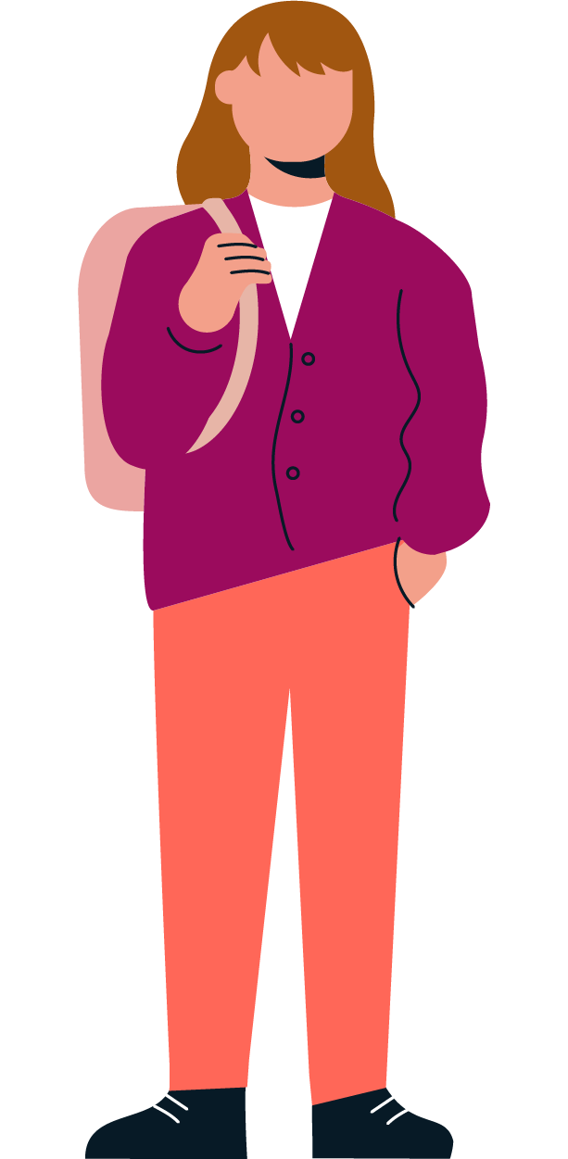
What is grief?
Grief is a balance between remembering the loss and rebuilding / restoration — keeping safe emotional connections (“continuing bonds”) while finding ways to move forward.
There may be changes in how the child or young person is feeling, together with possibly physical or behavioural changes.
A child’s grief process can be influenced by many factors, including:
A history of previous losses
The relationship or emotional connection to what has been changed or lost
Secondary losses (changes that happen because of the main loss)
The people and environment around the child
Family, community, and wider culture
What is grief? An animation from Child Bereavement UK

Slide 5
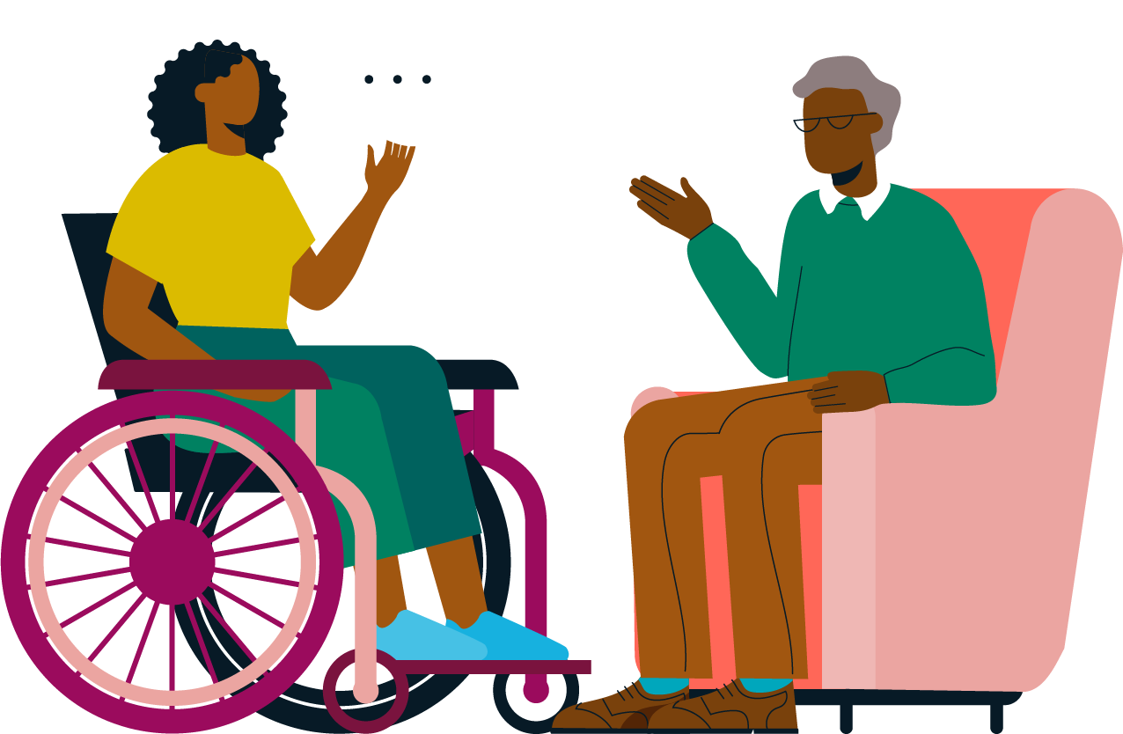
How we can support

Slide 6
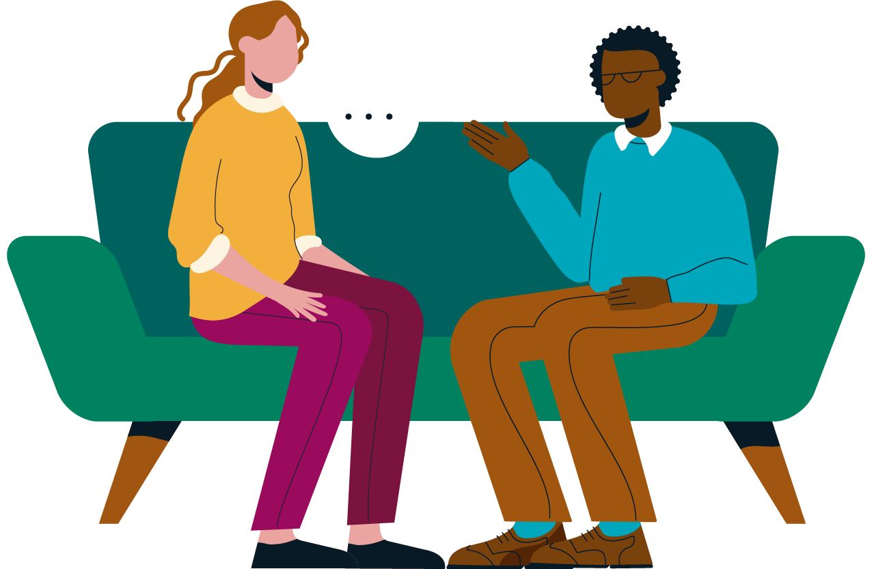
Specialist Learning Disability pathway
A compassionate, accessible approach to grief support for children and young people with moderate to profound learning disabilities, addressing both anticipatory and post-loss experiences.
Provide compassionate support to children with learning disabilities who are experiencing life-threatening and life-limiting conditions.
To create safe, understanding spaces where children with a learning disability can express and make sense of their emotions, through the ways that feel right for them at their own pace, in their own way.
Help families navigate practical aspects of grief, such as funeral arrangements or memorial services
Offer grief support through sensory based meaningful activities. We adapt resources and pace to match each child’s communication style and sensory needs, helping them feel secure and connected.
Connect families with support groups and community resources for ongoing help
Support schools, respite and the wider team - including guidance and support during transitions, such as changes in care or school environments following a loss.
In house grief and bereavement awareness training for staff.

Slide 7
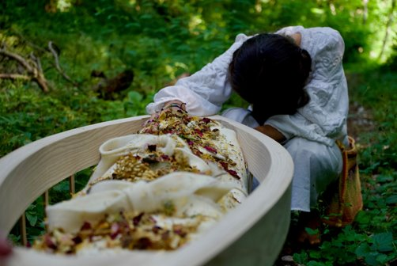
Community Children’s Nursing pathway
Community Children's Nurses:
Support children with life threatening and life limiting conditions to remain in their own home and avoid unnecessary hospital admission​
Support end of life planning and symptom management 24/7
Co-ordinate multidisciplinary working to facilitate palliative and end-of-life care delivery ​
Joint working to optimise seamless care for the family​
Out of hours service to provide home end of life care enabling choice in place of care
Support with care after death
Provide bereavement support for the child, parents and siblings
Support care staff in schools, respite and other settings with bereavement

Slide 8
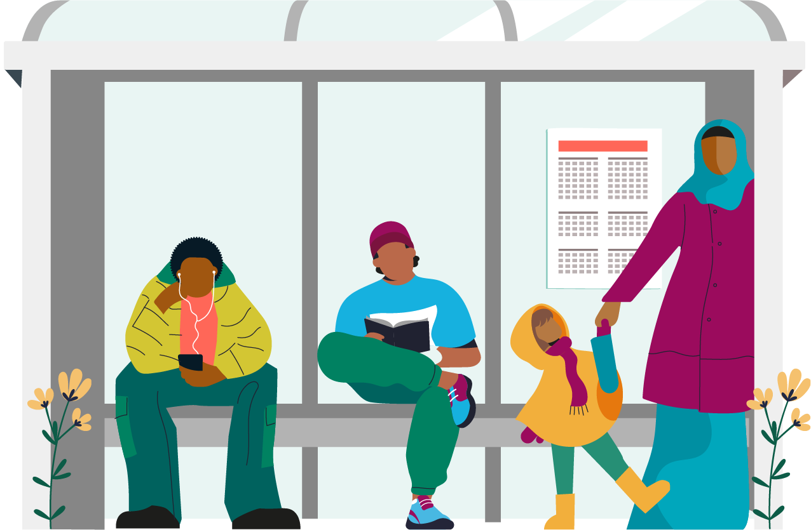
Ongoing support from CFHD pathways
By creating inclusive spaces, we help children and families feel seen, heard, and supported.
We aim to support them not only as they process grief, but also to grow in confidence, strength, hope, and connection. To have the knowledge that they are not alone.

Slide 9
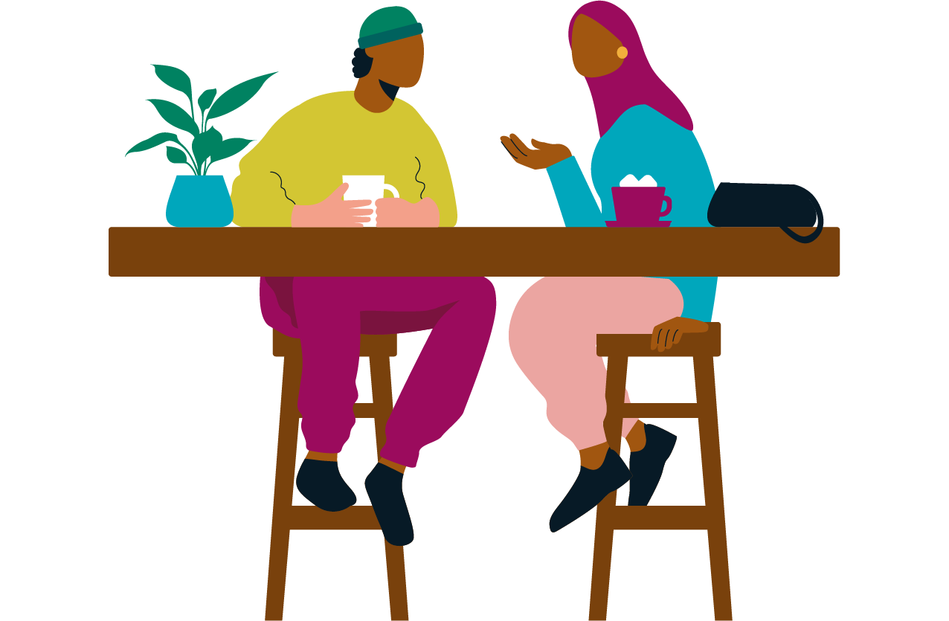
Signposting
National and Local Child Bereavement Charities
Child Bereavement UK- Child Bereavement UK
Winston’s Wish
(Child Bereavement UK and Winston's Wish are merging, with the combined organisation to be named Child Bereavement UK)
The Compassionate Friends (TCF)
Care for the family- www.careforthefamily.org.uk
To search for more support options- AtaLoss.org: UK wide bereavement signposting and information website | Find Support Now
Child Bereavement Charities Devon
Balloons (Exeter, East and Mid Devon)
Children in Grief (South Devon)
Families in Grief (North Devon)
Jeremiah’s Journey (Plymouth and the immediate surrounding area of Devon)
BackPocketTeacher (Sarah Helton) - consultancy, training, resources and support for those working with bereaved and grieving children and adults with learning disabilities/SEND.

Slide 10
Selected Publications for Supporting Grief & Bereavement
A Special Kind of Grief by Sarah Helton — The Complete Guide for Supporting Bereavement and Loss in Special Schools (and Other SEND Settings). Jessica Kingsley Publishers - USA+1
A Jumble of Knotted Thoughts by Sarah Helton — A sensory story to support bereavement and loss. Good Grief+1
Muddles, Puddles and Sunshine by Winston’s Wish — An activity book offering practical and sensitive support for bereaved younger children. Winston's Wish+1
A Child’s Grief: Supporting a child when someone in their family has died — Publication from Winston’s Wish. Winston's Wish
We All Grieve: Supporting Bereaved Children Who Have Special Educational Needs/Disabilities — Publication from Winston’s Wish. Winston's Wish
As Big As It Gets: Supporting a child when someone close to them is seriously ill — Publication from Winston’s Wish. Winston's Wish
Then, Now and Always: Supporting Children as They Journey Through Grief – A Guide for Practitioners by Julie A. Stokes
Grief in Children: A Handbook for Adults by Atle Dyregov
The Invisible String by Patrice Karst

Slide 11
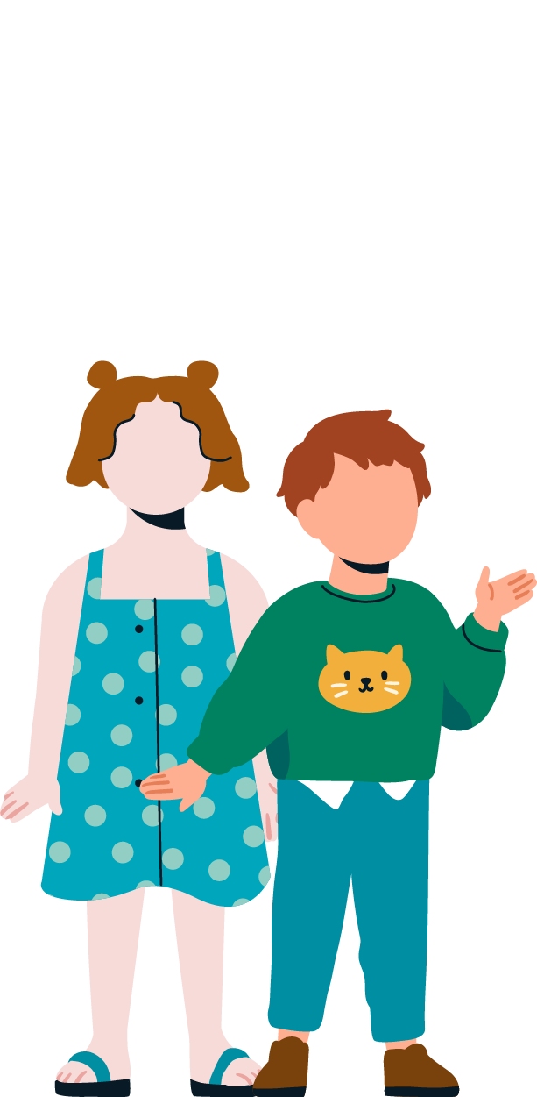
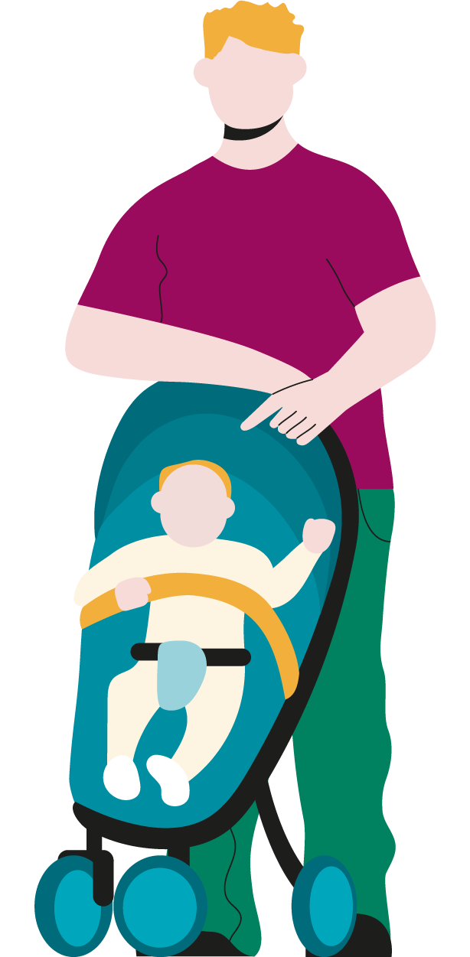

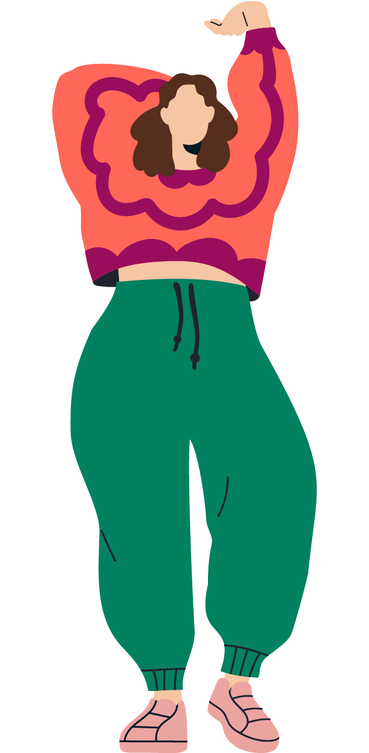
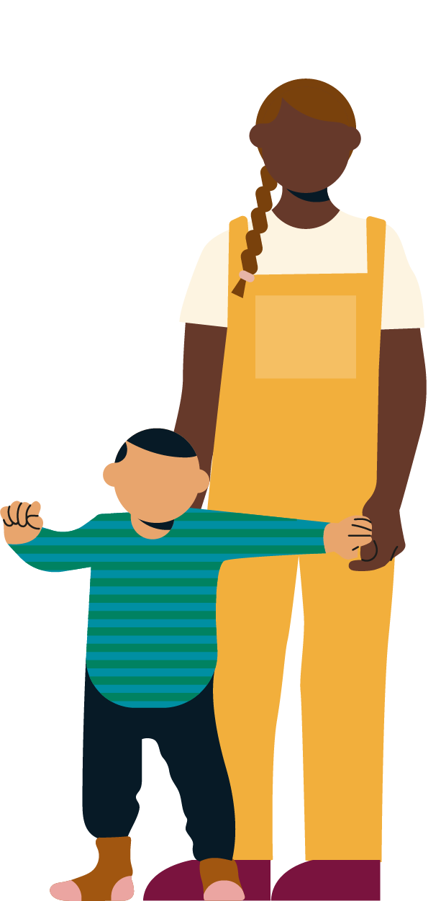


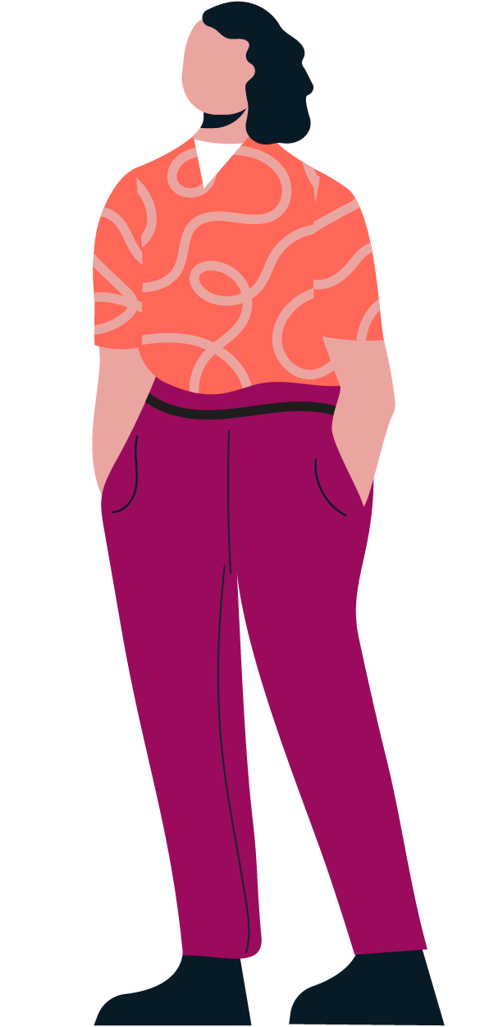


Thank you
Any questions

