Slide 1
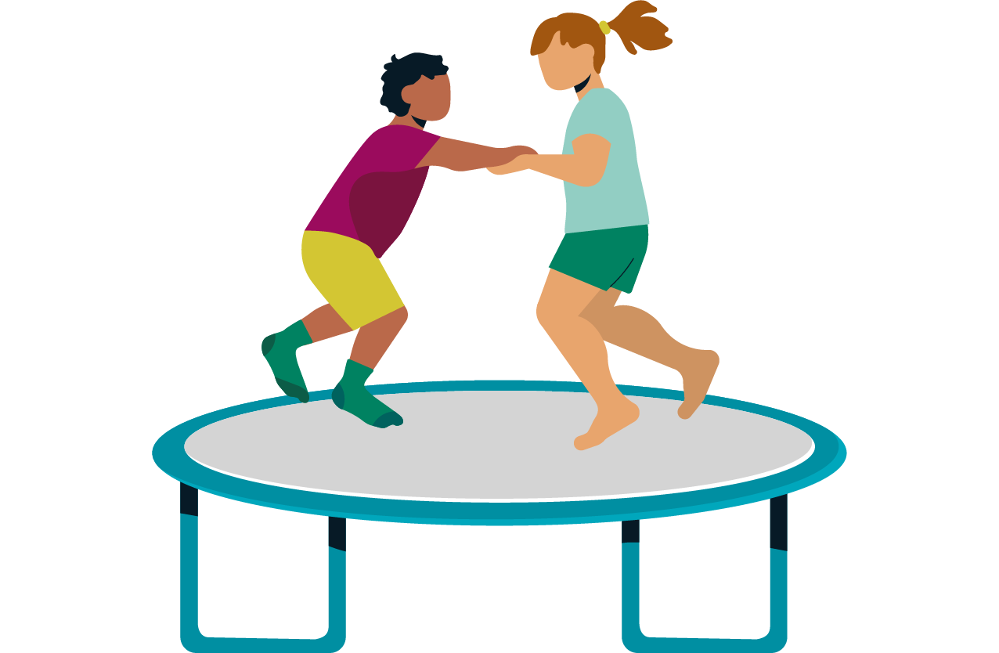
Speech Language and Communication Pathway (SLC)
Notes:
Hello and welcome. Thank you for joining me for the Speech Language and Communication Pathway Update – with a focus on providing some information regarding the roll out of the link therapist model and what this means for you , your setting, your team and the children and families within your settings.

Slide 2
Notes:
Here is an overview of the children that we see within the SLC pathway - go through slide

Slide 3
What is Speech Language and Communication ?
Notes:
So what do we mean by speech language and communication?
In the next slide we will just review the terminology

Slide 4
Speech
Language
Communication
Sounds used to build up words
Saying sounds accurately and in the right places
Speaking fluently.
Speaking with expression and a clear voice, using pitch, volume and intonation to support meaning
Understanding words (vocabulary) and their meaning
Knowing how words go together to form phrases and sentences
Understanding and using grammar
Joining sentences together
Using higher level skills such as reasoning, inference
Expressive language- Having words to describe objects, actions and attributes, using these words to build up sentences, using these sentences to build up conversations and narratives, following the rules of grammar, so that things make sense
Receptive language - Processing and making sense of what people say, understanding words being spoken, understanding the rules of grammar used
The way in which language is used to interact with others
Using language in different ways; to question, clarify, describe and debate
Using non-verbal rules of communication: listening, looking, knowing how to take verbal turns and how to change language use to suit the situation
The ability to take into account other people’s perspectives, intentions and wider context
Notes:
Read slide

Slide 5
Current position
Notes:
As you are probably aware CFHD operate a pathways of care model with the speech language and communication pathway being one of those pathways
As with all the CFHD pathways the speech language and communication pathway is currently modelled using the I thrive framework – which consists of 4 quadrants
Getting advice – so supporting families to access universal signposting advice through our website and more specialist websites, visiting their local family hubs or talking to the settings/G.P or health teams
Getting help – this is accessing more targeted support such as training, videos available of our website or signposting families to local groups running in their areas
Getting more Help - at this level the children will be sitting within the SLC pathway – they will also have received all the information at the getting advice and getting help level but at this level the child and family are seen to need a more specialist level of service through assessment and intervention from the speech and language therapy team
Getting risk support – at this level families are supported - if required to get support from services such as safeguarding or mental heath services where we will work in collaboration to holistically support the family during this period of need

Slide 6
So What’s New?
https://www.thebalancedsystem.org
Notes:
However – things are changing
Cfhd SLT’s have been working closely with Better Communication CIC to deliver services that align with the Balanced system Principles
The Balanced System is a framework for organizing and delivering support for children's speech, language, and communication needs (SLCN) within a local area.
The balanced system has been devised by a speech and language therapist and the balanced system CIC are a team of speech and language therapists who believe passionately that services should be delivered to cyp and families according to 15 main principle and these 15 principles fall within 5 strands
read 5 strands
It is important to say at this point that although SLT are key to instigating this change it is a system wide change that requires all partner agencies to be on board in order for this to be successful
It is also important to say that even though the model has been devised by a speech and language therapist it is a model that works for all services working with children from OT, physios and education services including local authority services

Slide 7
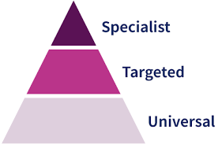
© The Balanced System 2025
Notes:
With the 5 strands there are 3 levels and these are universal targeted and specialist. The purpose of the system is to ensure that children and families received the right support at the universal and targeted levels to reduce the number of families needing serves at the specialist level

Slide 8
© The Balanced System 2025
Notes:
And to tie all this up there are 5 main core delivery principles
Firstly measurements are taken not solely through numbers –but through the impact that the support has had on the families receiving it
Secondly that access to services and support is easy – so families can ask the appropriate professional for help not have to sit on a waiting list for their turn to see one
Thirdly - that services are sitting within the communities that need them and that support is given in the places that the children occupy, such as schools nurseries and family hubs
Fourthly – Targeted support is crucial if we are to avoid the vortex that is pictured here on the side of the screen where families get offered lots if lovely universal support and then get sucked up straight into specialist services bypassing the targeted support
And lastly – that high quality information and resources are available to families right across the system

Slide 9
What does this mean for the Pathway ?
Early identification: Children and young people’s needs are identified early throughout the age ranges not only early in life but also early in emergence of need at any age. Parents, carers and professionals are supported to identify when a need arises and access services in a timely manner
Appropriate assessment: Assessment through an enquiry-based process rather than through delivering a battery of assessments in isolation and out of context only. The child or young person is assessed in the context where the need arises and is carried out in consultation with the child or young person; their family and school.
Easy access drop- ins /Place based Link Therapist: Therapists are geographically linked to schools, settings or a cluster of setting. They work with the school team and consult with them regularly to identify and support the broad range of needs across universal, targeted and specialist levels.
As this is a system wide change the work is being co-produced with parent groups education, early years settings, social care etc to meet the needs of CYP.
Notes:
So with all that in mind what does that mean for the SLaC pathway ?
We have identified our 3 key priorities which in turn will strengthen our targeted offer
We aim to do this by identifying needs earlier – so that read slide
And providing appropriate assessment - so our read slide
For easy access There are 2 main workstreams through which we have chosen to do this and this is through
Easy access drop ins – the purpose of the easy access drop ins is for families to be able to come to a community venue and get support and advice regarding their child's communication needs without the need for a referral .
And link therapist model – where there is a named key therapist whose time is allocated and protected for their schools and settings and who will work alongside the school or setting as part of their team team
As this is a system wide change the work is being co produced with parent groups, education, early years settings social care etc to ensure that we are meeting the needs of the CYP and their families

Slide 10
Link Therapist Model - Principles
* Link therapist – meaning a school or setting based key therapist whose time is consolidated into their schools and settings and who work regularly as part of the school or setting team
* Support is delivered in the most functionally appropriate and relevant place for the child or young person, their development and learning.
* Resources are allocated based on need – differential in either or both the nature of the offer or the volume of the offer based on evidence of need
* Intervention focused on functional outcomes – the therapeutic offer must be focused on functional, ideally child and family or young person led, outcomes
Notes:
So what is a link therapist?
A Link Therapist is a designated speech and language therapist who works closely with a school or setting to identify, assess, and support children with SLCN. The link therapist acts as a point of contact for the school and helps to implement the Balanced System approach, which emphasizes place-based support and a continuum of provision from universal to specialist levels.

Slide 11
The role of the Link Therapist
Relationship Building:
A link therapist builds a strong relationship with a school or setting, becoming familiar with the staff and the specific needs of the children.
Needs Identification:
They work with the school team to identify children who may need support with their speech, language, or communication.
Support Implementation:
The link therapist helps to implement the Balanced System framework within the school, ensuring that appropriate interventions are in place.
.
Notes:
Over the next 2 slides we will out line the main role if the link therapist

Slide 12
The role of the Link Therapist
Resource and Training:
They may provide training and support to school staff on how to identify and support children with Speech Language and Communication Needs (SLCN).
Collaboration:
They collaborate with other professionals, such as Special Educational Needs Coordinators (SENCOs) to ensure a coordinated approach to support.
Functional Outcomes:
The link therapist focuses on supporting children to achieve functional outcomes that will help them in their learning and social interactions

Slide 13
So what are the benefits of a Link Therapist ?
•Improved Outcomes:
By providing targeted support at the right time and place, the link therapist model aims to improve outcomes for all children with SLCN.
•Early Intervention:
It facilitates early identification and intervention, which can be crucial for preventing long-term difficulties.
•Empowered Staff:
The model empowers school staff to better understand and support children's communication needs.
•Effective Use of Resources:
By taking a systematic approach, the framework helps to ensure that resources are used effectively to meet the needs of all children.

Slide 14
What might this look like?
Notes:
Here we have a real life example of how the link therapist model has worked for a child in a school in Worcester who have been operating the balanced system for some time

Slide 15
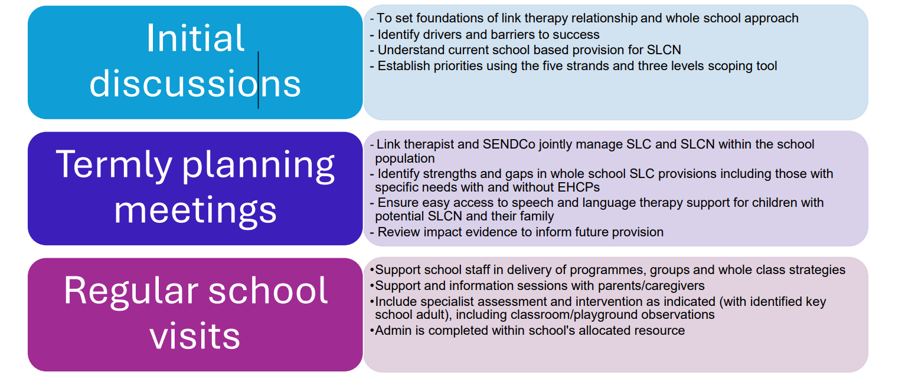
What will we receive from our Link Therapist? https://youtu.be/E_zc3w31urw
Notes:
Your school will have been allocated time each term that your link therapist is available to your school
For more information on how these were allocated
The 3 main strands of support you will receive will be based around
an initial discussion the purpose of this discussion will be to
A new menu of support will be available for you to select activities from based on your school priorities- this will allow you to personalise the offer you receive from us
All of the offers available from us will focus on supporting you and the children in ur school on the 5 strands and 3 levels of the balanced system framework

Slide 16
Timeframes for Implementation
Link Therapist
Torbay, South and West – September 2025
North Devon –January 2026
Exeter, East and Mid Devon –January 2026

Slide 17
What happens next?
Two Q&A sessions have been planned in September 2025 to give you the opportunity to ask and questions
A letter will be sent to schools to introduce your link therapist when implementation in your area occurs.
Your link therapist will be in touch with you to plan your initial conversation and share the menu of options with you

Slide 18
Thank you
Thank you for watching this session and we look forward to working with you to make the Balanced System a success

