Slide 1
Vocabulary Development Supporting School Age Children
Presented by
Children and Family Health Devon
Speech & Language Therapy Team
Notes:
This is a training video for all staff on how to support the vocabulary development of school age children and is particularly relevant for children who have developmental language disorder

Slide 2
Overview
The development of communication
How we learn new words
Why do children have vocabulary difficulties?
Impact of vocabulary difficulties
How to support vocabulary learning through direct intervention
How to support vocabulary learning in the classroom
Notes:
Read out each item
We know that Teaching staff are very experienced at teaching vocabulary and classrooms are vocabulary rich environments.
For most children they absorb vocabulary easily
Children with language difficulties find this much harder. They find it difficult to learn, retain and recall words. They require a different approach to learning vocabulary.
Speech and Language Therapists can therefore work with school staff to support these children.

Slide 3
Communication Development Pyramid
talking
play
attention and listening
understanding of language
speech sounds
Notes:
To put vocabulary learning into context:
We will briefly look at the core skills of communication and how these typically develop.
Take a few moments to think about children who are beginning to learn to talk and the foundation skills they build on, working up from the bottom to the top
Think about where the words above fit into this pyramid then we will review this on the next slide

Slide 4
Communication Development Pyramid
speech sounds
talking
understanding of language
play
attention and listening
Notes:
Each layer of the pyramid builds on the one before though none of them function fully independently.
Understanding of language can also be referred to as receptive language
And talking is also known as expressive language or spoken language
We will consider vocabulary development in these two areas: understanding of vocabulary and use of vocabulary

Slide 5
Stages of Learning New Vocabulary
I am really familiar with that word. I know what means, can define it and use it in my talking and writing
Heard it but don’t really know what it means
Some idea of what it means, get the gist when I hear it but don’t really use it
I pretty much know what it means and might try it out in my talking
I am familiar with it and can use it without thinking in my talking
Never heard of it
Notes:
We will now consider the stages of learning new words.
Have a think about the following words. Where would you put them based on your own vocabulary knowledge?
Surreptitious – kept secret, especially because it would not be approved of
Fricassee - A dish of stewed or fried pieces of meat served in a thick white sauce.
Tyranny – Cruel and oppressive government or rule
Sensitive - Quick to detect or respond to slight changes, signals, or influences; (Of a person or a person’s behavior) having or displaying a quick and delicate appreciation of others' feelings:
You may find that you place these words in different positions on this scale depending on how familiar you are with each word

Slide 6
Typical Vocabulary Development (References: ICAN; ICS School Age Resource Pack, Templin, 1957; Clark, 2003; Miller and Gildea, 1987)
AGE | Expressive Vocabulary Words the child says | Receptive Vocabulary Words the child understands
1 year | Child may begin to say a few words | Will understand more words than they can say
18 months | 50 words (approximately) | 200 + (approximately)
5-6 (Year 1) | 3,000 – 5,000 (approximately) | 14, 000 by age 6 years (approximately)
A typically developing school age child may learn around 3,000 new words per year Word learning continues throughout our lifespan
Notes:
It is useful to consider what is typical vocabulary development in children.
There are variations in the literature as to exact timings for each stage.
at around 18 months we might expect a child to have an expressive vocabulary (To be Using) about 50 words.
Although they will be able to understand many more words than they are using: with a receptive vocabulary of 4-5 times that figure: approximately e.g. 200 +
Typically developing children tend to become increasingly proficient at learning new words so that by 6 years it is estimated that a child will have approximately 14,000 words that they understand

Slide 7
How we learn words
Words are learned through experience and within context
We build up a store of words based on:
The sounds in the word (phonology)
The meaning of the word (semantics)
Make a connection between the two
Notes:
We cannot learn words in isolation. Words are developed over a lifetime of experience and are learned in context.
New vocabulary learning is built upon words we already know
We build up a store of words based on the sounds in the word (phonology) and the meaning of the words (semantics)
There is an importance of making lots of ‘pathways’ to words and between words to support a strong vocabulary and easy retrieval

Slide 8
Why do Children Have Vocabulary Difficulties?
Receptive language difficulty – poor understanding of words/smaller vocabulary
Expressive language difficulty –limited spoken vocabulary/ word finding difficulty
Developmental Language Disorder (DLD)
Hearing Difficulty
Attention and Listening Difficulty
Autistic Spectrum Disorder
Auditory Processing Disorder
Lack of Exposure
General Developmental Delay
Notes:
Children may have a limited receptive or expressive vocabulary and or word finding difficulties due to a range of reasons including the following:

Slide 9
The child with receptive language (including vocabulary) difficulties may:
Not follow instructions correctly
Look puzzled or appear to ignore you
Copy words or phrases rather than generating their own
Watch and copy what other children are doing
Find activities which rely on listening to language difficult to cope with
Have good mechanical reading but lack true understanding e.g. can read a book by rote but cannot answer questions about what they have read
Have difficulty remembering information
Use strategies to cover up difficulties understanding e.g. changing the subject or watching the speaker’s face to guess the answer
Notes:
Read out each item
Children who are quiet and compliant and who use strategies to cover up their difficulties can easily be missed

Slide 10
Word–Finding Difficulties
Children may:
Use non-specific terms e.g. ‘this’, ‘that’, ‘thing’ etc
Have a disrupted flow of speech
Have inaccurate productions of the target word
Use a description instead of the target word
Say they can’t remember a word
Show signs of frustration
Notes:
Children with Word finding difficulties can KNOW a word, but cannot retrieve it easily. This results in the ‘tip of the tongue’ feeling that we all get from time to time. For some children, this happens all the time and can be very frustrating, tiring and can have a big impact on how well the child can express themselves.
Then go through slide:
Disrupted flow - due to hesitations, backtracking, repetitions and circumlocutions (where the child talks all the way round a target word because they can’t remember it)
Inaccurate productions – e.g. saying a word with a similar sound e.g. ‘cloud’ for ‘clown’ or saying a word with a similar meaning e.g. ‘knife for ‘scissors’
Description - e.g. ‘temperature thing’ for thermometer
Children may present with a combination of receptive, expressive vocabulary and word-finding difficulties. The support for these difficulties is the same.

Slide 11
Impact of Vocabulary Difficulties
Ability to get their needs met
Ability to share information
Social interaction
Family relationships
Peer relationships
Emotions
Behaviour
Confidence / Self esteem
Educational progress - Access to the curriculum, following instructions, understanding stories, understanding new concepts, reading comprehension, demonstrating their knowledge, sharing news, telling and re- telling stories
Life outcomes
Notes:
Having a good vocabulary is essential for every aspect of our lives: for understanding the world, interacting with others, understanding and expressing our emotions and learning. Vocabulary difficulties can therefore have a negative impact on all these areas.

Slide 12
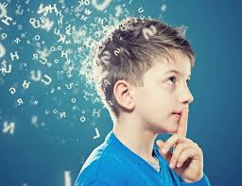
How to support vocabulary learning
Direct Teaching
Which words?
When?
Teaching word learning strategies
How?
Notes:
Learning vocabulary is not restricted to the classroom but happens all the time
Children learn words more easily when they have meaning to them, related to their own experience
Stress the importance of regularly reading TO children from an early age and beyond so that they are exposed to a rich vocabulary (wider than they are able to read themselves) within a context that is brought to life
We will cover how to involve families in vocabulary teaching later on
Children with language difficulties, especially those with DLD, do not learn through exposure to vocabulary alone and will need direct teaching of vocabulary. This can be very effective, however, it is also time consuming and it is not possible to teach every word.
Words therefore need to be selected carefully – so they are most useful and transferrable for the child
We will cover ways in which to do this in the following slides
Consideration also needs to be given to WHEN children are taught?
Small group, pre-teaching vocabulary sessions can be very effective
However,
There is the danger that children will miss important learning if they are regularly taken out of lessons.
There is no perfect solution to this:
However, the intervention session will have to have more benefit than disadvantage to the child for it to make a difference
Consider, varying the time of the day so they do not miss the same lesson
Do not take children out of lessons that they enjoy, that they are good at, or during breaks or lunchtimes
Keep sessions short and concise
Include as much repetition of the word as possible during direct teaching and in the classroom: in isolation and in sentences
Ensure that vocabulary learning is embedded within the classroom to aid generalisation, retention and so all children benefit
Utilise all the senses – to help the words stick! Touch, taste (where appropriate!), smelling, seeing, hearing, doing!! Can you bring the words to life?
This is easier with concrete vocabulary (umbrella, skipping, soft), however becomes more challenging with more abstract vocabulary (guilt, complicated, reluctance): but therefore more important to make these words more concrete through examples., pictures etc.
More important than direct teaching is teaching children HOW to learn words so they can learn future words independently
Teach children how to build up a good ‘picture’ of a word (we will cover this in following slides)
Encourage children to be curious about words by modelling this yourself (model how to ask what words mean, talk about your favourite word, talk about how you like how a word sounds, share the joy of rhyming words, include quick word games in the classroom e.g. I start with ‘fl’ and I can be played like this and I rhyme with ‘foot’: flute.

Slide 13
Which words should we teach?
Tier 3
SPECIALISED
Low Frequency
Topic Specific
Tier 3 :, photosynthesis, peninsular; molecule
DESCRIBING
Abstract words
Cross curricular
Often descriptive
Adjectives, adverbs,
Vocabulary of time.
Can usually be explained using easier and more familiar words
Tier 2
Tier 2 : centre; reluctant; vertical; protect; usually
Tier 1
BASIC
High frequency
Objects
Rarely taught specifically in junior school
Tier 1 : cat, flower; sun; mirror; soil
Ref: Word Aware, Stephen Parsons and Anna Branagan and Language Builders, Elkan
Notes:
This approach has taken from the Word Aware programme by Stephen Parsons and Anna Branagan and also the Language Builders publication by Elklan.
When selecting which words to directly teach it is useful to consider how vocabulary falls into 3 tiers:
Tier 1 words – basic words that most children learn through conversations at home and school and don’t need to be taught. However children with language disorders may not pick up the meaning of these words easily and could benefit from being taught them in a structured way.
Tier 2 words – these are words that are used a lot in books that are read to children or they are reading themselves but would not be used typically by the children in their own conversation. They are words for which the children have a concept of and would use a simpler word for e.g. “fortunate” is a more mature way of describing being lucky. They are words that are useful across subjects and in various situations.
Tier 3 words – these are words which are not encountered a great deal and when they are they tend to be specific to a subject e.g. knowing what insulate means. These are not very useful outside that specific subject.
For most children structured teaching of Tier 2 words will be most helpful but for children with developmental language disorder, there will often be surprising gaps in Tier 1 vocabulary which also need to be addressed.

Slide 14
Tier 3
ISOSCELES
GLADIATOR
OSMOSIS
Tier 2
COMPLICATED
SINISTER
ESSENTIAL
EVIDENCE
Tier 1
HAPPY
CLOCK
Notes:
Words will fly up to the correct tier in this order:
Clock
essential
gladiator
Evidence
Happy
Isoceles
Osmosis
complicated
sinister

Slide 15
Categorising words
Subject | Topic area
Term | NC Year
Tier 1 words | Tier 2 Goldilocks words | Tier 3
Everyday spoken language for a child of this age. Used at home and in daily interactions Most children are exposed to little else. | Not too easy, not too hard, just right to move understanding forward. Likely to be encountered again. Average adult has a good level of knowledge of the word. | Average adult does not have much knowledge of the word. Topic / subject specific.
©pipstjohn Pre-Teaching Vocabulary (PTV)
Notes:
This table gives an example of how to sort out words that are covered in a certain topic or subject, this can be retained for future years
Note that the tier 2 words are considered the goldilocks words: not too easy, not too hard, just right.
When selecting words to directly teach:
Think about how often the child will come across this word and need to use it in their everyday life and in school.
Think about the individual child. Have they got the basic Tier 1 words in order to be able to talk about the topic, e.g. if they don’t know the word ‘house’, should we introduce the word ‘igloo’ or rather focus on developing their knowledge of the word house e.g. their house, Mrs … house, Micky Mouse’ house, Pingu’s house, etc.

Slide 16
Example:
Word Aware - Stephen Parsons & Anna Branagan
Notes:
Here is an example taken from the word aware programme for a Year 4 Geography lesson on a village in india:

Slide 17
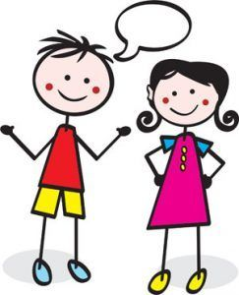
How do you teach a word?
Say it
Write it
Define it
Draw it
Teach more detail
Notes:
1. Say it (sinister). On its own, in a sentence, give different examples
2. Write it (sinister) – adult does this for the child if the child is not able (this is not a writing task)
3.Define it (a describing word that tells you about something scary or evil)

Slide 18
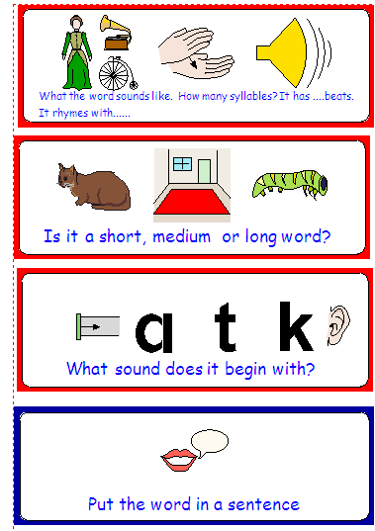
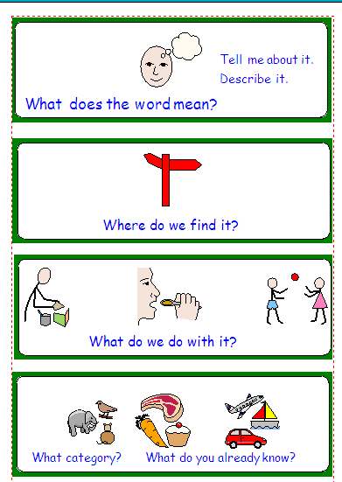
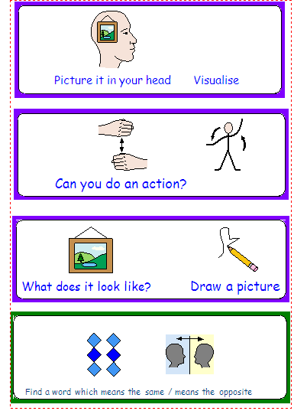
Teaching vocabulary
©pipstjohn Pre-Teaching Vocabulary (PTV), Widgit
Notes:
Add more detail to help the child build up a good picture of the word This is a good framework to teach children how to learn words independently
Colour coding is helpful to remember to include all elements:
Red: relates to the sounds (phonological awareness) which are really important for word learning
e.g
If we take the word: Sinister
Si nis ter (it has 3 syllables or beats/claps)
It rhymes with ‘finister’!
It’s a long word
It starts with ‘s’
The word sounds creepy!
The green relates to the meaning of the word
What does the word mean (something scary is happening)
Where do you find it (scary books, haunted houses, related to witches, demons, evil things)
What do we do with it? (more related to an object so not relevant for this word)
What category? Adjective/describing word
Similar words: evil, spooky, scary
Opposite words: bright, golden, fair
The blue relates to how to put the word into context/action/picture
Put the word in a sentence: he looked at me in a sinister way; there was something cold and sinister about him, the ruined house had a sinister appearance
Show pictures from the internet of a sinister looking person, haunted house
draw a picture of something sinister
Mime/do a facial expression to match

Slide 19
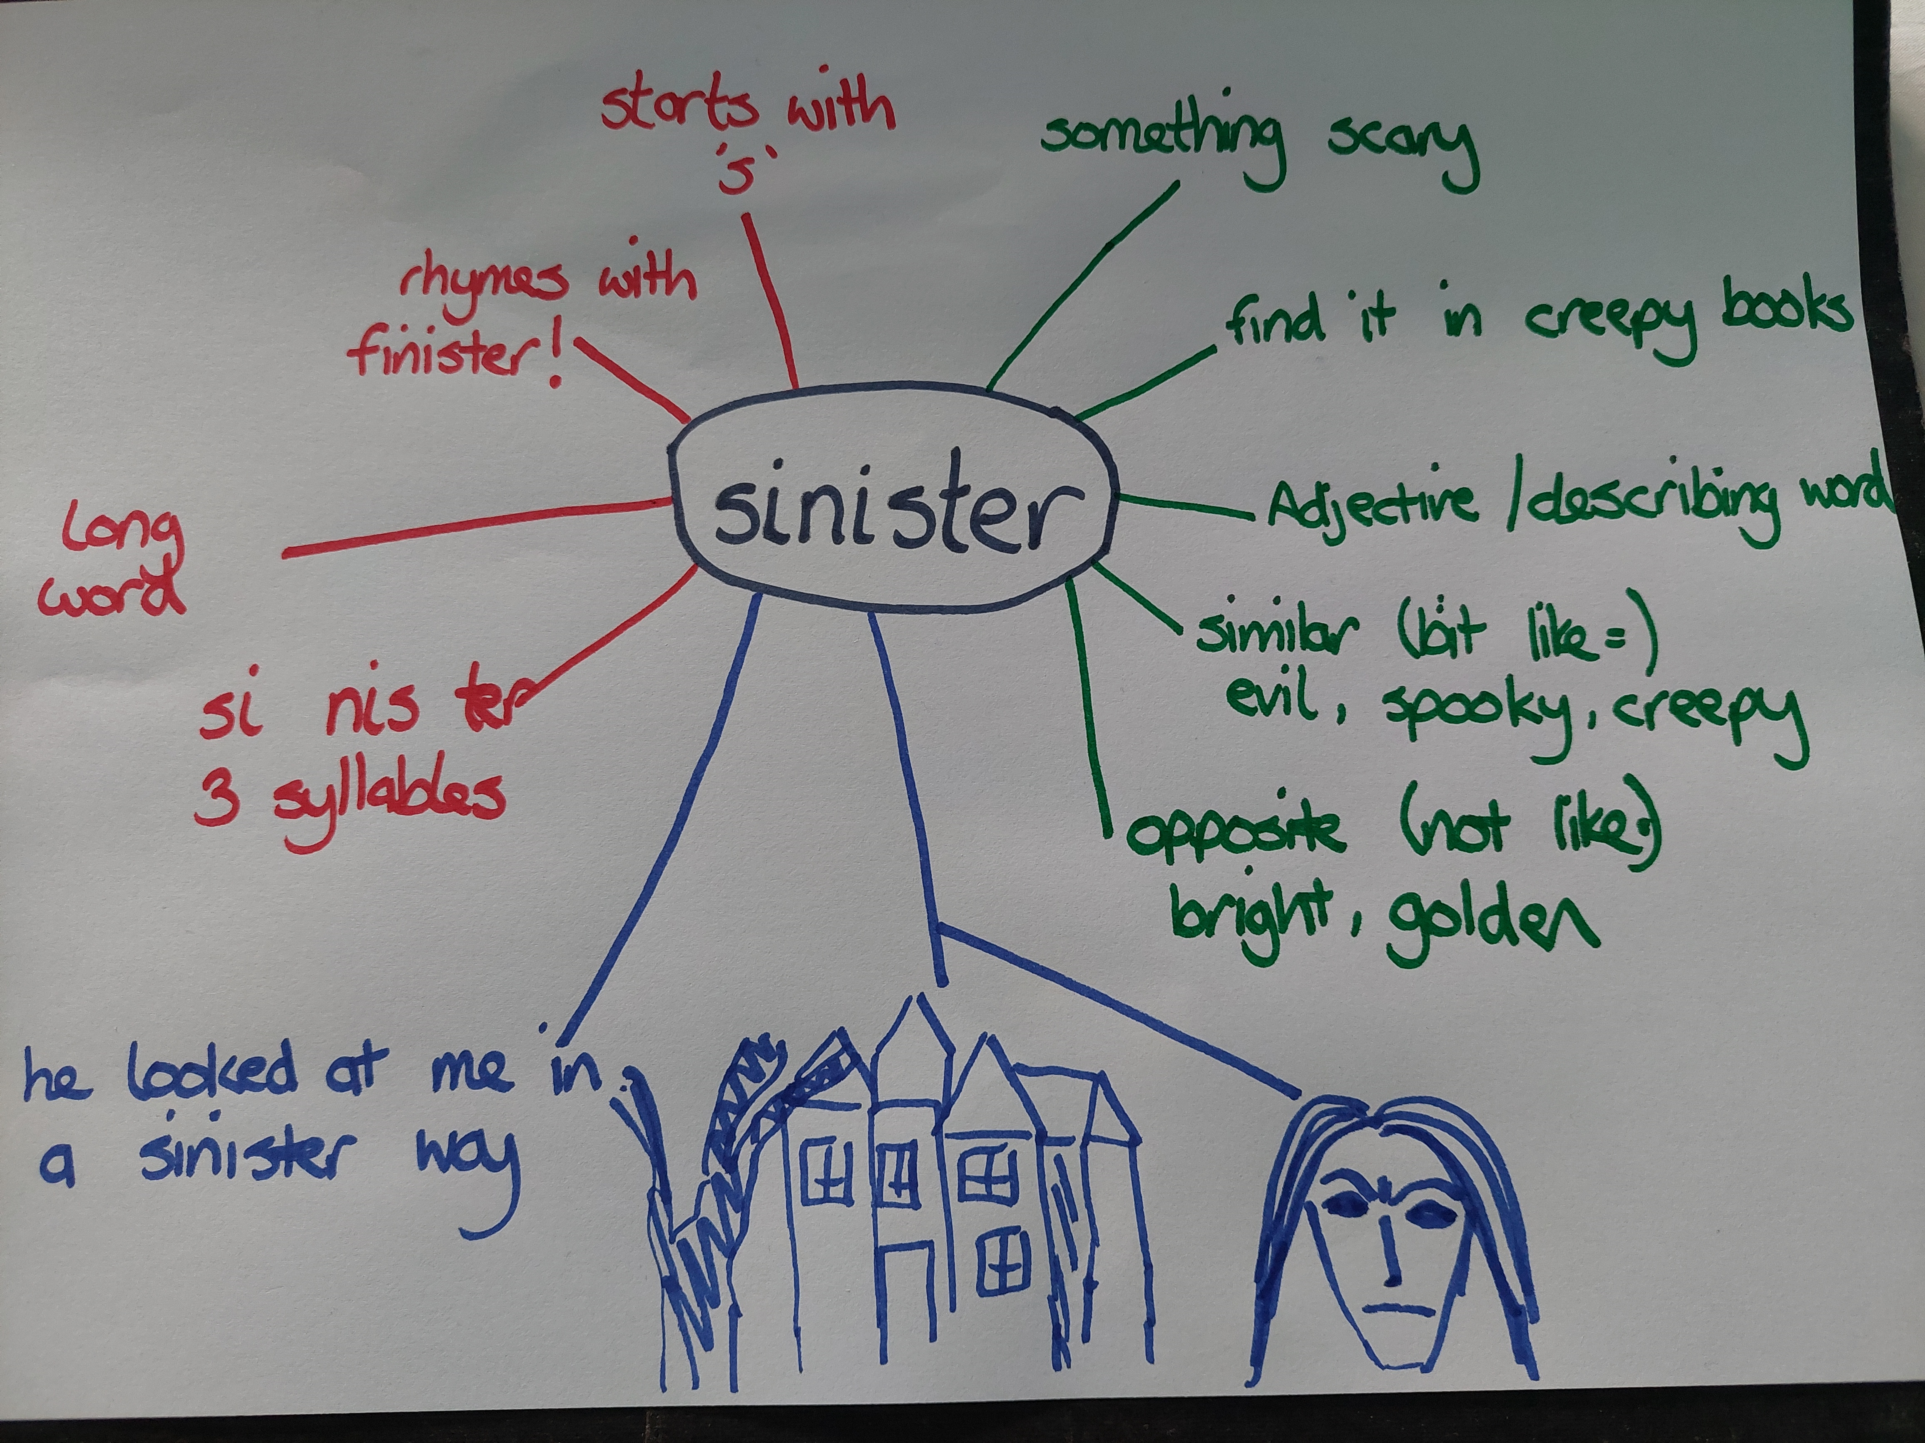
Word web
Notes:
A completed word web using the above categories and colour coding could look something like this

Slide 20
Practicalities
Teacher and member of staff carrying out the intervention to discuss which words the children should learn
Agree on a small number of words and build up as appropriate
Use a variety of activities – keep it interesting and fun
Use practical activities, objects, photos, film, pictures, books, gestures, acting out, internet
Review the word to make sure it has been learned
Involve families where appropriate
Notes:
Teacher and member of staff carrying out the intervention to discuss which words the children should learn
Agree on a small number of words and build up as appropriate
Use a variety of activities – keep it interesting and fun
The activities do not have to include expensive or particular resources or require a lot of planning: use what is available, share ideas and resources between yourselves, and use a range of resources: (particularly for younger children) practical activities, objects, pictures, gestures, books, the internet, word webs, lotto games, generic games where you can practice using the words
Use the words often and within context as much as you can
Review the word to make sure it has been learned
Involve families as much as possible. Keep it simple and achievable (do not overload with too many words!) and explain to parents what you are doing.
For example, child gets a sticker with a word written on it, parent sees the sticker on their child’s jumper and this sparks a chat about the word.
Adults do not know every word! Encourage parents to look up a word together with their child (most of us now have dictionaries at our fingertips on our mobile phones)

Slide 21
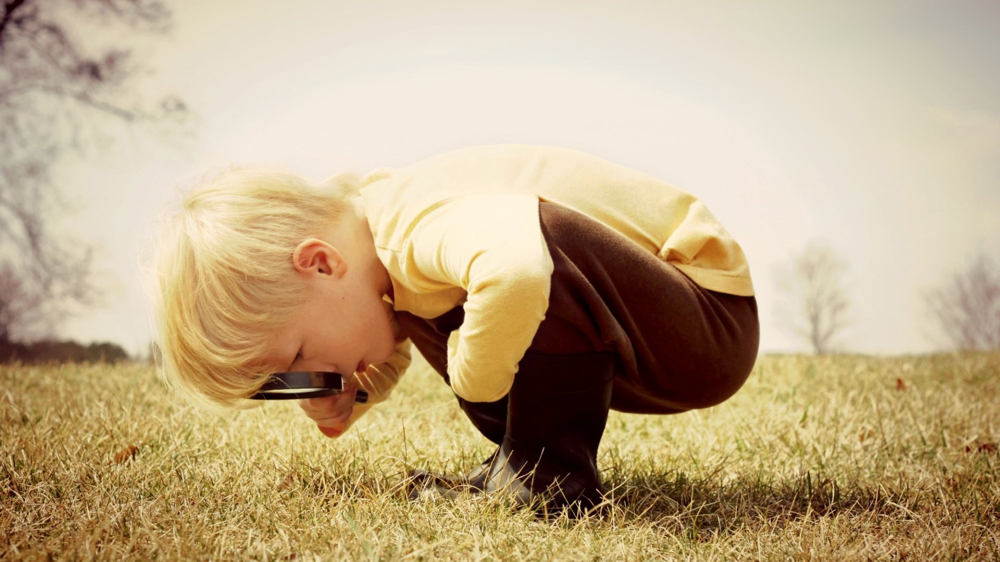
General Strategies to Support Children’s Vocabulary Development in the Classroom.
Teach new vocabulary to the whole class then repeat repeat repeat!
Embed in the classroom and in different situations
Play regular word games
Model word curiosity
Word mats for specific child / small group of children
Classroom displays - word webs, posters, words on the washing line
If the child can’t think of a word and appears stuck, try prompting for example:
What does it look like? Can you show me?
Where would you find it? What do you do with it?
Don’t expect the child to use words in their written work, if they are not using them confidently in their spoken language

Slide 22
Thank you for watching
Useful websites
Word Aware - Thinking Talking
Widgit Symbol Resources | Pre-teaching Vocabulary
Children and Family Health (childrenandfamilyhealthdevon.nhs.uk)
Notes:
Thank you for watching and I hope you found this video useful
Please contact us if you would like to leave any feedback about this training

