Slide 1



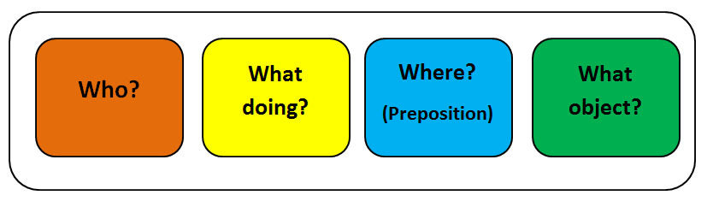
Supporting children’s sentence structure and grammar through:
Colourful Sentences

Slide 2
Aims
What doing?
What?
To understand…
What is Colourful Sentences?
Why use Colourful Sentences?
Who benefits from Colourful Sentences?
Who can implement it?
How to get started with using colourful sentences
How to use the skills learnt in the classroom
Who?
Where?
Notes:
The aim of this session is to ( read slide )

Slide 3
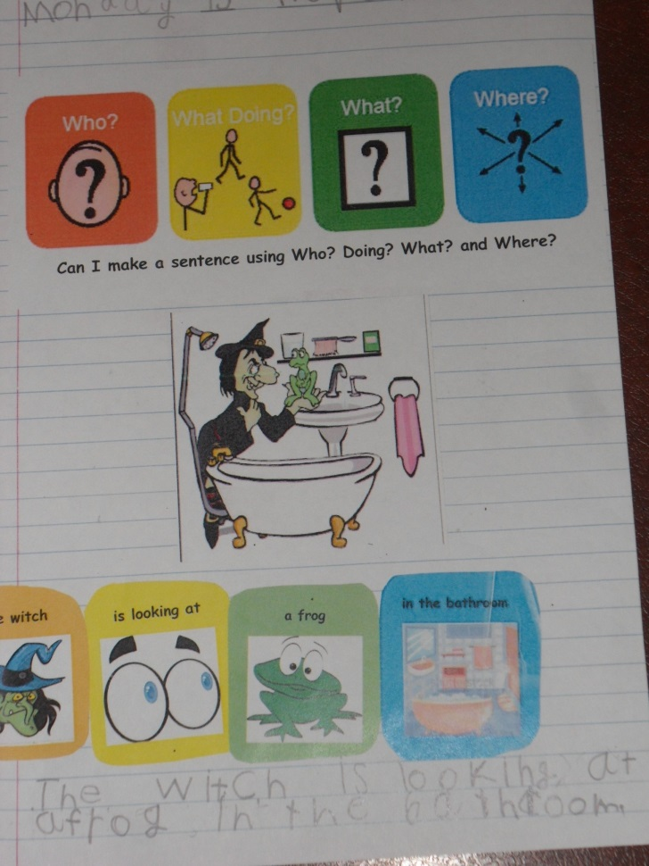
What is Colourful Sentences?
Originally developed by Alison Bryan (1997).
Uses colour coded pictures and prompt cards to ‘show’ children how to structure a sentence.
This helps the child to ‘see’ how the structure of the sentence is linked with its meaning.
Notes:
Read slide

Slide 4

Why use Colourful Sentences?
The approach aims to support children in developing their understanding and use of:
  Grammatical structures
  Vocabulary
  Longer sentences
  Spoken sentences and written sentences
  Questions words: who, what, where
  Nouns, verbs, prepositions and adjectives
  Structures needed for writing narratives
Notes:
By doing this you will be able to support children in using language in their daily like to describing events news telling etc…
It also supports their understanding and use of types of words
fro example nouns are objects or people and verbs are doing or action words
Colourful sentences also provides a long-term tool for helping students structure their utterances and supports the Development of literacy skills by building a strong foundation in oral language

Slide 5

Who benefits?
Everybody!!!
E.g. children who have:
Developmental Language Disorder
Children with literacy difficulties
Autism
Down’s syndrome
Learning difficulties
Notes:
First before slide - Initially developed for adults post stroke but it ca be used to support a whole range of children and young people including those with
Can be used for children from Recepton-Y6 (and beyond)
It is particularly useful fro Children who are visual learners
This is Because … It prompts the young person to lengthen their sentences to include all the relevant parts
It supports children with specific difficulties with grammar such as ordering sentence e.g.
It is a structured approach
And it is beneficial for children who are Bilingual / multilingual -as grammar is often last area to develop

Slide 6
Who can implement it?
Anyone trained in the approach
E.g.
Teachers,
Teaching assistants,
Parents/Carers etc.
Notes:
Read slide

Slide 7
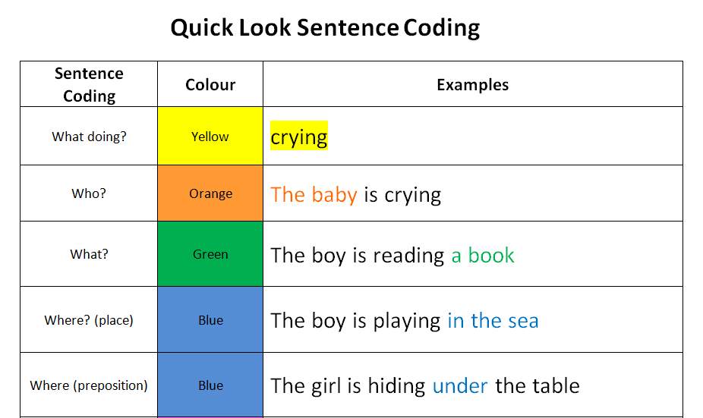
Notes:
Pack A supports Key levels of Colourful Sentences read slide
When it comes to ‘where’ this can be broken down furhter if requirted into
Where (preposition) when specifically teaching prepositions rather than teaching general location (e.g. in the sea / at the park etc)

Slide 8
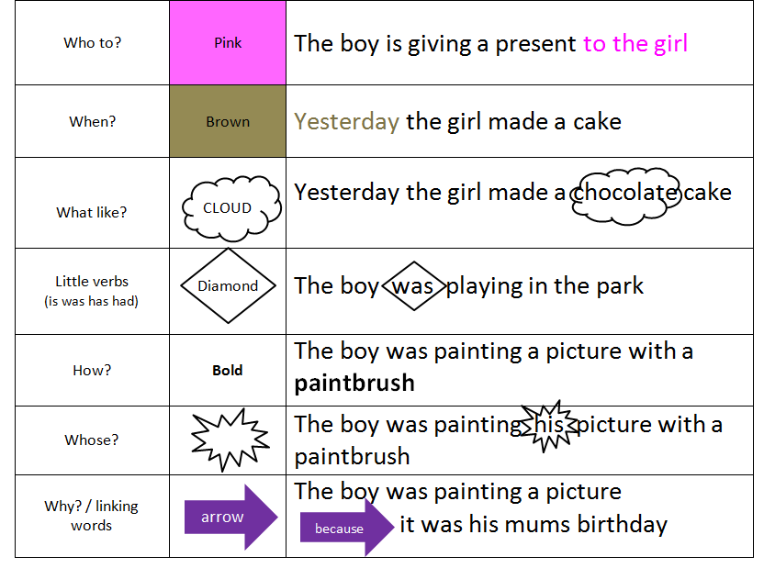
Notes:
The second pack Pack B covers more complex structures
Adjectives describing what something ids like are foud inn the clouds
Little verbs that indicate past or present tense
Adverbs describinbing how something happened
Pronouns or who something beongs to are in the spiky staburst
Reasoning words or Subordinating conjunctions can be added in the arows
e children do not need this level of support and can move straight to narrative work for a more functional approach

Slide 9


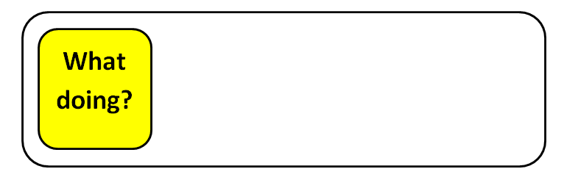
Session 1
Introduce the DOING sign:
Look at a range of pictures e.g. online, family/school pictures/photos/videos) of people doing things
Introduce the (WHAT) DOING colour (Yellow) on to a sentence strip
Ask: What are they doing?
DOING
DOING
DOING?
Notes:
Now we look at Pack A in a little more detail and how we introduce the different vocabulary and sentence structures
All new vocabulary will need to be modelled as you go – this will be explained as you use the pack
Remember, you can provide additional visual information and reinforce the concept by using a visual sign e.g. Makaton sign
Only use the sentence strip appropriate for the level you are working on
We will start with the verb or doing word – we do this as verbs are the group of words that children with language difficulties find the most challenging so we target these first
To introduce a doing word -
Say
What is the boy doing: running
Say
What is the cat doing: sleeping
Trouble shooting:
If they cannot choose from multiple options, give a choice of 2
If they cannot choose between 2 – model
**Only move on to next stage when the child can consistently complete this session**
(This may take 1 or 2 sessions – or could take a whole term – each child is different!)

Slide 10

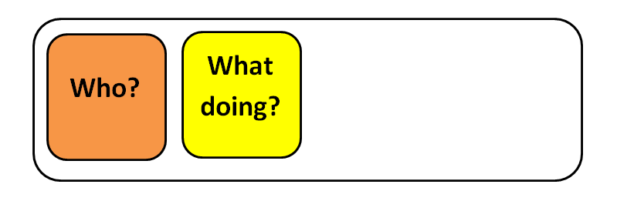
Session 2
Introduce the WHO sign alongside DOING
Look at a range of pictures/photos
(e.g. online, family/school pictures/photos/videos) of people (WHO) doing things
Add the WHO colour (Orange) on to the sentence strip
Ask the child to find the appropriate WHO + what DOING pictures – and add them to the strip
DOING
DOING
Notes:
Once they have established good range or verbs of doing words we can move on the subject of the sentence of ‘who’ this is modelled in the dame ay as we model the verbs
Examples:
IF YOU HAD A PIUCTURES OF AGIRL EATING YOU WOULD ASK
Ask: Who is in the picture (Child finds orange WHO)
Ask: What is X doing (Child finds yellow WHAT DOING)
Encourage children to say their sentence and then you can reinforce their response by asking the by asking WH questions
e.g. Who is in the picture?
**Only move on to next stage when the child can consistently complete this session**

Slide 11
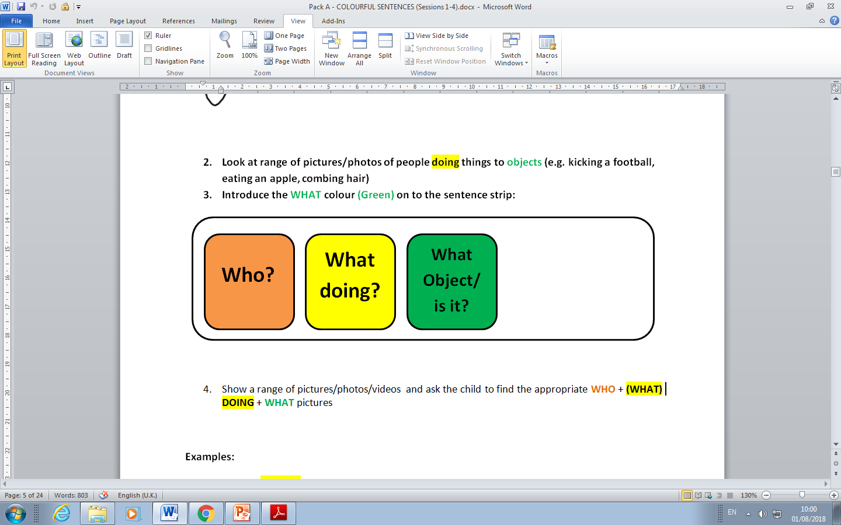
Session 3
Introduce the WHAT OBJECT sign
Look at range of pictures/photos of people doing things to objects
(e.g. kicking a football, eating an apple, combing hair)
Introduce the WHAT OBJECT colour (Green) on to the sentence strip
Ask the child to find the appropriate WHO + (WHAT) DOING + WHAT pictures to the strip
DOING
Notes:
Session 3 is where we can introduce the the what
The girl is eating an ice-cream
The man is washing the dishes
Ask: Who is in the picture (Child finds orange WHO)
Ask: What is the girl doing (Child finds yellow WHAT DOING)
Ask: What is the girl eating (Child find the green WHAT)
Encourage children to say their sentence
Adult reinforce by recapping the WH questions
**Only move on to next stage when the child can consistently complete this session**

Slide 12

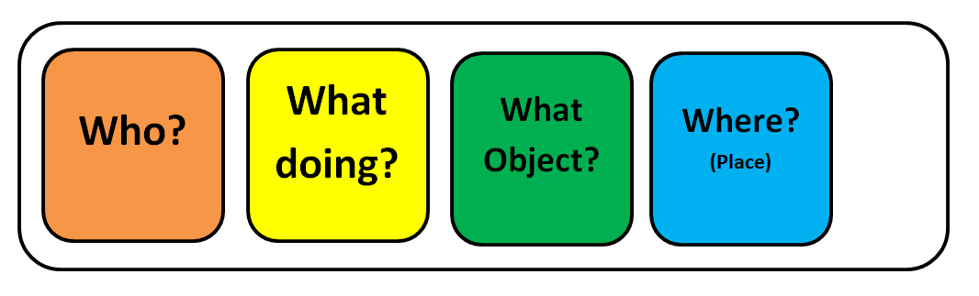
Session 4
Introduce the WHERE sign:
Look at range of pictures/photos of places (location)
Introduce the WHERE colour (blue) on to the sentence strip
Ask the child to find the appropriate WHO + (WHAT) DOING + WHAT + WHERE pictures to the strip
DOING
Notes:
Example:
The girl is eating an ice-cream in the park
The man is washing the dishes in the kitchen
Ask: Who is in the picture (Child finds orange WHO)
Ask: What is the girl doing (Child finds yellow WHAT DOING)
Ask: What is the girl eating (Child find the green WHAT)
Ask: Where is she (Child finds the blue LOCATION)
Adult reinforce by recapping the WH questions
Highlight:
At this stage the structure of sentences become more complex and varied
And the order of colours can be changed to reflect this

Slide 13
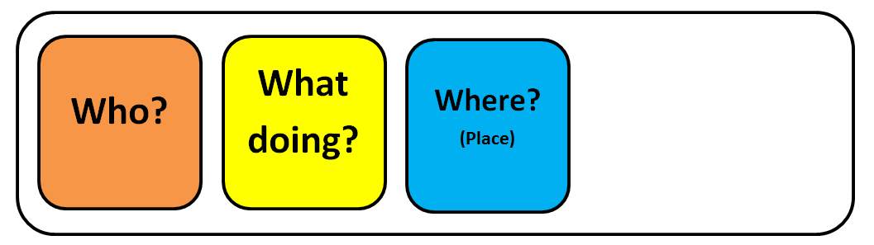
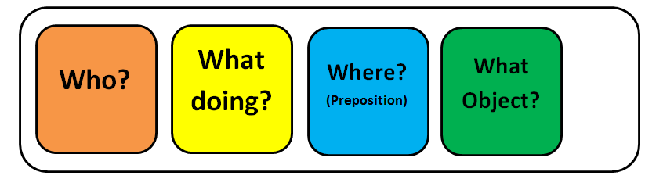
For example with some verbs you may not need the object (WHAT): The boy is playing in the sea
is playing
Or the order of WHERE and WHAT may change:
The boy is hiding under the table
is hiding
Notes:
As mentioned:
Having separate WHERE (preposition) cards means you can specifically target these structures in isolation
Some children may not need this level of support
Your SLT will support you if this is required

Slide 14
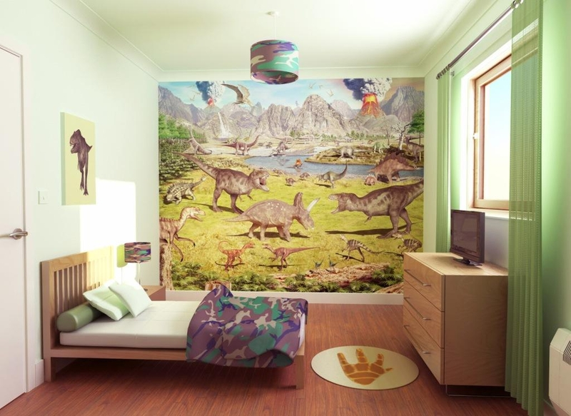
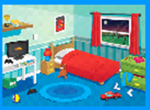
1. Set up a scene card
4. Finally ask the child wh questions to check they have understood:
‘who is eating the pizza?
‘where is he eating pizza?...
2. Encourage the child to make a sentence on the sentence strip
boy
eating
pizza
in the bedroom
“a boy is eating pizza in the bedroom”
3. Ask the child to read their sentence
Notes:
So here we have an example of how a sentence is created through these sessions
4 separate voice clips read them

Slide 15
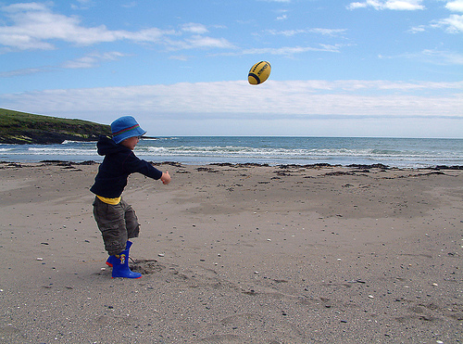
Generalising Skills Learnt
Aim for children to generate vocabulary independently
i.e. not needing small picture cards
Sentence strip alone is enough to help them use a full sentence
e.g. “The boy is throwing a ball”
Notes:
Read Slide
Sometimes children will find it difficult to achieve this e.g. children with limited vocabulary, word-finding difficulties, EAL, ASD needed more structured approach (looking for picture, choosing picture etc.)

Slide 16
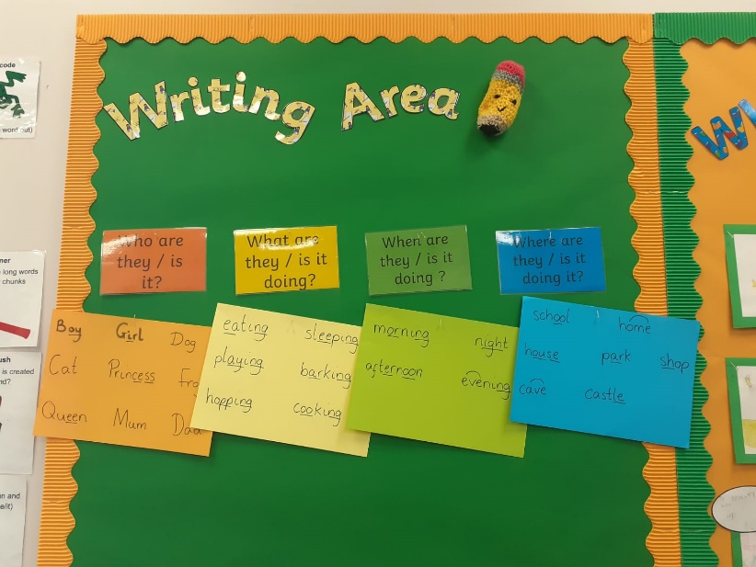
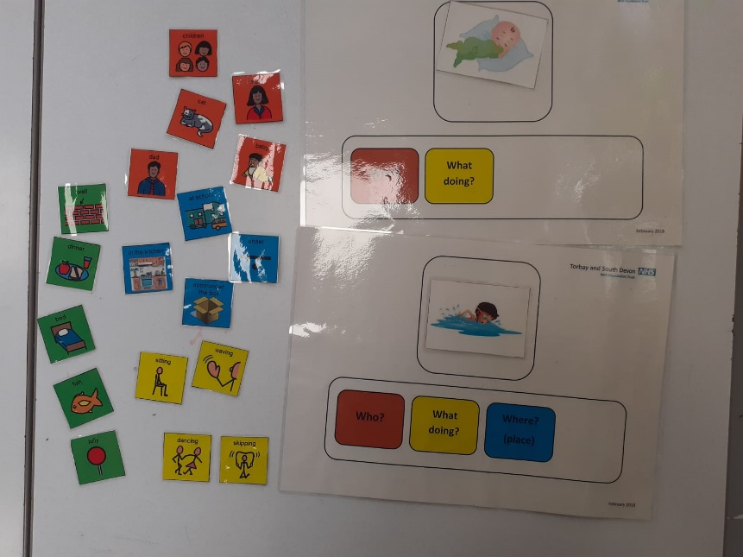
Classroom example
Both of these pictures show an interactive space that is easily adaptable for current topic language.
Notes:
The following 3 slides are some examples of how you may support the generalisation of these skills in the classroom
You can use this in a more general level by having interactive spaces in the classroom

Slide 17
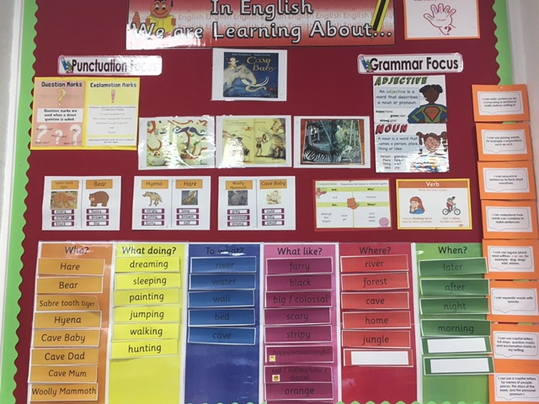
Colourful Sentences in the classroom:

Slide 18
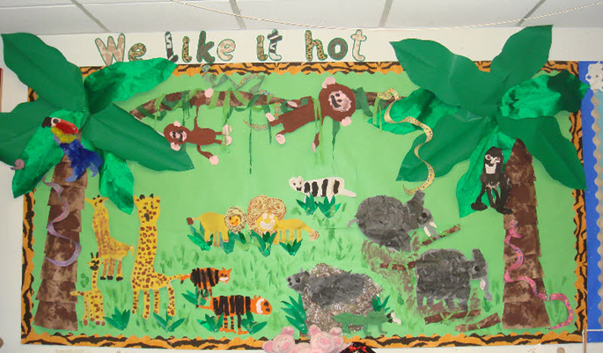

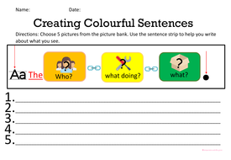
Using a sentence strip in the classroom:
Describing Pictures
Story telling
News Telling
Answering questions
Written work
Commenting on environment
Notes:
Or you can target this more specifically by include sentences strips in pieces of wok of on the children's desks or using any of the strategies on this slide

Slide 19

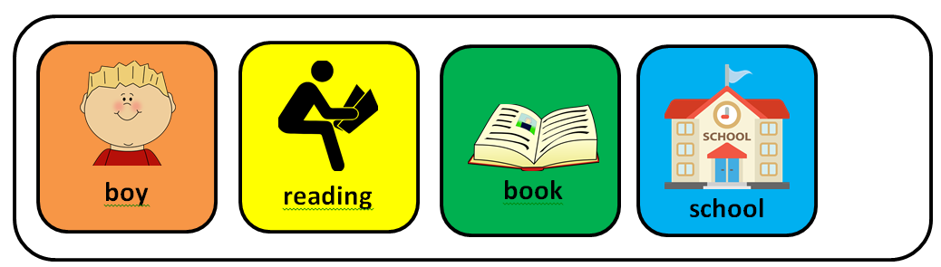
Have a picture of the week: e.g. photos of children in the class on a display board with sentence strip
Colourful Sentences in the classroom:
Notes:
To support engagement you can use personalised examples (read slide)

Slide 20
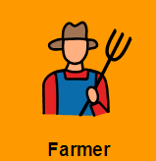






Put up posters containing brainstormed words and pictures for each cue
Notes:
Some school have created posters related to certain classroom topic such as the one you see here

Slide 21
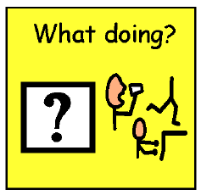


Have large copies of the cue cards up in the classroom to support understanding of wh questions
Notes:
You can also ( read slide)

Slide 22
Colourful Sentences in the classroom:
Who?
Baker
Samuel Pepys
King Charles II
Firemen
What doing?
Put out fire
Get water
Fire spread
Blow up
What?
Fire of London
Fire
Bucket
Bread
Where?
London
River Thames
Bakery
Pudding Lane
Notes:
For older children you can have the topic or key information written in the different colours

Slide 23
Colourful Sentences in the classroom:
Who was he?
Churchill
When did he live?
1874-1965
What did he do ?
do
Led country
What was his job?
Prime Minister
Where was his office?
10, Downing Street
Short, balding, clever,
good communicator
What was he like?
Notes:
And here you can see another example of how you can link the topic vocabulary to key fact recall

Slide 24
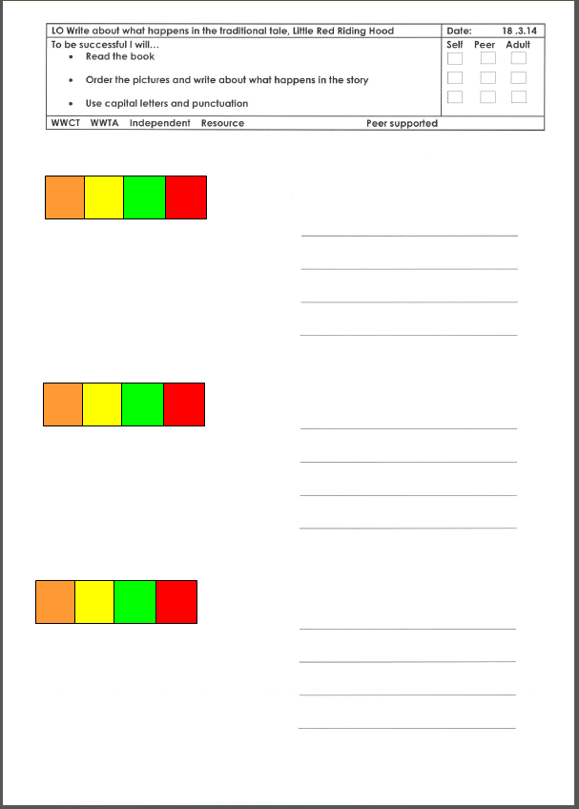
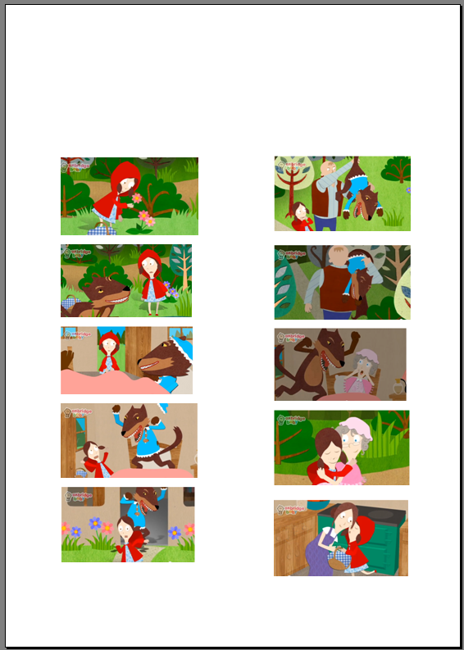
Worksheet with pictures and sentence strips, e.g.
Notes:
Colourful Sentences can be used to support written work as well as spoken language

Slide 25

Reading…
Encourage children to underline key words in a sentence or text using the Colourful Sentences colours to support reading comprehension
So…if all WHO words are in orange it will help them find the specific information that they need to take from the text.
Notes:
Colourful sentences can also be used to support reading ( read slide)

Slide 26

Activity
In pairs, discuss:
A topic being taught in your classroom
Two ways you will use Colourful Sentences to support children in your class
Notes:
Can you think of ways in which you can support colourful sentences in your classroom for example ( read slide)

Slide 27

Don’t forget!
It’s a tool, not a constraint!
Notes:
The aim is to give you resources to use it in a way that is meaningful and functional

Slide 28

Questions?
Notes:
Thank you for listening – if you have any question regarding this presentations or any of our other presentations please do contact your local therapy team or call the adviceline on 0333 321 9448

