Slide 1
Narrative Intervention
Notes:
Narrative Intervention is the next step after a child is able to form spoken sentences and has been designed to follow on from Colourful Semantics intervention or as a stand-alone therapy. It’s important to understand that we’ll be talking about developing spoken narrative skills rather than written narrative but the framework we use can be used to support written skills as well.

Slide 2
Why is narrative important?
Narrative helps us ‘talk to each other, organise our thoughts about the world and establish memories’ – ASHA (2006)
We use narrative when we:
Tell friends/family what happened at school/on the weekend
Teach a lesson/topic
Tell a doctor what’s wrong
Tell a teacher what happened on the playground
Have a conversation
Discuss a film/TV show/book.
Make plans/predictions
Tell/listen to a joke
Build relationships and relate to other people
Gossip!
‘…we dream in narrative, daydream in narrative, remember, anticipate, hope, despair, believe, doubt, plan, revise, criticize, construct, gossip, learn, hate and love by narrative.’- Hardy (1978)
Notes:
Why work on narrative? Being able to create and retell a story is an important skill that we often take for granted. In fact, it is so ingrained in our lives that we don’t often realise that we’re using it.
Can anyone suggest times when we use our narrative skill throughout the day? Here are some that we found: (listed on slide). Looking at all the different situations where we use narrative, we can begin to see why it’s such an important skill to have.

Slide 3
Why narrative is important?
Research has shown that:
The ability to retell a simple story is one of the best predictors of a child’s overall language skills in preschool (Bishop and Edmundson, 1987).
Narrative skills contribute to a child’s social and academic success (ASHA, 2006; Spencer and Slocum, 2010)
Children who develop their narrative skills have an improved ability in participating in and benefiting from mainstream classroom activities (Shanks and Davies, 2007)
Children make progress in other aspects of language, such as grammar and vocabulary development, while working on narrative (Petersen et al, 2010; Petersen et al, 2008; Davies et al, 2004)
Notes:
It holds developmental and academic importance as well. Research has shown that (first three points on slide). Narrative also provides us with a meaningful context to support the development of other aspects of language as well, such as the use of tense, use of pronouns and expanding vocabulary.
Language does not develop in a vacuum. We need context in order to understand when and how to use the different aspects of it and stories are a good way to provide that context.

Slide 4
Elements of a story
The parts of a story can be separated into two main categories:
Macro
Story Structure | Sequencing
 | Start -> Middle -> End
Story Content | Cause and Effect Relationship
 | Introduction, Problem, Solution
 | Character Actions, Speech, Thoughts and Feelings
Notes:
Before we can look at how to develop a child’s narrative skills, we first have to understand what narratives are are made of. What elements are needed to form a story? The parts of a story fall into two main categories. The macro elements are the overall structure and content of the story.
Does the story as a whole make sense? For example, does it have a start, middle and end and are these sequenced in an appropriate order? Is there a problem and is it resolved? Do we follow a character through the story or is this told as a sequence of events that they just happen to be in?

Slide 5
Elements of a story
The parts of a story can be separated into two main categories:
Micro
Sentence Structure | ‘The boy walked to the park’
Vocabulary | Nouns, Verbs, Adjectives, Adverbs, Connectives
Pronouns | He/She - Him/Her - His/Her
Tense | Walk - Walking - Walked
Notes:
The micro elements refer to the words and grammar of the story. Are the words used in an order that makes sense? Are they connecting sentences together? Do they use the right pronouns so that you know who is doing what? Is past or present tense used consistently? Are they using a range of words that you would expect them to for their age?

Slide 6
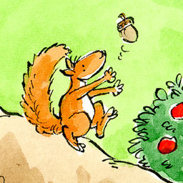
Assessing narrative skills
Ages 3 - 5
Ages 5 - 9
Ages 6 - 11
Notes:
We can evaluate a child’s narrative skills using several assessments, including The Squirrel Story, Peter and the Cat narrative assessment or the Monkey story from the Assessment of Comprehension and Expression. During this assessment, the child is told a story with pictures and asked to retell it. Their retelling is recorded and the macro and micro elements mentioned previously are analysed based on the age-related expectations within these categories.
This allows us to decide whether the child is performing at an age-appropriate level across these areas.

Slide 7
When is narrative therapy appropriate?
The child must:
Be able to form a sentence,
Have an understanding of language at Blanks Level 2 or higher,
Have a difficulty with more than one macro or micro element.
Notes:
Based on the results, we can decide whether it would be appropriate to offer narrative therapy. The child must typically be able to put together a sentence. Their sentences can have a few grammatical errors, however if they are finding it difficult to put more than 3-5 words together with the correct use of grammar, then a sentence-level approach, such as Colourful Sentences, will likely be more appropriate for them.
They need to demonstrate at least a Blanks Level 2 understanding of language. If they are unable to answer who/what/where questions about something they have recently experienced or actions/events in their immediate environment, then they will find it difficult to access the level of language in this intervention. It may also be inappropriate to offer therapy if their narrative skills are delayed but in line with their understanding of language.
Finally, the child has to demonstrate a difficulty with more than one macro or micro element. For example, if the child has a difficulty with just pronouns, this can be targeted with environmental support using specific strategies and pronoun-based resources. There can be other factors that are taken into account, for example the child’s ability to attend to the tasks, but these are the main criteria that need to be filled.

Slide 8
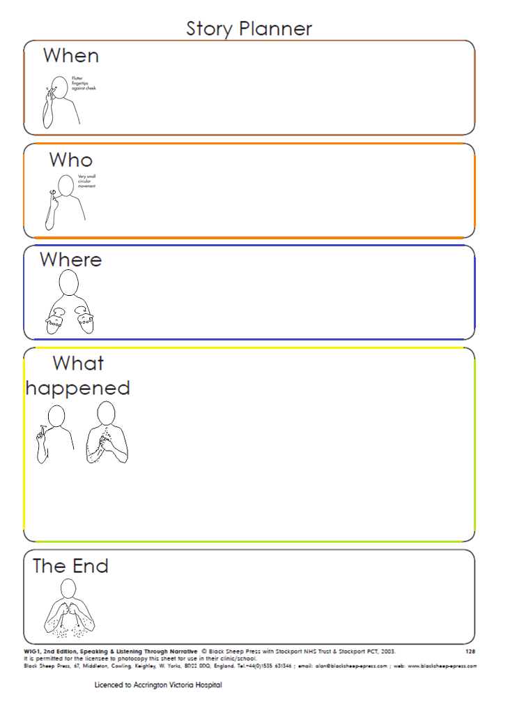
Therapy Framework
Notes:
Once we’ve identified the areas for a child to work on, then we can provide therapy. We target these difficulties using a Story Planner adapted from the Blank Sheep narrative programmes. The type of story planner used with the child and the level of detail within it will depend on their targets and language levels. The colours used in this planner correlate with the Colourful Sentences colours to make it an easy transition for children who have previously received that intervention and to help them understand the type of information needed in each section. The Colourful Sentences pictures can also be used with this framework for children who need the extra visual support or just as a way of introducing or familiarising the child with the planner.
We’ve also included the Makaton signs for the questions to reinforce the abstract language with visual support. We know that not all stories will follow the structure outlined on the planner but this format provides the child with a basis for organising their thoughts and developing the macro and micro skills which can be generalised to other formats as they progress.

Slide 9
Narrative Approach to Therapy
Each session consists of:
1 Introduction | Familiarise child with questions on story planner, order and meaning
2 Story | Create silly story Recall story (prepared or made up by adult) Sequence pictures to make a story Create own story (real or made up)
3 Micro | Activity to target regular and irregular tense, pronouns, verbs, word-finding, etc
4 Story Review | Support child to amend story to incorporate grammar/vocabulary being targeted Child retells story again
5 Homework | Further resources are given for the child to practice their macro and micro skills outside of session Advice and strategies given to adult as needed
Notes:
We typically offer 3-6 sessions to implement the therapy and coach the TA and/or family member that will be supporting them and practicing with them outside of the sessions.
In a typical session, we start by familiarising the child with the planner – can they remember the questions, order and information that goes in each of them? Then, depending on the macro skills we are targeting, we might ask them to sequence a story from a set of pictures, make up a silly story, recall a story we tell them or create their own story using the planner. Again, we are mainly focussing on the child’s verbal skills. The child can write their answers down if they have good written skills. Alternatively, the adult can write their responses for them, the child can draw pictures, write key words or use the Colourful Sentences pictures to complete the story planner. Then, we would focus on a micro element activity, for example, if the child has difficulty with pronouns, we might do some ‘he/she’ sentence sorting where the adult reads a sentence with a ‘he/she’ in it and the child assigns it to the picture of the boy or girl. Then we would look at the story on the planner again, supporting the child to implement the micro element into it, such as encouraging them to use he/she instead of the character’s names when recalling what’s happened. Finally, the child is given homework to practice until the next session with resources provided by the SLT. They may be given more pictures to sequence and create a story from, a few Language for Thinking stories to listen to and recall or asked to use the planner to retell a story about their day/weekend. The SLT will give the TA or family member in the session any useful advice or strategies to support the child when practicing too, such as how to alter the task if the child finds it too easy or too hard.

Slide 10
Workshop
Have a go at putting together a story using the Story Planner.
Create a silly story using the Colourful Sentences pictures.
One person read the Language For Thinking story and the rest of the table retell it by filling in the planner (key words/drawings/sentences).
One person tell a story about your weekend and the rest of the table retell it by filling in the planner (key words/drawings/sentences).
Sequence the pictures into the correct order and then create the story using the planner (key words/drawings/sentences).
Notes:
Now we’d like you to have a go at making your own stories using the planner. (Assign a task to each table and provide resources as necessary. Groups are given 10 minutes to complete the task. Stories are reviewed at the end. SLT can suggest macro/micro areas that may be worked on to enhance narrative skills).

Slide 11
Generalisation
Continue to practice with the child outside of therapy sessions.
Reduce dependency on visuals as appropriate – turn planner/pictures over when child is retelling story after filling it in.
Use planner outline to create/recall story without filling it in.
Prompt child to remember the planner when talking about their day in general conversation/in class.
Use planner to write a story.
Ask child to recall the story in their reading book.
Notes:
As with any skill, you will only see progress if you practice. This is the main reason that we ask for an adult to be present during the sessions as the recommendations and activities will differ for each child and they will need to practice consistently in order to improve their targeted skills and then generalise them.
Here are some of the strategies that we encourage to help the child practice and generalise these skills (on slide). If you can think of any other uses for the story planner that will help the child practice and generalise the skills being targeted, then please feel free to use them. The suggestions that are currently on the back of the story planner have mostly been offered by TAs and we are always happy to hear of new ways to make this intervention as functional for the child as possible.

Slide 12
Thank you!
Notes:
Thank you for listening – if you have any question regarding this presentations or any of our other presentation please do contact your local therapy team or call the adviceline on 0333 321 9448

