Slide 1
Speech development series Session 1
Notes:
Welcome to the speech development series, session 1
My name is Eve.
Adults, you should have already watched the information video. If not, go back and watch this now.
For this session you will need, a musical instrument, or anything to make a noise with.
You will also need your loud and quiet and long and short sound pictures. These can be found on our website for you to print off. Or we will show the pictures on the screen throughout the video.
If you need to, pause the video now to get what you need.

Slide 2
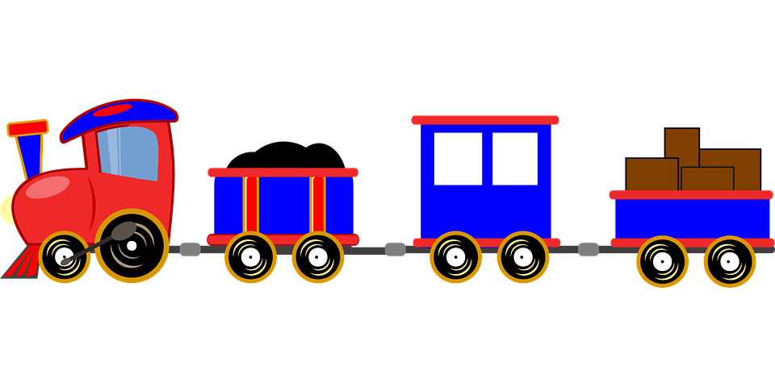
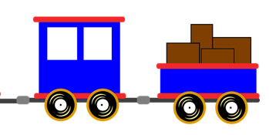
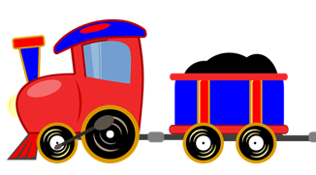
You will need:
Musical instrument
(loud/quiet and long/short pictures)

Slide 4
Notes:
Hello song is finished,
Now it’s time to play our musical instruments. We’ll learn about loud and quiet sounds. First, you listen.
This is a loud sound. When I say go you make a loud sound, ready? Go….STOP. Go…….STOP.
This is a quiet sound. When I say go you make a quiet sound, ready? Go….STOP. Go…….STOP.
Good now listen. Can you make a loud sound? GO…..STOP.
Now make a quiet sound. Go…..STOP. Good listening. If you want to practice this more, pause the video now.
Now we’re going to learn about long and short sounds.
This is a long sound. When I say go you make a long sound, ready? Go….STOP. Go…….STOP.
This is a short sound. When I say go you make a short sound, ready? Go….STOP. Go…….STOP.
Can you make a long sound again? GO….STOP.
Now make another short sound. GO…STOP. Good job. Pause the video now, and practice making loud, quiet, long and short sound.

Slide 7
Notes:
Musical instruments have finished, now it’s time to do some clapping.
First, let’s practice clapping our names. We clap the beats. My name is Eve. Eve. That’s one clap for Eve.
My friend’s name is Billy. Lets clap Billy. How many claps for Billy? 2 claps. Now pause the video and practice clapping your names.
Now it’s time for a story and we will clap some of the words in the story.
You can practice this using any story you like.

Slide 8
Notes:
Clapping has finished, now it’s time to say goodbye!
Goodbye song.

Slide 9
Thank you for watching!
Practice these activities regularly (around 3 times a week for 5-10 minutes)
Additional homework activities can be found on the website.
Practice for 2 weeks. Then, when you’re ready, click on the next video in the series!

